Slide 1
Applying for a 2024 NCR-SARE
Professional Development Program Grant
Online proposals must be submitted by
April 3, 2024, 4:00 pm CDT
Notes:
.

Slide 2
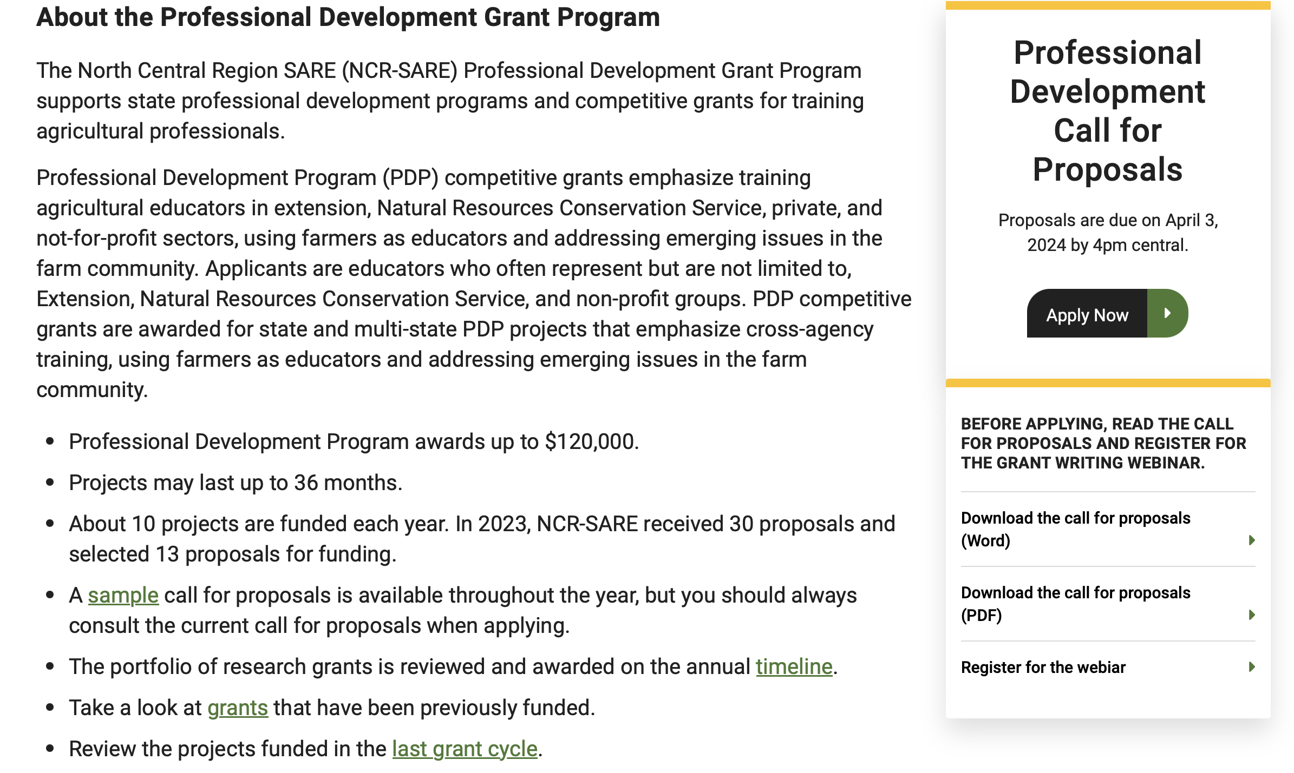
Click here to download Call for Proposals
Notes:
Download the 2024 Call for Proposals. It will be posted under the Apply for a Grant section on the home page of the North Central SARE website. (Not yet posted in this screen shot.) Make sure it is the 2024 Call, because there are changes made each year to the application. If you have any problems downloading the Call for proposals, please contact the NCR SARE office and we can email you a copy, or send a hard copy.

Slide 3
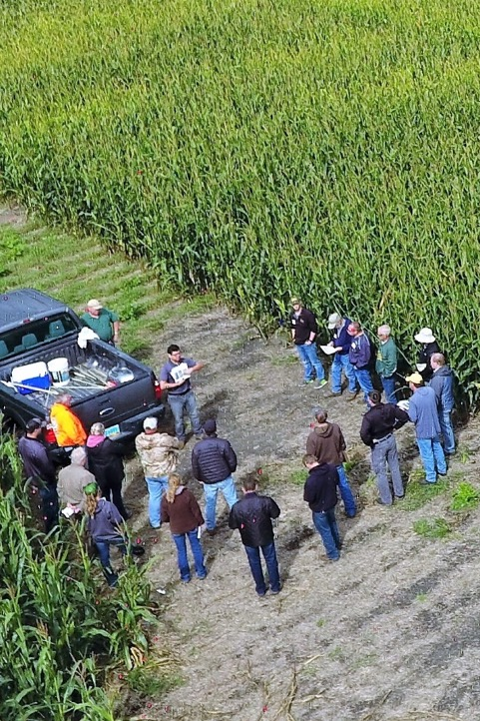
Photo courtesy of Marisol Berti.
Notes:
The USDA Sustainable Agriculture Research and Education program, commonly referred to by our acronym, SARE, is a part of the USDA, funded through the National Institute of Food and Agriculture or NIFA program.

Slide 4
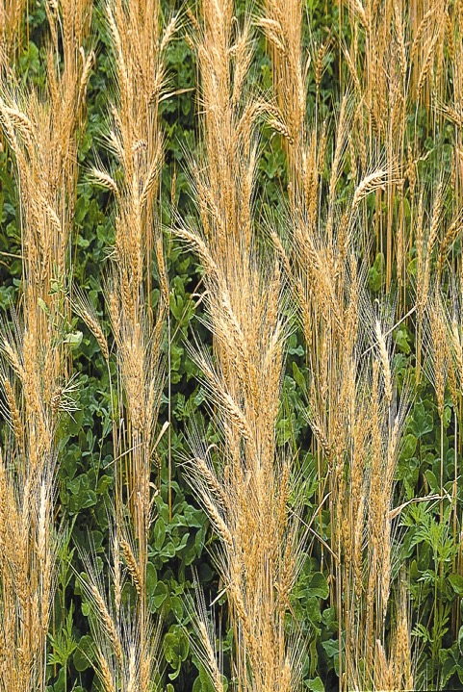
What is SARE?
Grants and outreach to advance sustainable innovations to the whole of American agriculture.
Notes:
We provide grants and outreach to advance sustainable innovations to the whole of American agriculture.

Slide 5
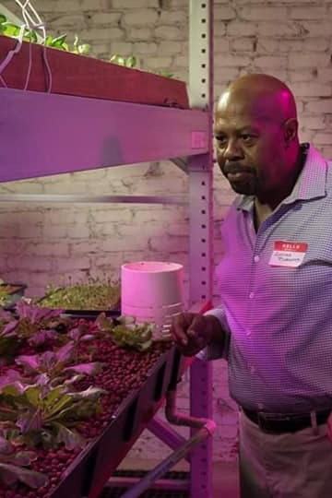
Something New and Different
SARE was started in 1988, conceived as a
decentralized, science-based, grassroots, practical, problem solving – and inclusive – competitive grant making and outreach program.
Photo by Layne Thompson-Forbes.
Notes:
This slide highlights some of the main characteristics of the SARE program--
We are decentralized, in that each of the four regions make their own funding decisions, including which grant programs to offer.
We are science-based, and a grassroots grant program. Our proposal review teams and our administrative council include farmers and ranchers, extension educators, researchers and personnel from state and federal agencies. That’s an important point to remember when you’re writing your grant proposal—don’t assume that everyone reviewing your proposal is an expert in your field—try to avoid using jargon.
Also, we only fund projects with strong farmer/rancher or end-user involvement.

Slide 6
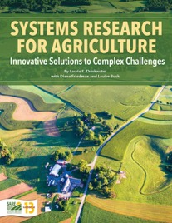
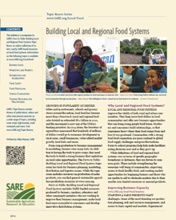
_{SARE Outreach}
a library of practical,
how-to books (in print or download for free)
media outreach
a portfolio of in-depth reports on current topics
Topic rooms for multimedia information
countless online resources, including project reports
Notes:
We also have materials available for free as pdfs online, or for small fees, based largely on SARE grant results.

Slide 7
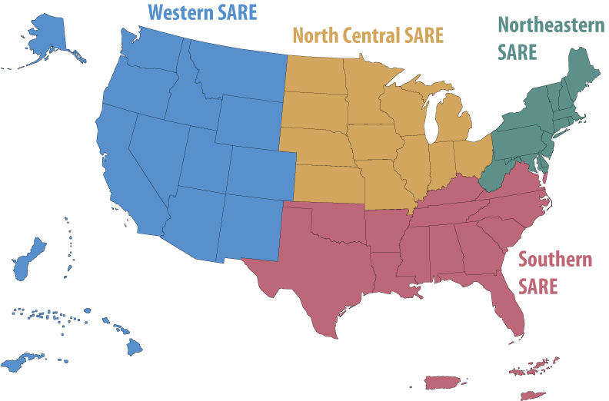
NCR-SARE
Grant Types
Farmer/Rancher
Research & Education
Partnership
Professional Development
Graduate Student
Youth Educator
To connect to 12-state North Central Region, go to www.northcentralsare.org
Photo by Carol Flaherty
Notes:
We are decentralized. The North Central region includes 12 upper midwestern states, and we have our own 16 member Administrative Council, composed of farmers/ranchers, researchers, educators and federal and state agency personnel. They set priorities and make grant funding decisions. In our region, we offer the six grant programs listed above. Information on all grant programs can be found on our website.

Slide 8
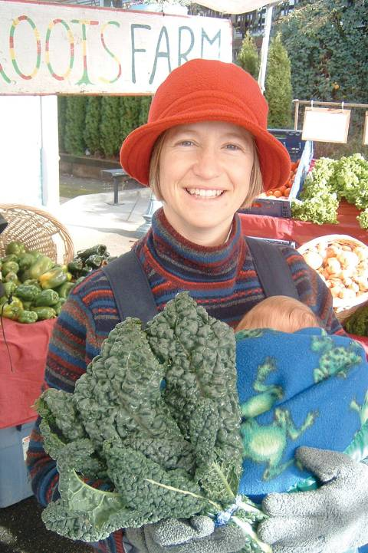
The
SARE Model
Successful SARE grantees are engaged in projects that simultaneously address the “3Ps” of sustainability:
People – who depend on agriculture
_{Profit – over the long term}
Protection – of the nation’s land and water
Photo by Ted Coonfield
Notes:
Successful SARE grantees have projects that simultaneously address the 3Ps of sustainability—people, profit over the long term and protection of our resources.
The North Central SARE uses slightly different wording, but also highlights the “3Ps” of sustainability, in the NCR-SARE broad based outcomes, listed at the top of p. 3 in the Call for Proposals.
In your proposal, you must address how your project addresses each of these outcomes, even if it emphasizes one over the others. The outcomes are:
Improving the profitability of farmers and associated agricultural businesses.
Sustaining and improving the environmental quality and natural resource base on which agriculture depends.
Enhancing the quality of life for farmers/ranchers, communities, and society as a whole.

Slide 9
Social Sustainability https://www.sare.org/resources/understanding-and-measuring-social-sustainability/

Slide 10
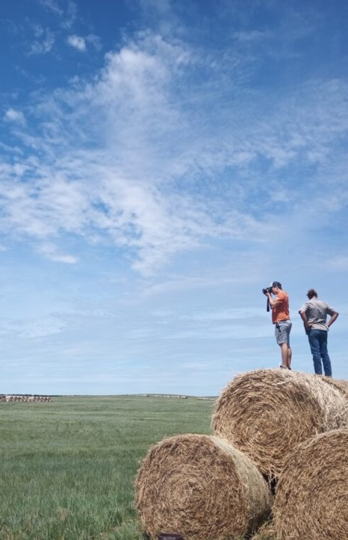
The
SARE Portfolio
Sustainable pest and weed mgmt.
Marketing and local food systems
Water quality and nutrient mgmt.
Systems research
High tunnels and season extension
Crop diversification
Cover crops and soil health
Small ruminants/poultry/cattle
Pastured livestock/grazing systems
Pollinators and biodiversity
Urban agriculture
…and much more
Photo by Erin Gaugler.
Notes:
Those are broad outcomes, so as you can see we fund a wide range of topics that we’ve funded here’s a partial list of the SARE portfolio

Slide 11
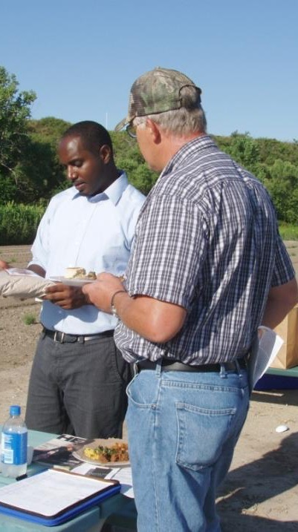
Professional Development Program
Competitive grants
Grants of up to $120,000 for ag educators to train other ag educators
Proposals due April 3
Grantees informed of funding decisions by August 1
Funds available October 1, 2024
SARE state activities organized by SARE State Coordinators
Each North Central Region state has a SARE State Coordinator or Co-coordinators who are extension employees that spend part of their time working with SARE
photo credit: Teresa Webb

Slide 12
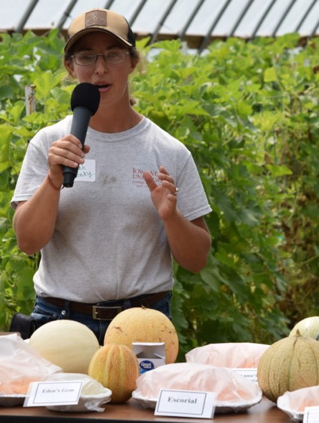
Who Can Apply for NCR-SARE PDP Grants?
Typical applicants:
Colleges and universities
Non-profit organizations engaged with sustainable agriculture
State or federal agency staff
Soil and water districts
Any organization doing
sustainable agriculture training or
education programs can apply
Photo courtesy of Ajay Nair.

Slide 13
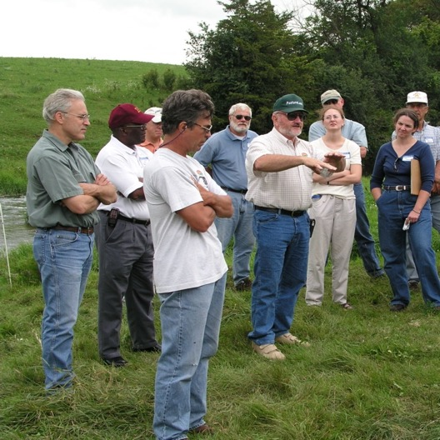
Audiences to be targeted for SARE professional development grants
Extension educators
NRCS educators
Soil and water district staff
State agency staff
Non-profit educators
Vo-tech ag teachers
Private sector farm advisors
Farming or ranching consultants

Slide 14
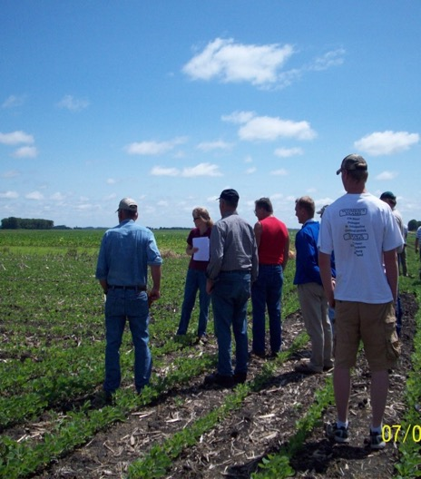
What Activities Can NCR-SARE PDP Grants Fund?
Training workshops
Webinars
Video development
Field tours/bus tours
Special training session added to a conference
In-depth “academies”
Other types of training or professional development for educators

Slide 15
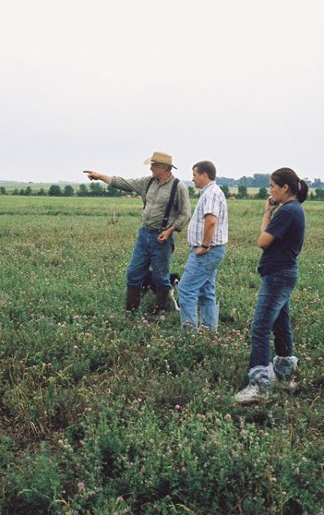
Use of NCR-SARE PDP grant funds
Grants can be for up to 3 years; no-cost extensions available
Salaries/benefits of individuals providing the training
Speaker honorariums, especially for farmer/rancher speakers
Consultant fees
Travel and office expenses
Meals/refreshments if relevant to continuity of the meeting
Video development
Facility/AV rental fees
Photo courtesy Wayne Martin

Slide 16
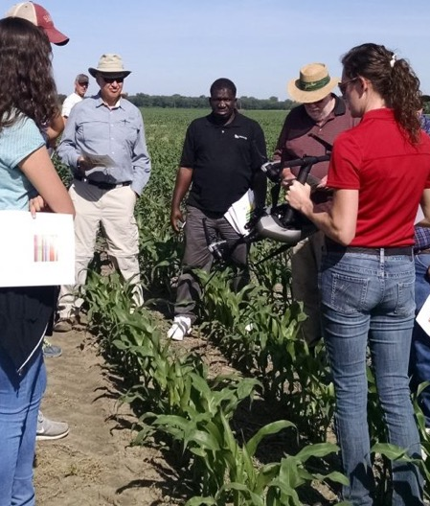
Project Proposal Summary
250 word limit
Specific audience for project
Brief listing of outcomes
Brief description of activities
Photo courtesy of Dean Stevens.

Slide 17
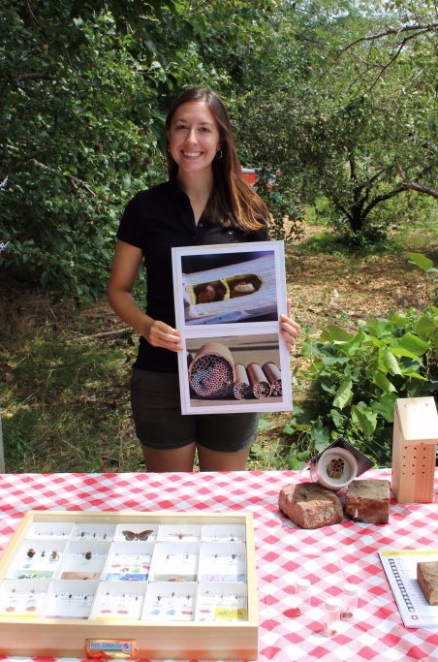
Proposal narrative
Inputs (400 words) – people and resources used on project
Activities (1000 words) – will there be workshops, webinars, field tours and/or other events? Provide specific details!
Timeline (300 words) – share when events are expected to happen and sequence
Photo courtesy of Katherine Turo.

Slide 18
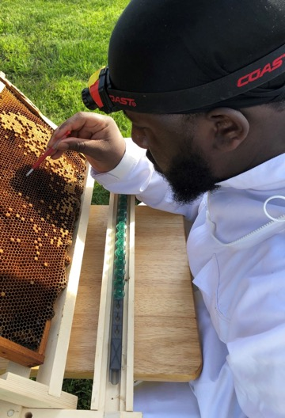
Proposal Narrative also Includes Output and Outcomes
Outputs (500 words)
New educational materials or curriculum or partnerships
Numbers and types of educators to be trained (extension vs NRCS vs NGO vs other types of educators)
Outcomes (750 words)
Describe expected behavior changes, such as will educators trained get new skills, offer their own programs for farmers that leads to new practice adoption etc.
Photo by Homgnei Byarlay.

Slide 19
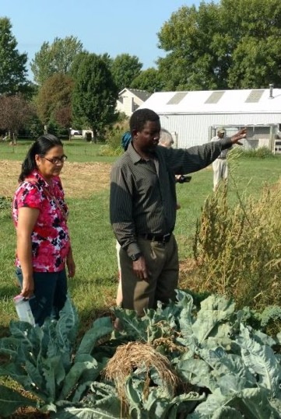
Program Evaluation
and Key Personnel
Program evaluation (300 words)
What specific evaluation steps will be taken, such as pre- and post-testing, any followup on outputs and outcomes
Key personnel (250 words)
All personnel with a major role in the project, include a description of role and a 2-page cv (don’t need a cv for farmers or other speakers)
Photo by Nicholas Meurtz.

Slide 20
Include a one-page logic model

Slide 21
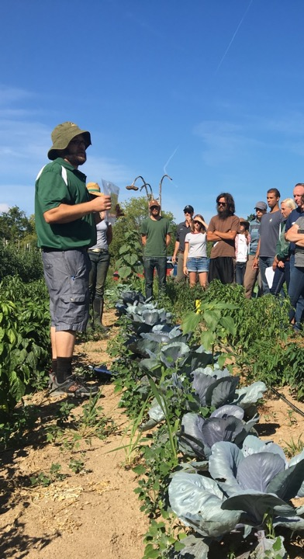
Budget and Letters
Budgets and budget justification
Expenditures should closely align with goals and outcomes of your project.
Grants have $120,000 limit, indirect costs are capped at 10%.
Budget for farmer compensation if relevant.
Letters
We do want a letter of collaboration from any organization receiving a subcontract
We DON’T want general letters of support
Photo courtesy Zsofia Szendrei.

Slide 22
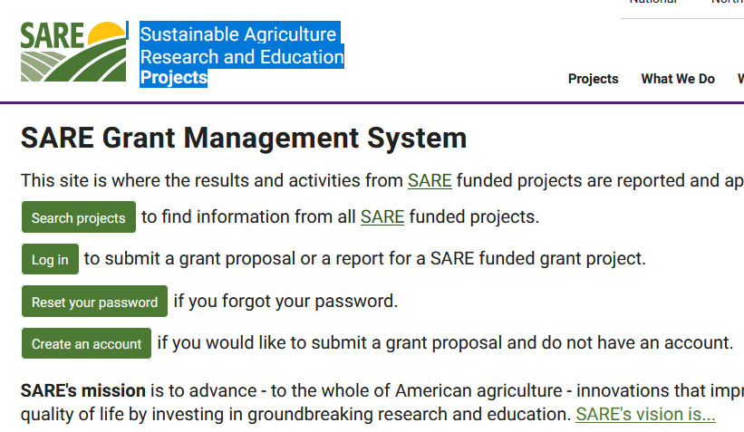
Go to: projects.sare.org
Look up past SARE projects to see how your work differs or builds on past projects.
Notes:
To look up the projects funded in the past, go to projects.sare.org, and click on search projects.

Slide 23
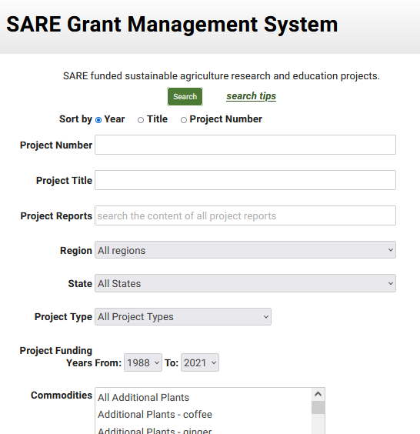
Notes:
To search for relevant projects:

Slide 24
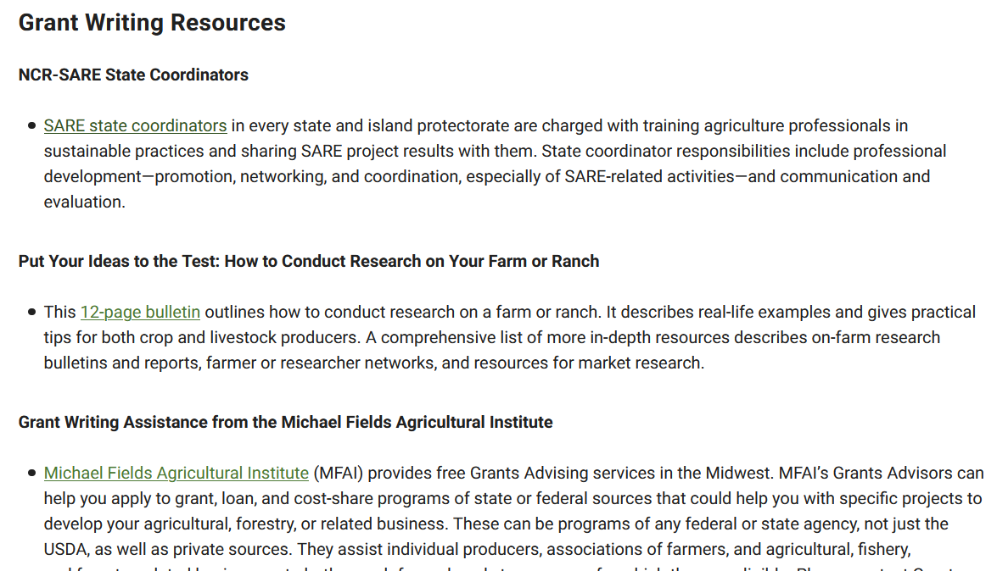
Contact your SARE state coordinator
Notes:
Scroll down that page to grant writing resource, and you’ll see NCR-SARE Sustainable Agriculture Coordinators. You should contact your state coordinator for NCR SARE. Click on the link indicated in this slide to obtain the name and contact information of your state coordinator. They can discuss your idea with you, offer suggestions, and may be able to link you to collaborators. They can be especially helpful in connecting you to farmers who might be interested in your work and willing to collaborate.

Slide 25
https://projects.sare.org/
Notes:
So those are the basics for preparing your proposal. Now I’m going to switch gears and walk you through the new online application system.
If you’ve never had a SARE grant before, you’ll first need to create an account and complete your user profile. Go to projects.sare.org and click on “create an account”
If you’ve had a SARE grant previously and filed reports in this system, your profile will already be in the system and you can log in with the information you used for reporting.

Slide 26
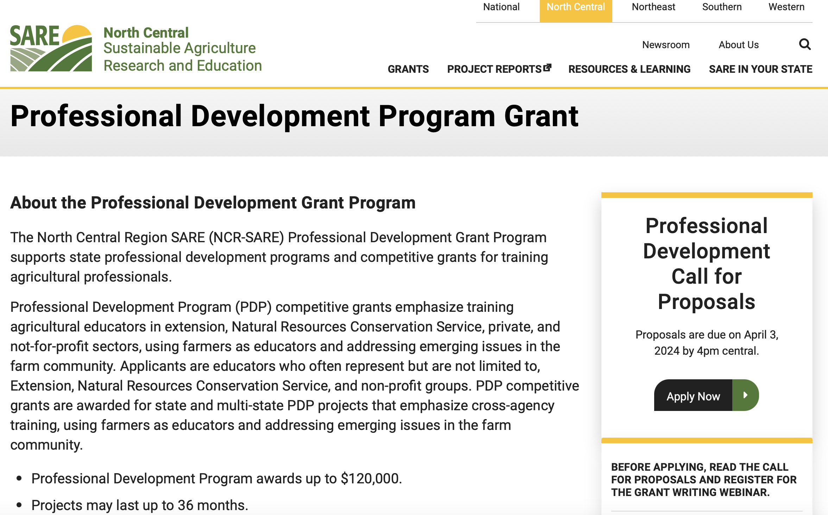
Notes:
Once you log in, you’ll see this screen. Under projects, you’ll see a list of all projects you’ve been associated with. Under proposals, you’ll see a link to manage applications. This is for you to edit proposals you’ve started but not submitted.
Click on “start a new grant” to start a new proposal.

Slide 27
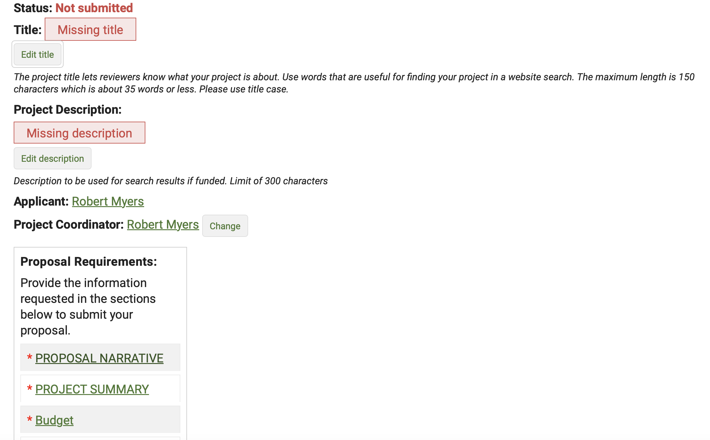
Proposal sections

Slide 28
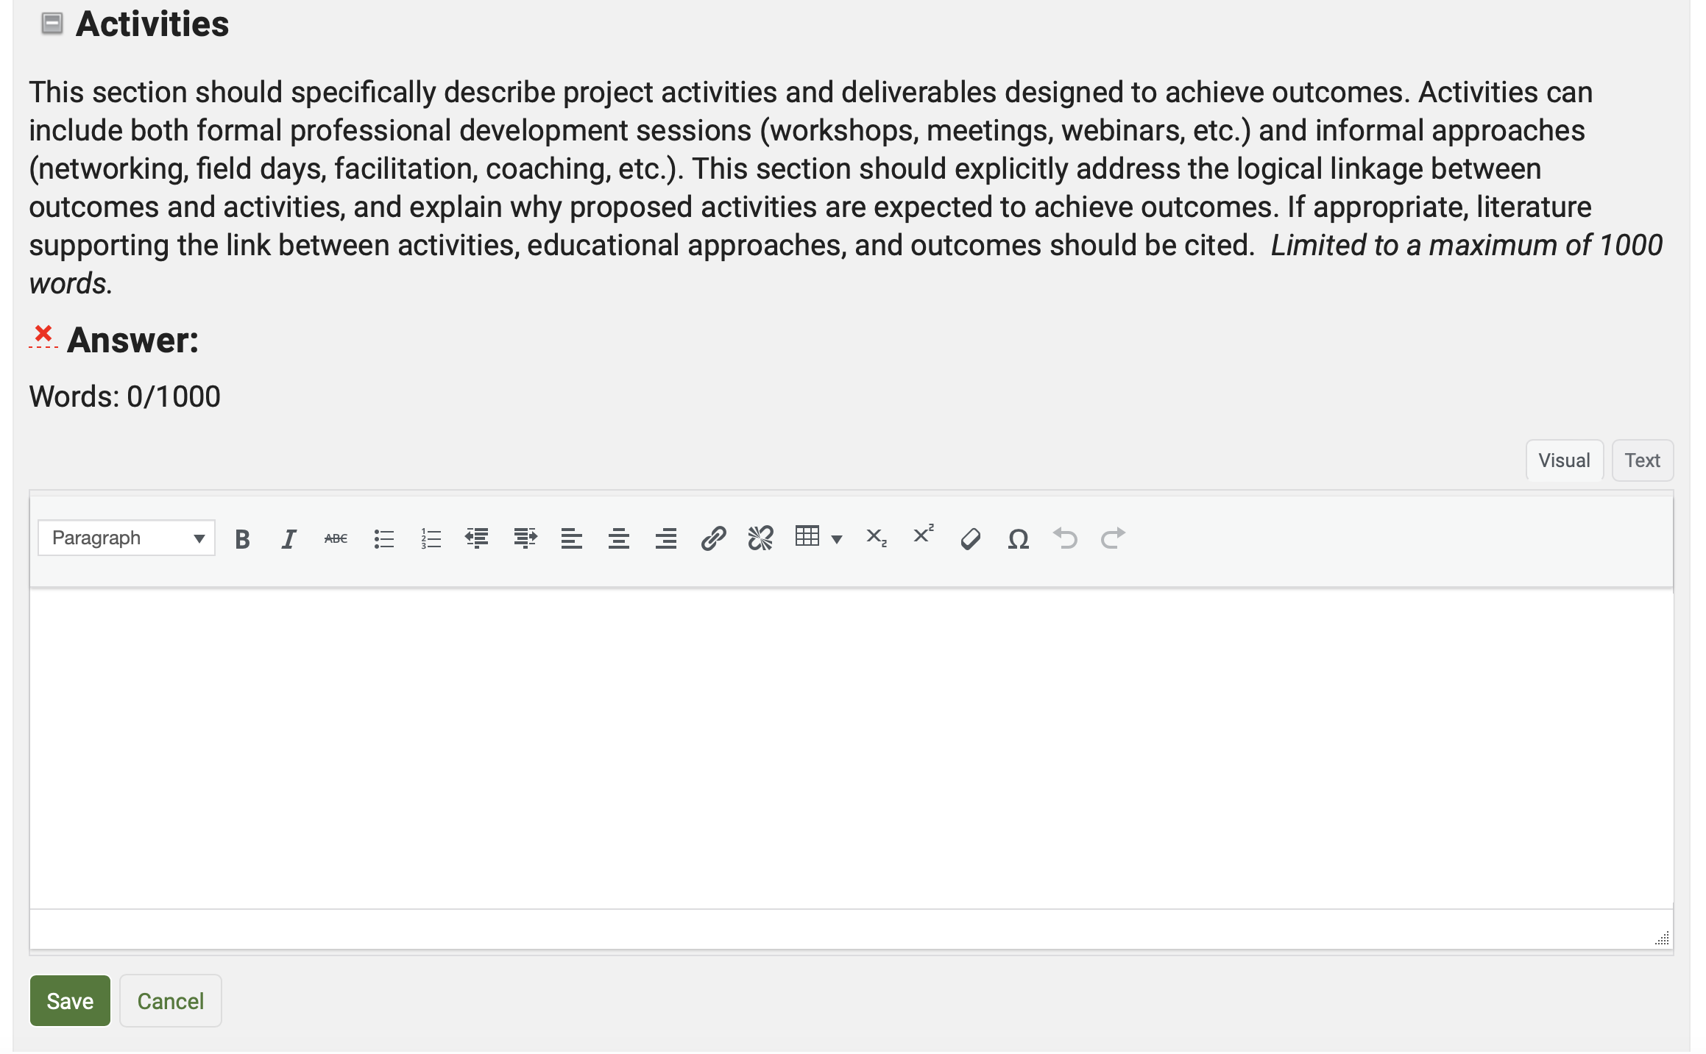
Filling out the proposal narrative
Be sure to hit save after each box is completed – can paste in text from word processor.

Slide 29
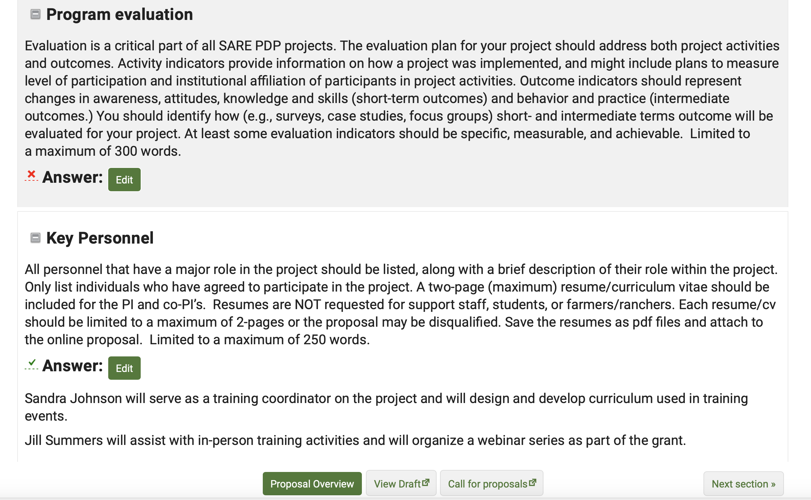
Completed questions are marked with a green check.
Navigation buttons
Notes:
Answer each question by clicking on “edit answer” and saving your answer. Once you’ve completed the cover page information, or at any time, you can click on “back to proposal” to go back to the main page. SAVE as you go. If you’re interrupted, only what has been “saved” will be kept.

Slide 30
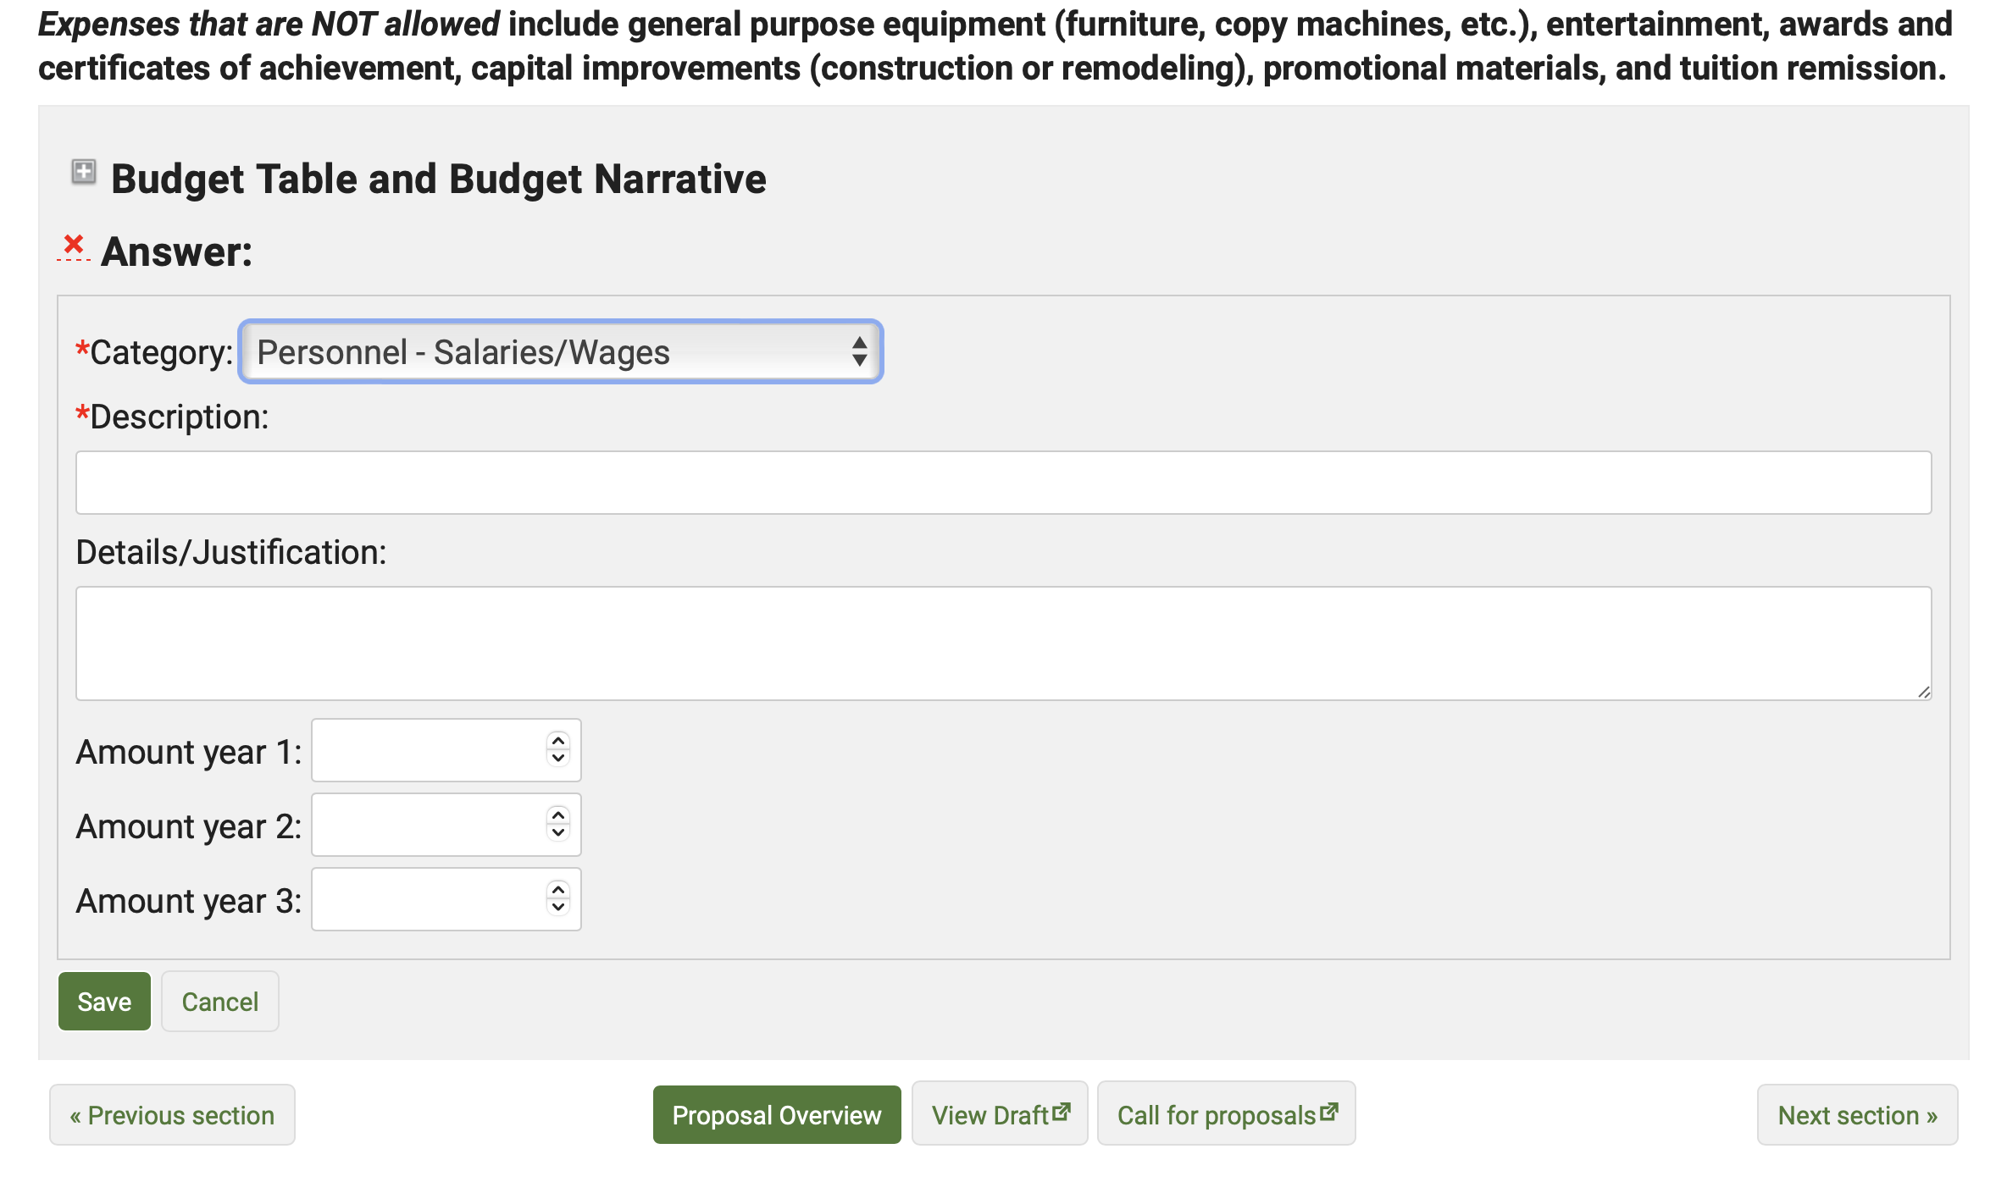
Budget section

Slide 31
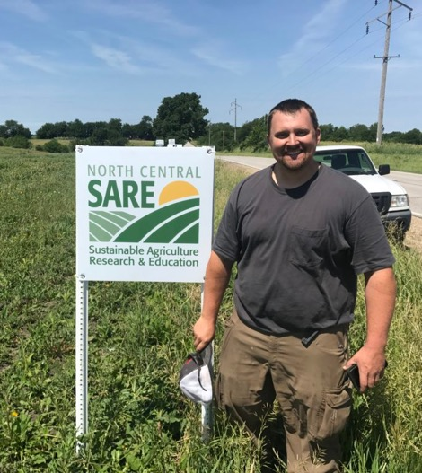
Things to Remember
Focus on training or other professional development for educators.
Submit proposal by the 4:00 p.m. CDT April 3 deadline!
Photo courtesy Charles Martin.
Notes:
Things to remember!

Slide 32
Questions?
Contact NCR-SARE
Rob Myers, Regional Coordinator
Email: myersrob@missouri.edu
Andy Larson, Associate Regional Coordinator
Email: andrew.larson@business.wisconsin.edu
North Central SARE Office:
E-mail: ncrsare@umn.edu
www.northcentralsare.org
Notes:
Here is contact information for me and for Jean Andreasen. Please feel free to contact us with questions.. We look forward to receiving your proposal.

