Slide 1
Applying for a 2022
NCR-SARE
R&E Grant
NCR-SARE’s Research and Education Grant Program is a competitive grant program that funds
collaborative teams of scientists, farmers, institutions and educators who are exploring sustainable agriculture through research projects or education/demonstration projects.
For 2022 program, preproposals are due
Thurs., Oct. 7, 2021, 4:00 pm CDT
Advancing sustainable agriculture since 1988
Notes:
Welcome to this presentation about applying for a research and education grant in the North Central SARE program. I’m Beth Nelson, and I coordinate this program. This presentation goes over material that is in the Call for Preproposals, so it would be useful to have that in front of you as you’re going through this presentation. I’ll begin with a quick overview of SARE and North Central SARE, and I’ll emphasize some of the SARE philosophy that I hope will aid you in developing your proposals. Then I’ll go through some of the sections of the proposal with you with more specific information about what reviewers are looking for, and wind up going through some screenshots of online submission process. My contact information is at the end of the presentation, so please call if you have questions. This grant program is a competitive grant program to fund research or education projects that address sustainable agriculture issues in the north central region.

Slide 2
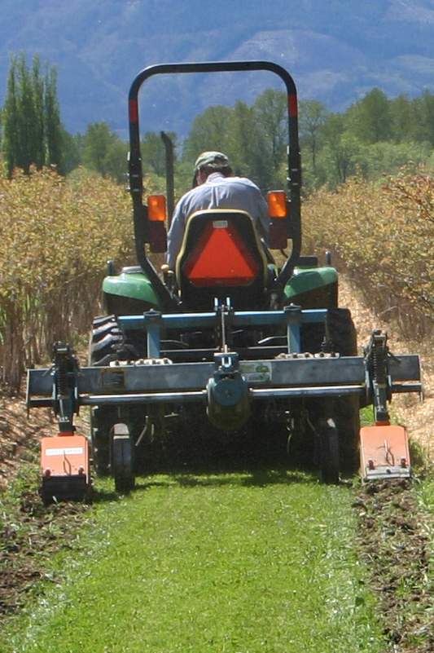
Advancing sustainable agriculture since 1988
Photo by Jerry DeWitt
Notes:
The USDA Sustainable Agriculture Research and Education program, commonly referred to by our acronym, SARE is a a program of the United States Department of Agriculture, funded through the National Institute of Food and Agriculture or NIFA program.

Slide 3
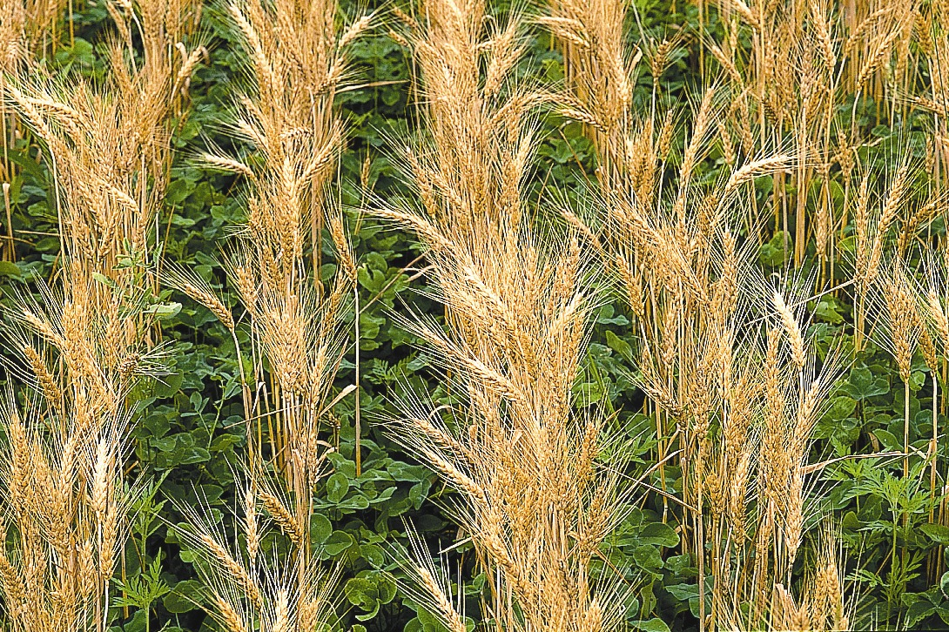
What is SARE?
Grants and outreach to advance sustainable innovations to the whole of American agriculture.
Notes:
We provide grants and outreach to advance sustainable innovations to the whole of American agriculture.

Slide 4
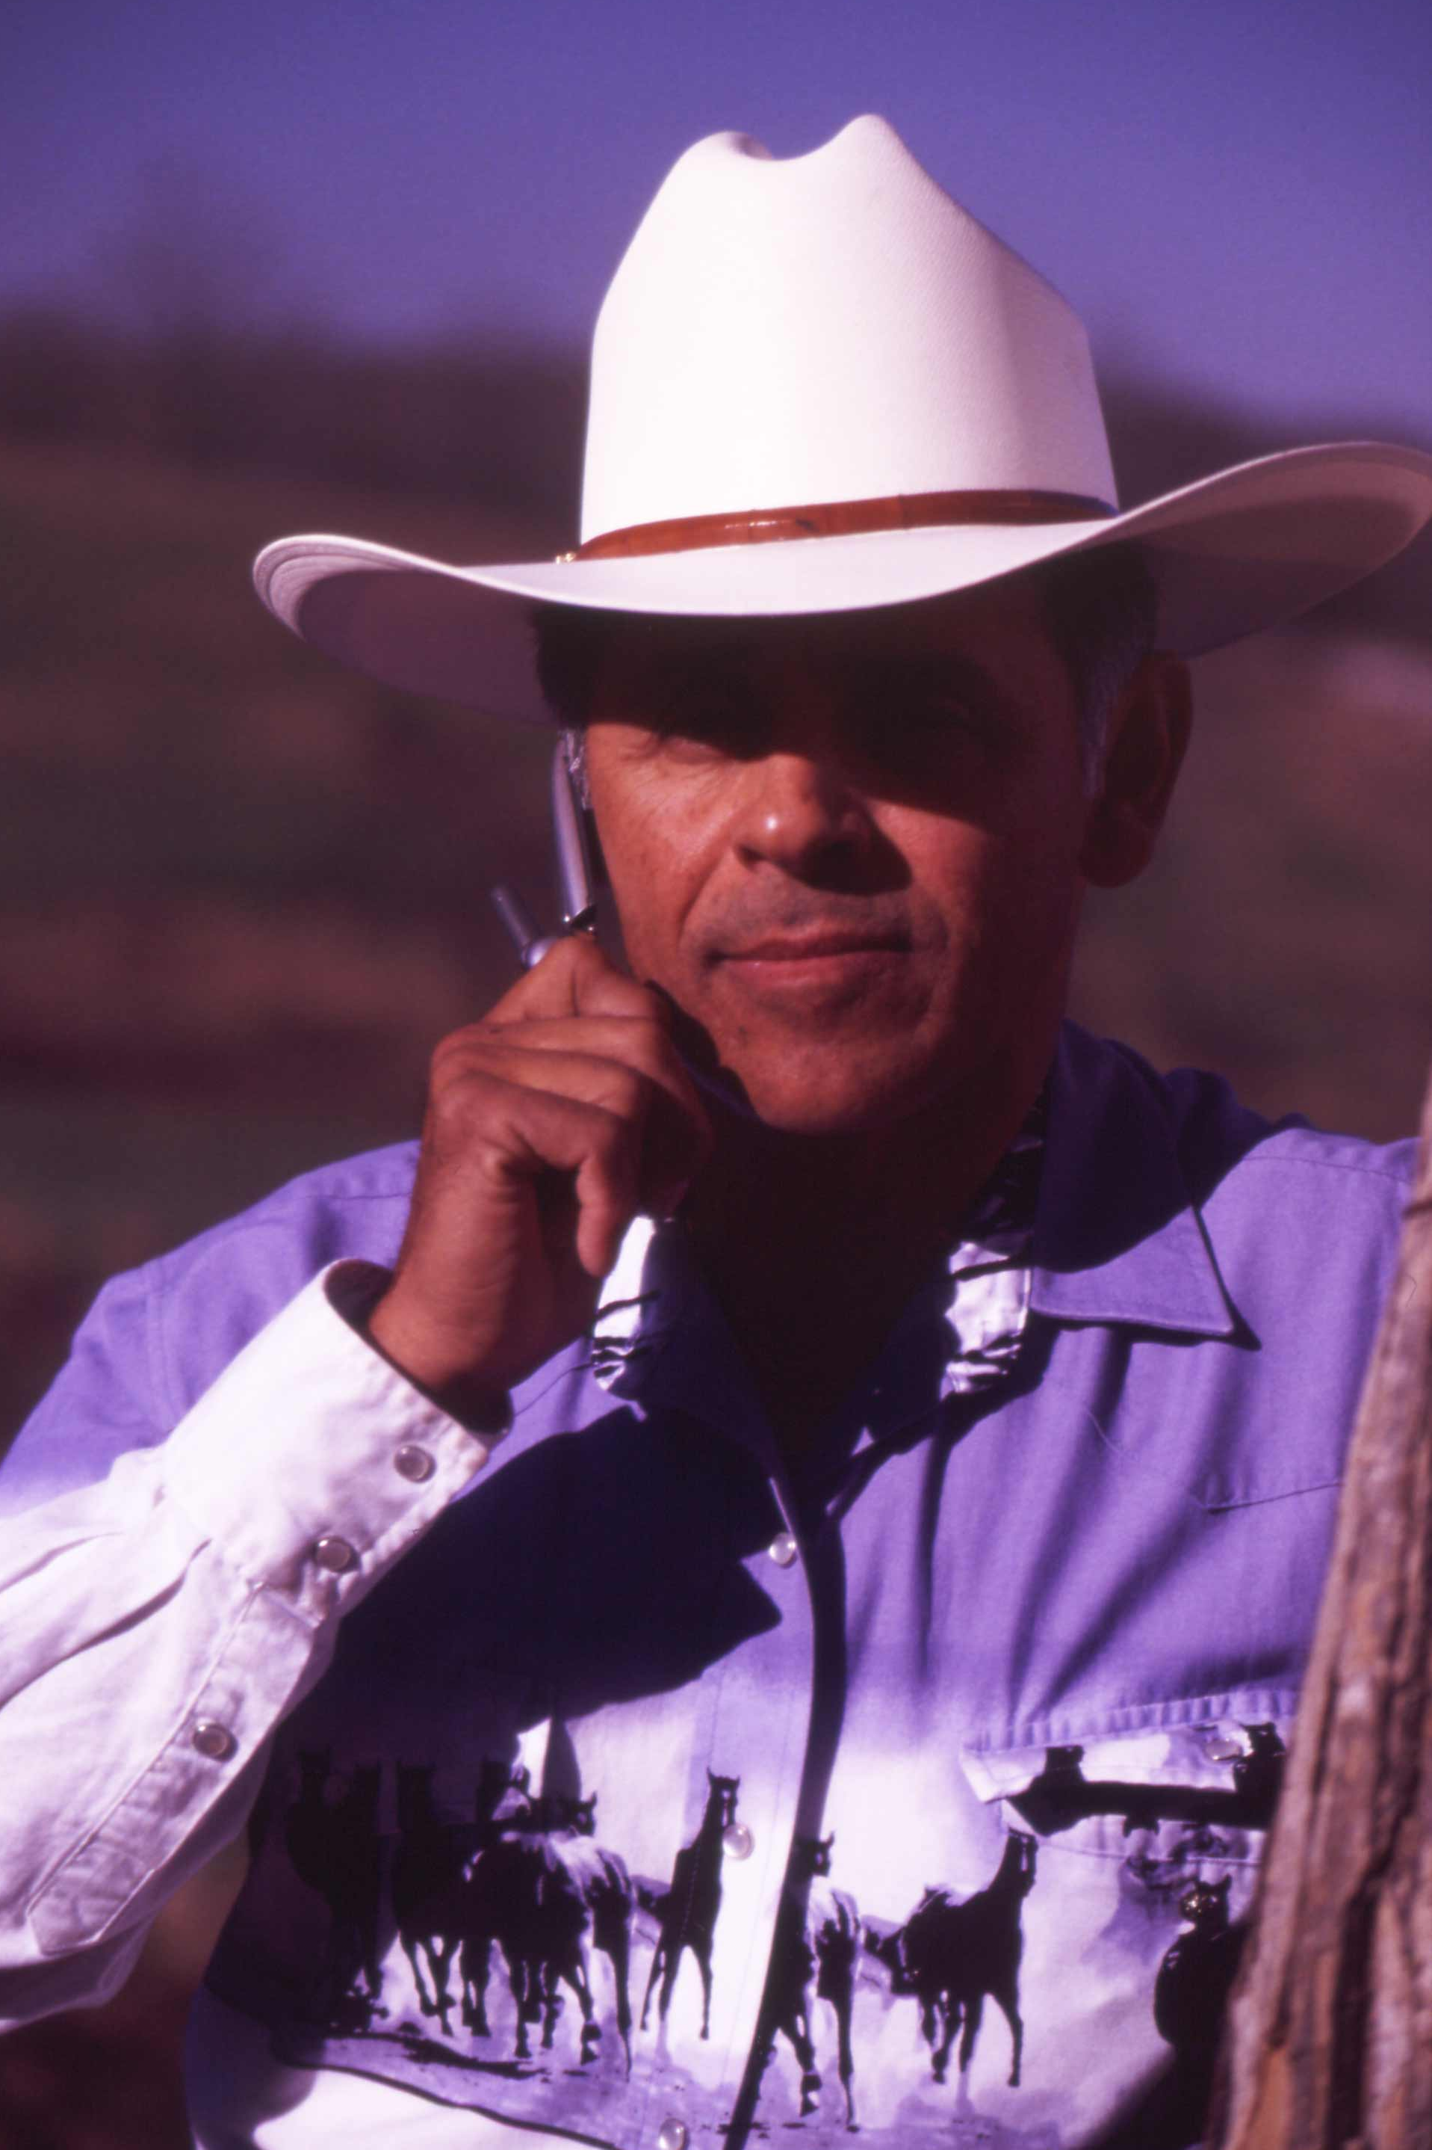
Something New and Different
SARE was started in 1988, conceived as a
decentralized, science-based, grassroots, practical, problem solving – and inclusive – competitive grant making and outreach program.
Photo by Jerry DeWitt
Notes:
This slide highlights some of the main characteristics of the SARE program--
We are decentralized, in that each of the four regions make their own funding decisions, including which grant programs to offer.
We are science-based, and a grassroots grant program. Our proposal review teams and our administrative council include farmers and ranchers, extension educators, researchers and personnel from state and federal agencies. That’s an important point to remember when you’re writing your preproposal—don’t assume that everyone reviewing your proposal is an expert in your field—try to avoid using jargon.
We look for projects with strong farmer/rancher or end-user involvement, and most projects are applied research projects.

Slide 5
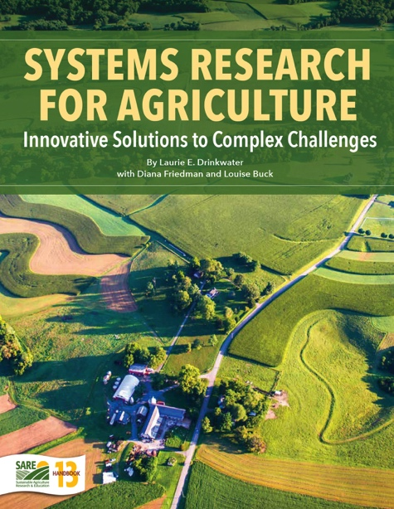
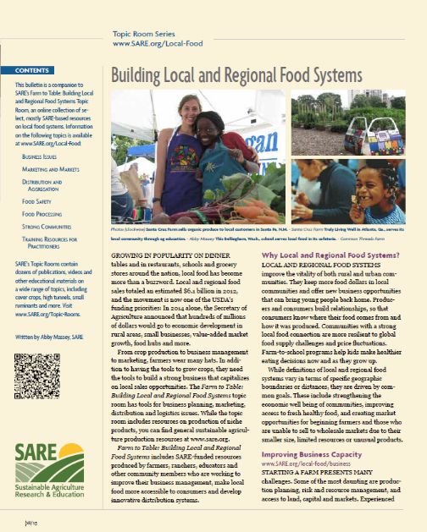
_{SARE Outreach}
a library of practical,
how-to books (in print or download for free)
media outreach
a portfolio of in-depth reports on current topics
Topic rooms for multimedia information
countless online resources, including project reports
Notes:
We are a grants and education program, and SARE Outreach produces practical information like you see here, and you can find a wealth of information online, including informative bulletins on topics from Clean Energy and Water Conservation to Building Local and Regional Food Systems. These are available to view online or download as pdfs.

Slide 6
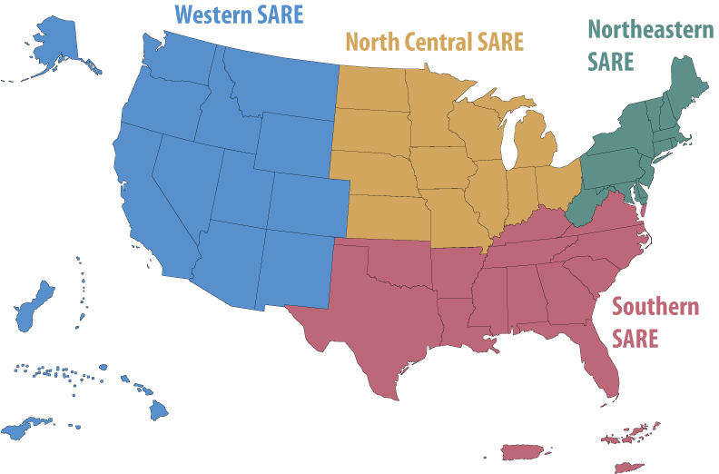
NCR-SARE
Grant Types
Farmer/Rancher
Research & Education
Partnership
Professional Development
Graduate Student
Youth Educator
To connect to 12-state North Central Region, go to www.northcentralsare.org
Photo by Carol Flaherty
Notes:
We are decentralized in that each of the four regional administrative councils set priorities and make grant decisions. The North Central region includes 12 midwestern states--a highly productive, critical agricultural region. We offer the six grant programs listed above. Information on all of our grant programs can be found on our website www.northcentralsare.org and you should look at all our grant programs to determine the one that might be the best fit for your project. The Partnership Grant program a newer program in the North Central region.

Slide 7
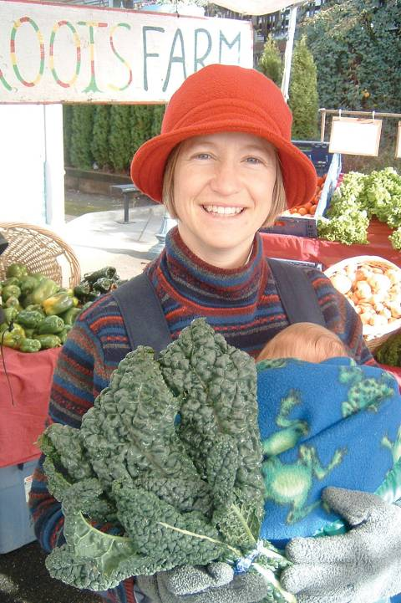
The
SARE Model
Successful SARE grantees are engaged in projects that simultaneously address the “3Ps” of sustainability:
People – who depend on agriculture
_{Profit – over the long term}
Protection – of the nation’s land and water
Photo by Ted Coonfield
Notes:
Successful SARE grantees have projects that simultaneously address the 3Ps of sustainability—people, profit over the long term and protection of our resources.
The North Central SARE uses slightly different wording, but also highlights the “3Ps” of sustainability, in the NCR-SARE broad based outcomes, listed in the Call for Preproposals.
In your proposal, you should address how your project addresses each of these outcomes, even if it emphasizes one over the others. The outcomes are:
Improving the profitability of farmers and associated agricultural businesses.
Sustaining and improving the environmental quality and natural resource base on which agriculture depends.
Enhancing the quality of life for farmers/ranchers, communities, and society as a whole.

Slide 8
The
SARE Portfolio
Sustainable pest and weed mgmt.
Marketing and local food systems
Water quality and nutrient mgmt.
Systems research
High tunnels and season extension
Crop diversification
Cover crops and soil health
Small ruminants/poultry/cattle
Pastured livestock/grazing systems
Pollinators and biodiversity
Urban agriculture
…and much more
Photo by Troy Bishopp
Notes:
We have funded projects on a wide range of topics.

Slide 9
North Central Region SARE
www.northcentralsare.org
Photo courtesy NRCS
Notes:
Now I’d like to focus in on the North Central Region and the Research and Education grant program and how to prepare a preproposal

Slide 10
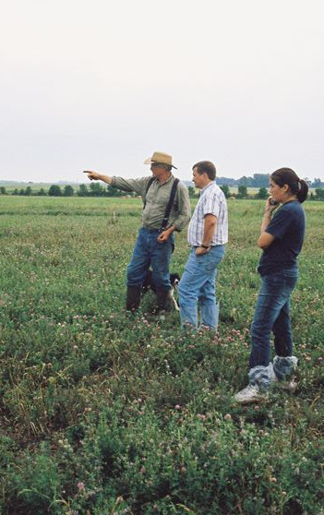
Research and Education
Grant Program
Grants for up to $250,000 total, 10% Indirect Costs allowed;
Can be up to 36 months
New long-term funding option
Can be research OR education, or demonstration projects
Proposals due October 7, 4:00 CDT
Invite 30 to 35 preproposals; fund 14-15 proposals
Funds available mid-fall, 2022
Photo courtesy Wayne Martin
Notes:
These are the program basics. R&E grants are for up to $250,000, and that is an increase from the $200,000 cap we’ve had in the past. Of that amount, 10% of that can be taken by your institution as Indirect Costs. Duration of these projects vary widely, but most are for 36 months. This year we have a new long-term option that you can apply for, and I will explain more about that later. Grants can be for research, OR education, or demonstration projects, but all have an outreach component. Your preproposal must be submitted online by 4:00 p.m. CDT, on Thursday, the 8th of October. Last year we received 153 preproposals and funded 13 proposals. This year we intend to invite 30 - 35 preproposals to be developed into full proposals, and anticipate funding 12-14 proposals. Our Administrative Council reviews the preproposals and makes decisions about which ones to invite to develop full proposals in January. All applicants are notified in late January or early February, and full proposals are due in April. A different review committee reviews the full proposals and makes recommendations which the AC votes on in July, with funds available mid-fall, 2021

Slide 11
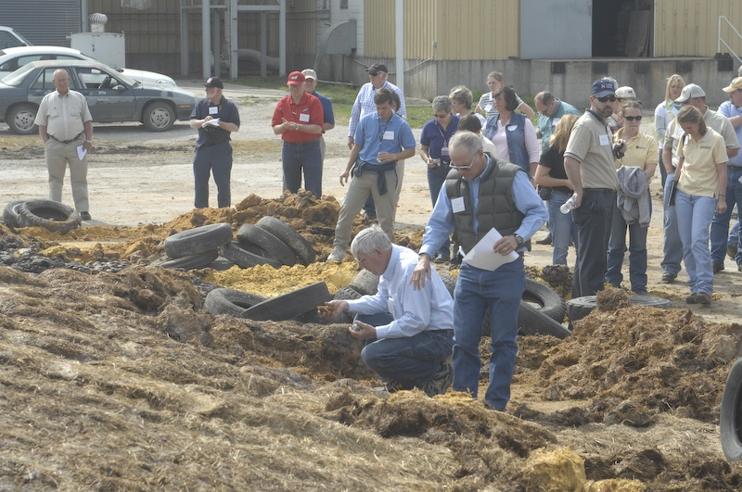
Preproposal Review Process
Preproposals reviewed by Administrative Council members in groups based on expertise/topic.
Score on relevance to sustainable agriculture in our region, methods/approach, and farmer engagement.
Identify top 5-6 from each group, then whole AC discusses and votes on total slate.
photo credit: Francis John Hay
Notes:
Preproposals are reviewed by our Administrative Council members in groups based loosely on expertise/topic. However, at the preproposal stage they are not evaluating the technical merit of the proposals, but looking at the concepts. The preproposal is reviewed with regard to its relevance to sustainable agriculture in our region, and farmer engagement in the project.

Slide 12
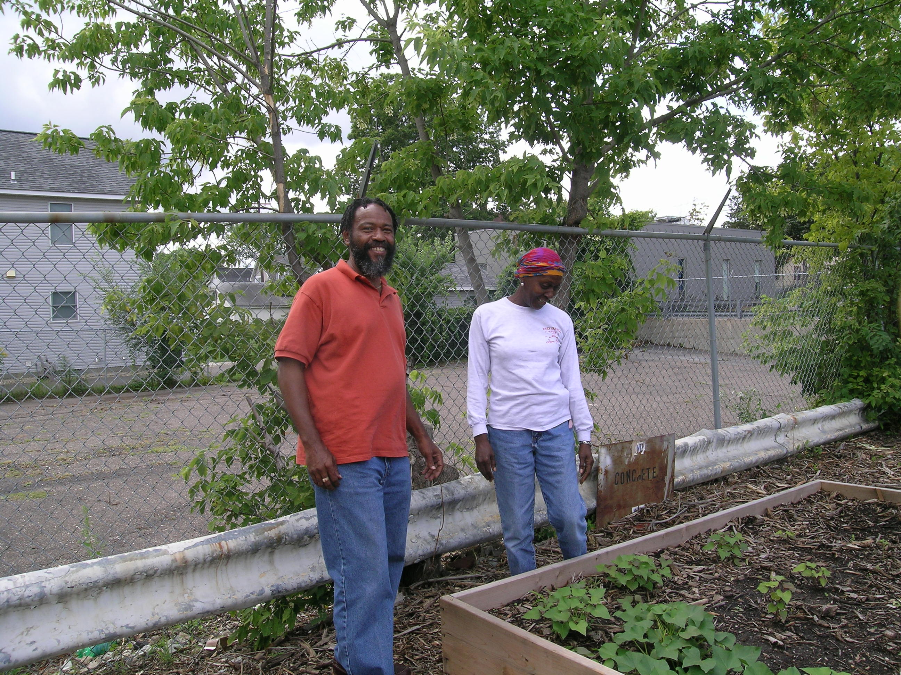
Successful Preproposals
Demonstrate relevance to North Central region and Address NCR-SARE’s three broad-based outcomes
Involve farmers/ranchers in project
Photo courtesy Joan Benjamin
Notes:
Projects that come into this grant program can be quite different, but in general, successful projects clearly present the relevance of the proposed work to the north central region, and they clearly define their objectives and outcomes. They address NCR-SARE's broad-based outcomes, and all successful research and education grant preproposals also demonstrate farmer/rancher involvement in the proposal, beyond just identifying farmers/ranchers as the targeted recipients of the information. Sometimes farmers have expressed the need for the research, or served as advisors in planning the project, or will be involved in implementing the project or disseminating the findings, but it’s important to convey how they are or will be involved.

Slide 13
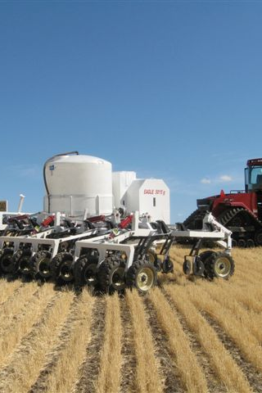
Successful Preproposals
(cont)
Have clear outcomes
Photo courtesy Karl Kupers
Notes:
Successful preproposals also have clearly defined Outcomes for their project. These are the impacts of your project—somewhat different from the results. The Outcomes are what will happen as a result of the project being completed. Last point I’ll emphasize is that you should make sure that the budget is appropriate to the work.

Slide 14
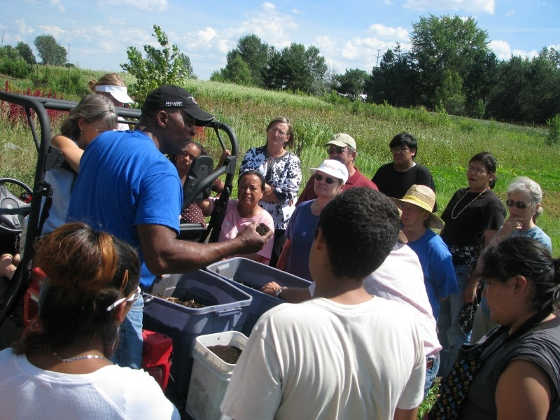
Preproposal
Application
Online submission
(link in Call for Preproposals)
Suggest you prepare as a word document, following questions in the Call for Preproposals. Then cut and paste into online system.
Photo courtesy NRCS
Notes:
The 2022 Call for Proposals contains all the questions you’ll be asked to complete in the online system. We suggest that you prepare your proposal in a word processing program so that you can track your word counts, since all sections in the online proposal have word limits. Then you can cut and paste into the online system.

Slide 15
Long-term funding option
Indicate long-term option on preproposal (preproposals compete with other long-term preproposals only)
Include strong justification for why this research requires long-term funding
For full proposal, initial 3-year cycle with budget with work plan for later cycles
Funding for further cycles awarded if project proceeding as expected.
Notes:
Recognizing that some research/extension systems work is complex and requires a collaborative, interdisciplinary approach that may take years to put in place, NCR SARE is offering a long-term funding option in the Research and Education grant program. Projects that apply under the long-term (more than 3 years) option in the preproposal will be asked to provide a strong justification for why this is a longer-term project and the estimated duration of the project. The justification might include the complexity of the set-up of the project or relationship building; the ecosystem processes at play; or need for longer-term data collection/analysis. Reviewers will consider the long-term funding justification and decide if the project merits long-term funding, before inviting for a full proposal and comments shared with applicant. If the project is invited for a full proposal, the applicant will need to decide whether or not to pursue the long-term funding option, based on reviewer comments. If the long-term funding option is checked, the project will be reviewed and considered for long-term funding or no funding at all. If invited to complete a full proposal, and the applicant checks the long-term funding option, they will complete a typical proposal application, requesting funding at no more than the standard cap of $250,000 for the first three year funding period, and your proposal budget will be for that amount, but applicants will complete an additional segment that provides a projected work plan for a second (and third, if needed) three-year cycle. Funded long-term projects will receive funding in three-year increments (contingent on NCR- SARE receiving funding.) Each additional increment of funding will be dependent on satisfactory performance in the first round based on: reports submitted in a timely manner with yearly objectives and milestones reported on and met, site visits, and an adequate work plan for the next phase. There are no priorities for long-term projects, but some examples of types of project topics that could be considered long-term include: soil/water quality enhancement or degradation, agro- forestry, integrated crop-livestock systems, participatory action research, pest resistance mitigation, and climate adaptation.

Slide 16
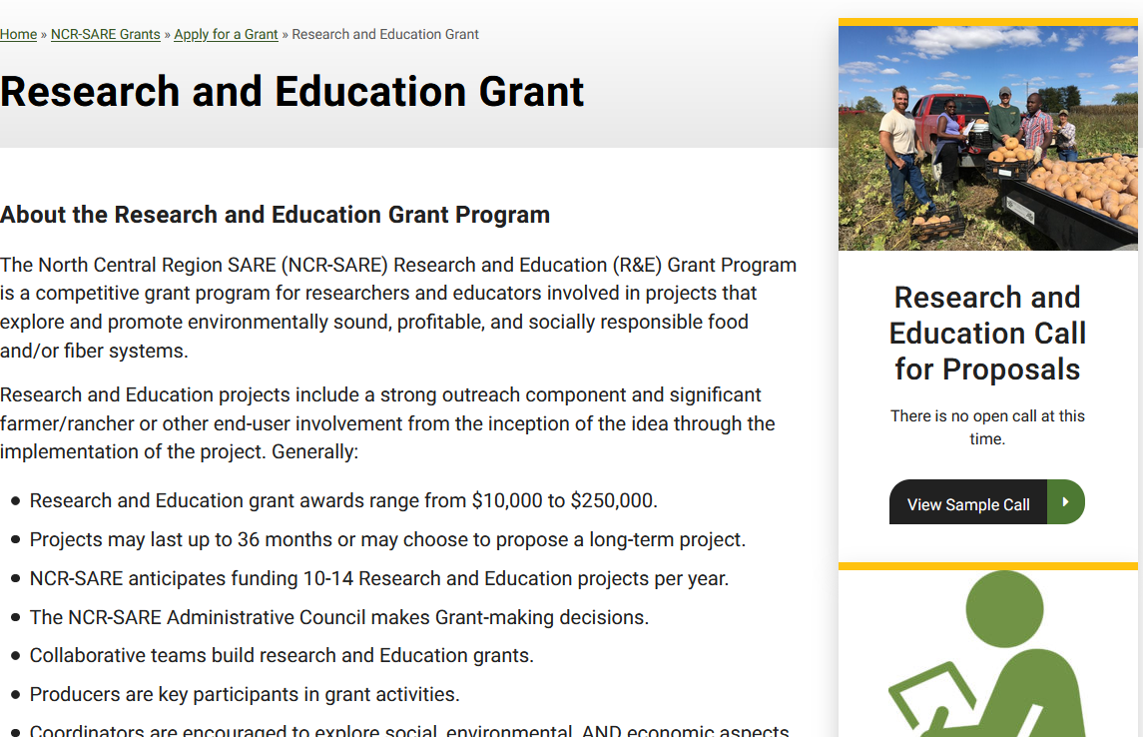
Go to Research and Education grants page and click on Research and Education Call for Preproposals
Look up past SARE projects to see how your work differs or builds on past projects
Notes:
If you navigate to the Grants page, and click on Research and Education grants, you ‘ll find information about the this grant program and access to download the Call for proposals.
You should also look at past grant projects to see how your work builds on those, and use that information in your preproposal.

Slide 17
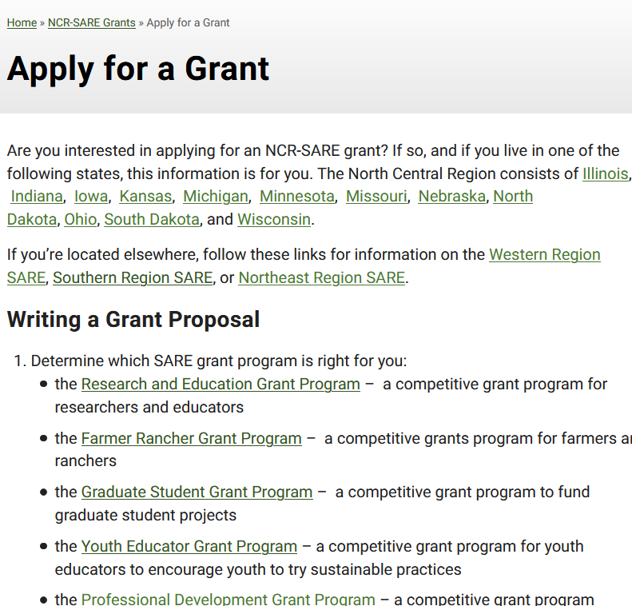
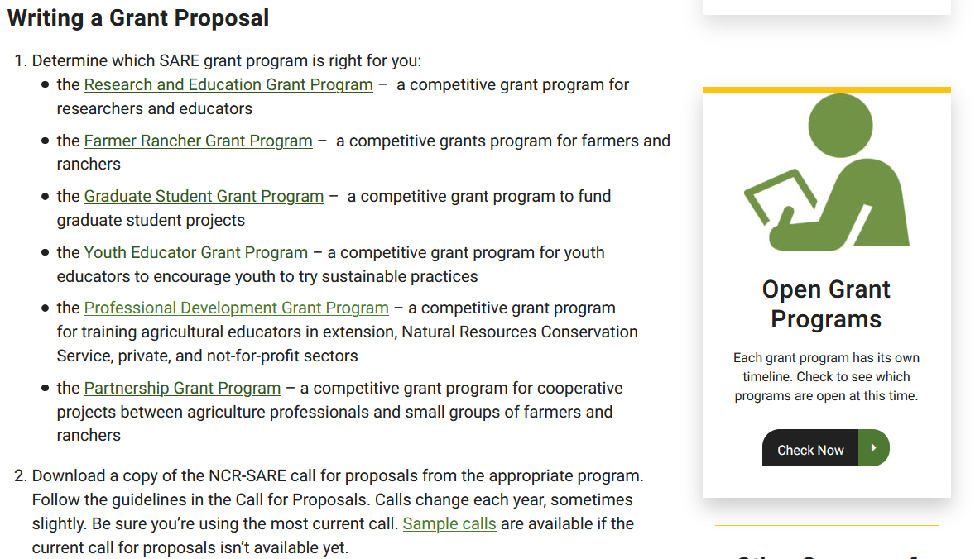
Notes:
You can get additional help for writing grants on the NCR-SARE website.

Slide 18
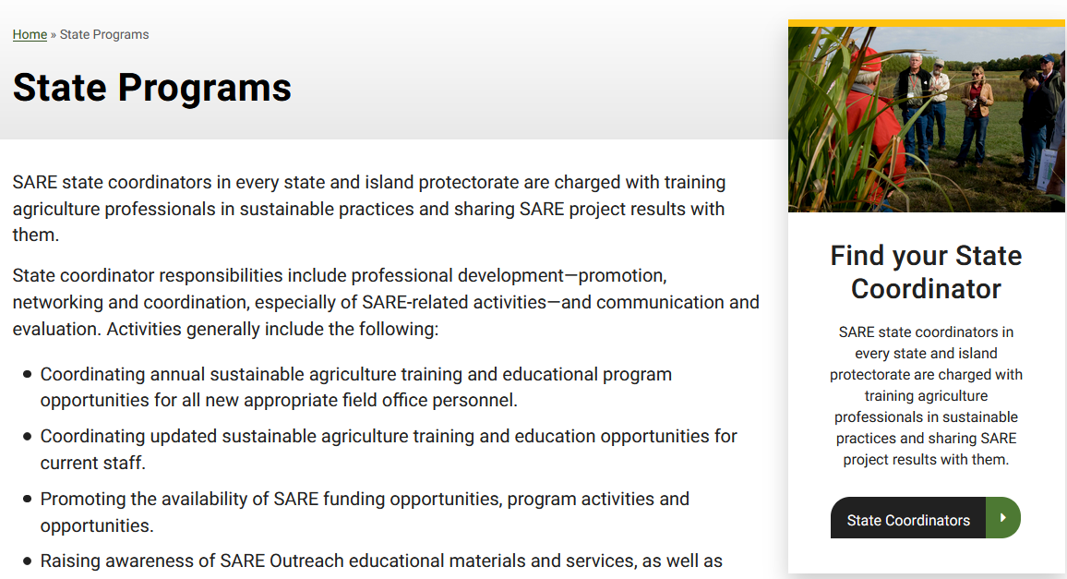
Contact your SARE state coordinator
Look up past SARE projects to see how your work differs or builds on past projects
Notes:
An important resource for you is your state NCR SARE coordinator. If you click on the link indicated in this slide, you will pull up the contact information for your state coordinator. They can discuss your idea with you, offer suggestions, and may be able to link you to collaborators. They can be especially helpful in connecting you to farmers who might be interested in your work and willing to collaborate.
You can get additional help for writing grants on the NCR-SARE website. If you navigate to the Grants page, and click on our grants, you ‘ll find information about the grant programs. An important resource for you is your state NCR SARE coordinator. If you click on the link indicated in this slide, you will pull up the contact information for your state coordinator. They can discuss your idea with you, offer suggestions, and may be able to link you to collaborators. They can be especially helpful in connecting you to farmers who might be interested in your work and willing to collaborate.
You should also look at past grant projects to see how your work builds on those, and use that information in your preproposal.

Slide 19
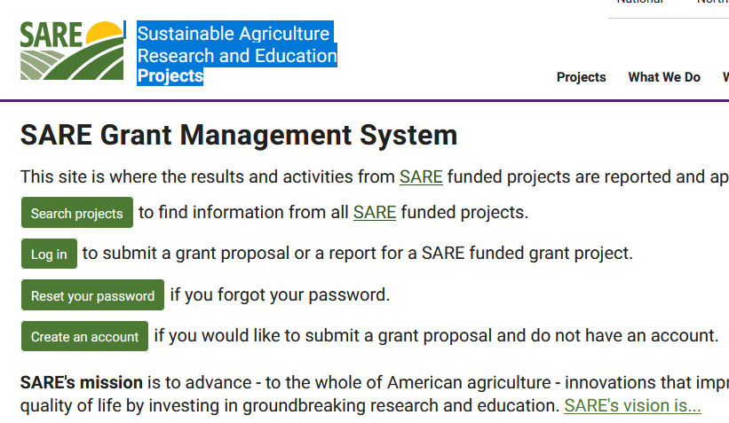
Go to : projects.sare.org
Look up past SARE projects to see how your work differs or builds on past projects.
Notes:
You should also look at past grant projects to see how your work builds on those, and use that information in your preproposal.

Slide 20
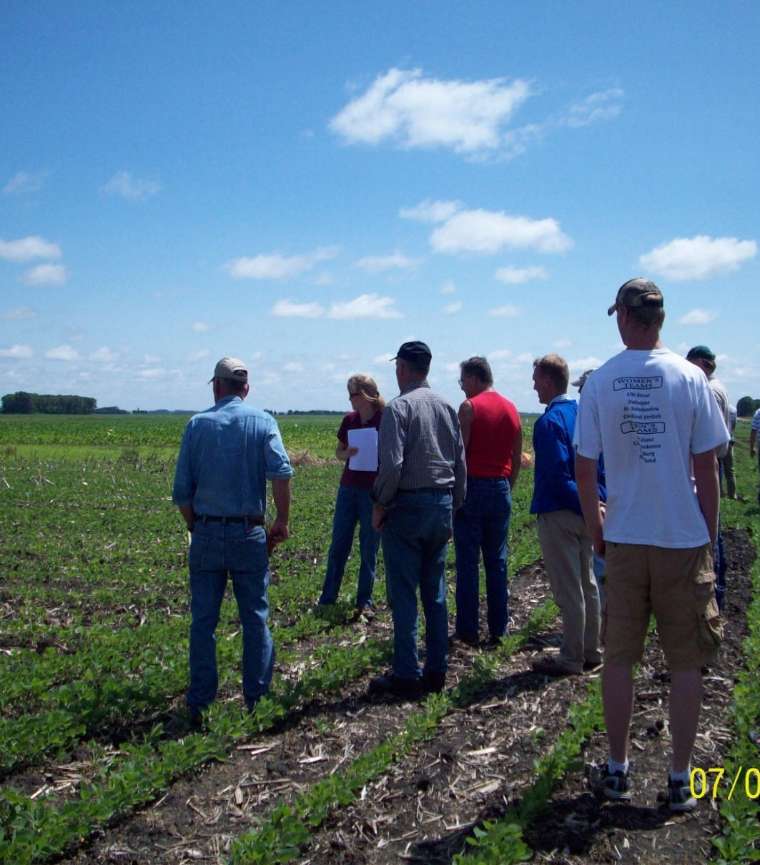
Cover
Title, Project Description
Start and End Dates
Whether your project will focus on socially disadvantaged or limited resource farmers
Funding Request range
Project Focus (Research OR Education/Demonstration
Long-term funding option?
Systems category and Commodity category
Institutional information
Notes:
Once you’ve entered the online application system, you’ll complete the information requested for a cover page. Your title should be descriptive but not too long. and you'll be asked to enter your Start and End dates—remember that your project cannot begin before November 1, 2022. The Project Coordinator is the person running the project, and they will be our primary contact--basically the principal investigator for the project. Note that we require you to designate one lead for the project, although you can name additional people as other collaborators in the section about Team members. You’ll also be asked to categorize your proposal as to whether it is primarily a research project, or an education/demonstration project, and whether you are applying under the long-term funding option. We also ask you to identify a systems or practices category, and a commodity category. This is primarily for cataloguing projects for our purposes, and you’ll choose from drop down lists in the online system.

Slide 21
Preproposal Body
Project Summary
Objectives/Outcomes
Relevance to sustainable agriculture in our region
Method/Approach
Photo by Troy Bishopp
Notes:
In preparing your preproposal, these will be the major headings, and note the designated word limits for each section. I’ll say a little bit more about defining your project outcomes, but basically, these are what you expect will happen as a result of doing your project. The method/approach will give a brief summary of how you plan to approach the research problem, or implement the education program. One of most important parts of your preproposal is to describe how is the proposed work is relevant to sustainable agriculture in our region. How does it solve a problem or issue? You should also give reviewers an idea of the extent of the problem, or the reach your project may have by estimating the number of acres affected, or the size or value of the livestock or crop industry affected in the north central region. In this section you’ll want to refer to past SARE projects and explain either how your project builds on that work, or how your project differs from work that’s been done in the area.

Slide 22
Outcomes
Education Project: Post-harvest handling workshops
Learning Outcomes: Farmers will learn post harvest handling and packing techniques for sales to institutions.
Action outcomes: Farmers will use post harvest techniques and increase sales to institutions
Photo by Jerry DeWitt
Notes:
To define your project outcomes—think about what you want to happen as a result of you completing this project. Learning outcomes can happen fairly quickly, and are things like changes in awareness, skills, knowledge or attitude; action outcomes are changes in behavior, practice or decision-making, and those are the outcomes that might achieve at the end of your project.
So as an example: for an education project on post-harvest handling with farmers as the target audience. Your learning outcomes might be that farmers will learn post harvest handling and packing techniques—so will increase both their awareness of specific requirements from institutional buyers, and increased knowledge about those techniques. The Action Outcomes might be that farmers will use post harvest techniques and increase sales to institutions.

Slide 23
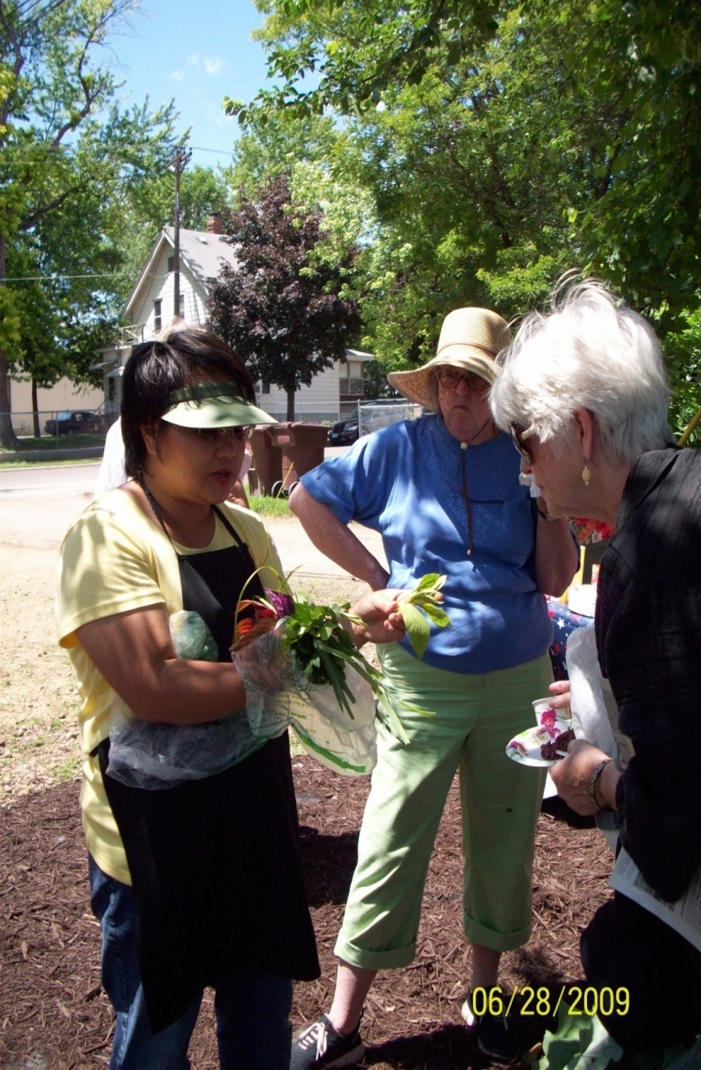
Outcomes
Research Project: Landscape diversity influence on vegetable crop pollinator population
Learning Outcomes: Farmers will learn how diverse landscape influences number and type of pollinators.
Action Outcomes: Farmers will use biodiverse plantings to increase pollinator population.
Photo by Beth Nelson
Notes:
For a research project that looks at how landscape diversity affects the pollinator population, a learning outcome might be that farmers will learn how diverse landscapes affects the number of pollinators—that will be the information generated from the research.
An action outcome will be that farmers plant diverse landscape strips in the hopes of increasing pollinator populations, a change in farmer behavior. We realize that if your project is primarily research, and you are collecting data for 2-3 years in order to share the results with farmers, it’s unlikely that you’ll see farmer adoption within the three year term of your project, so you might not be able to measure those action outcomes.

Slide 24
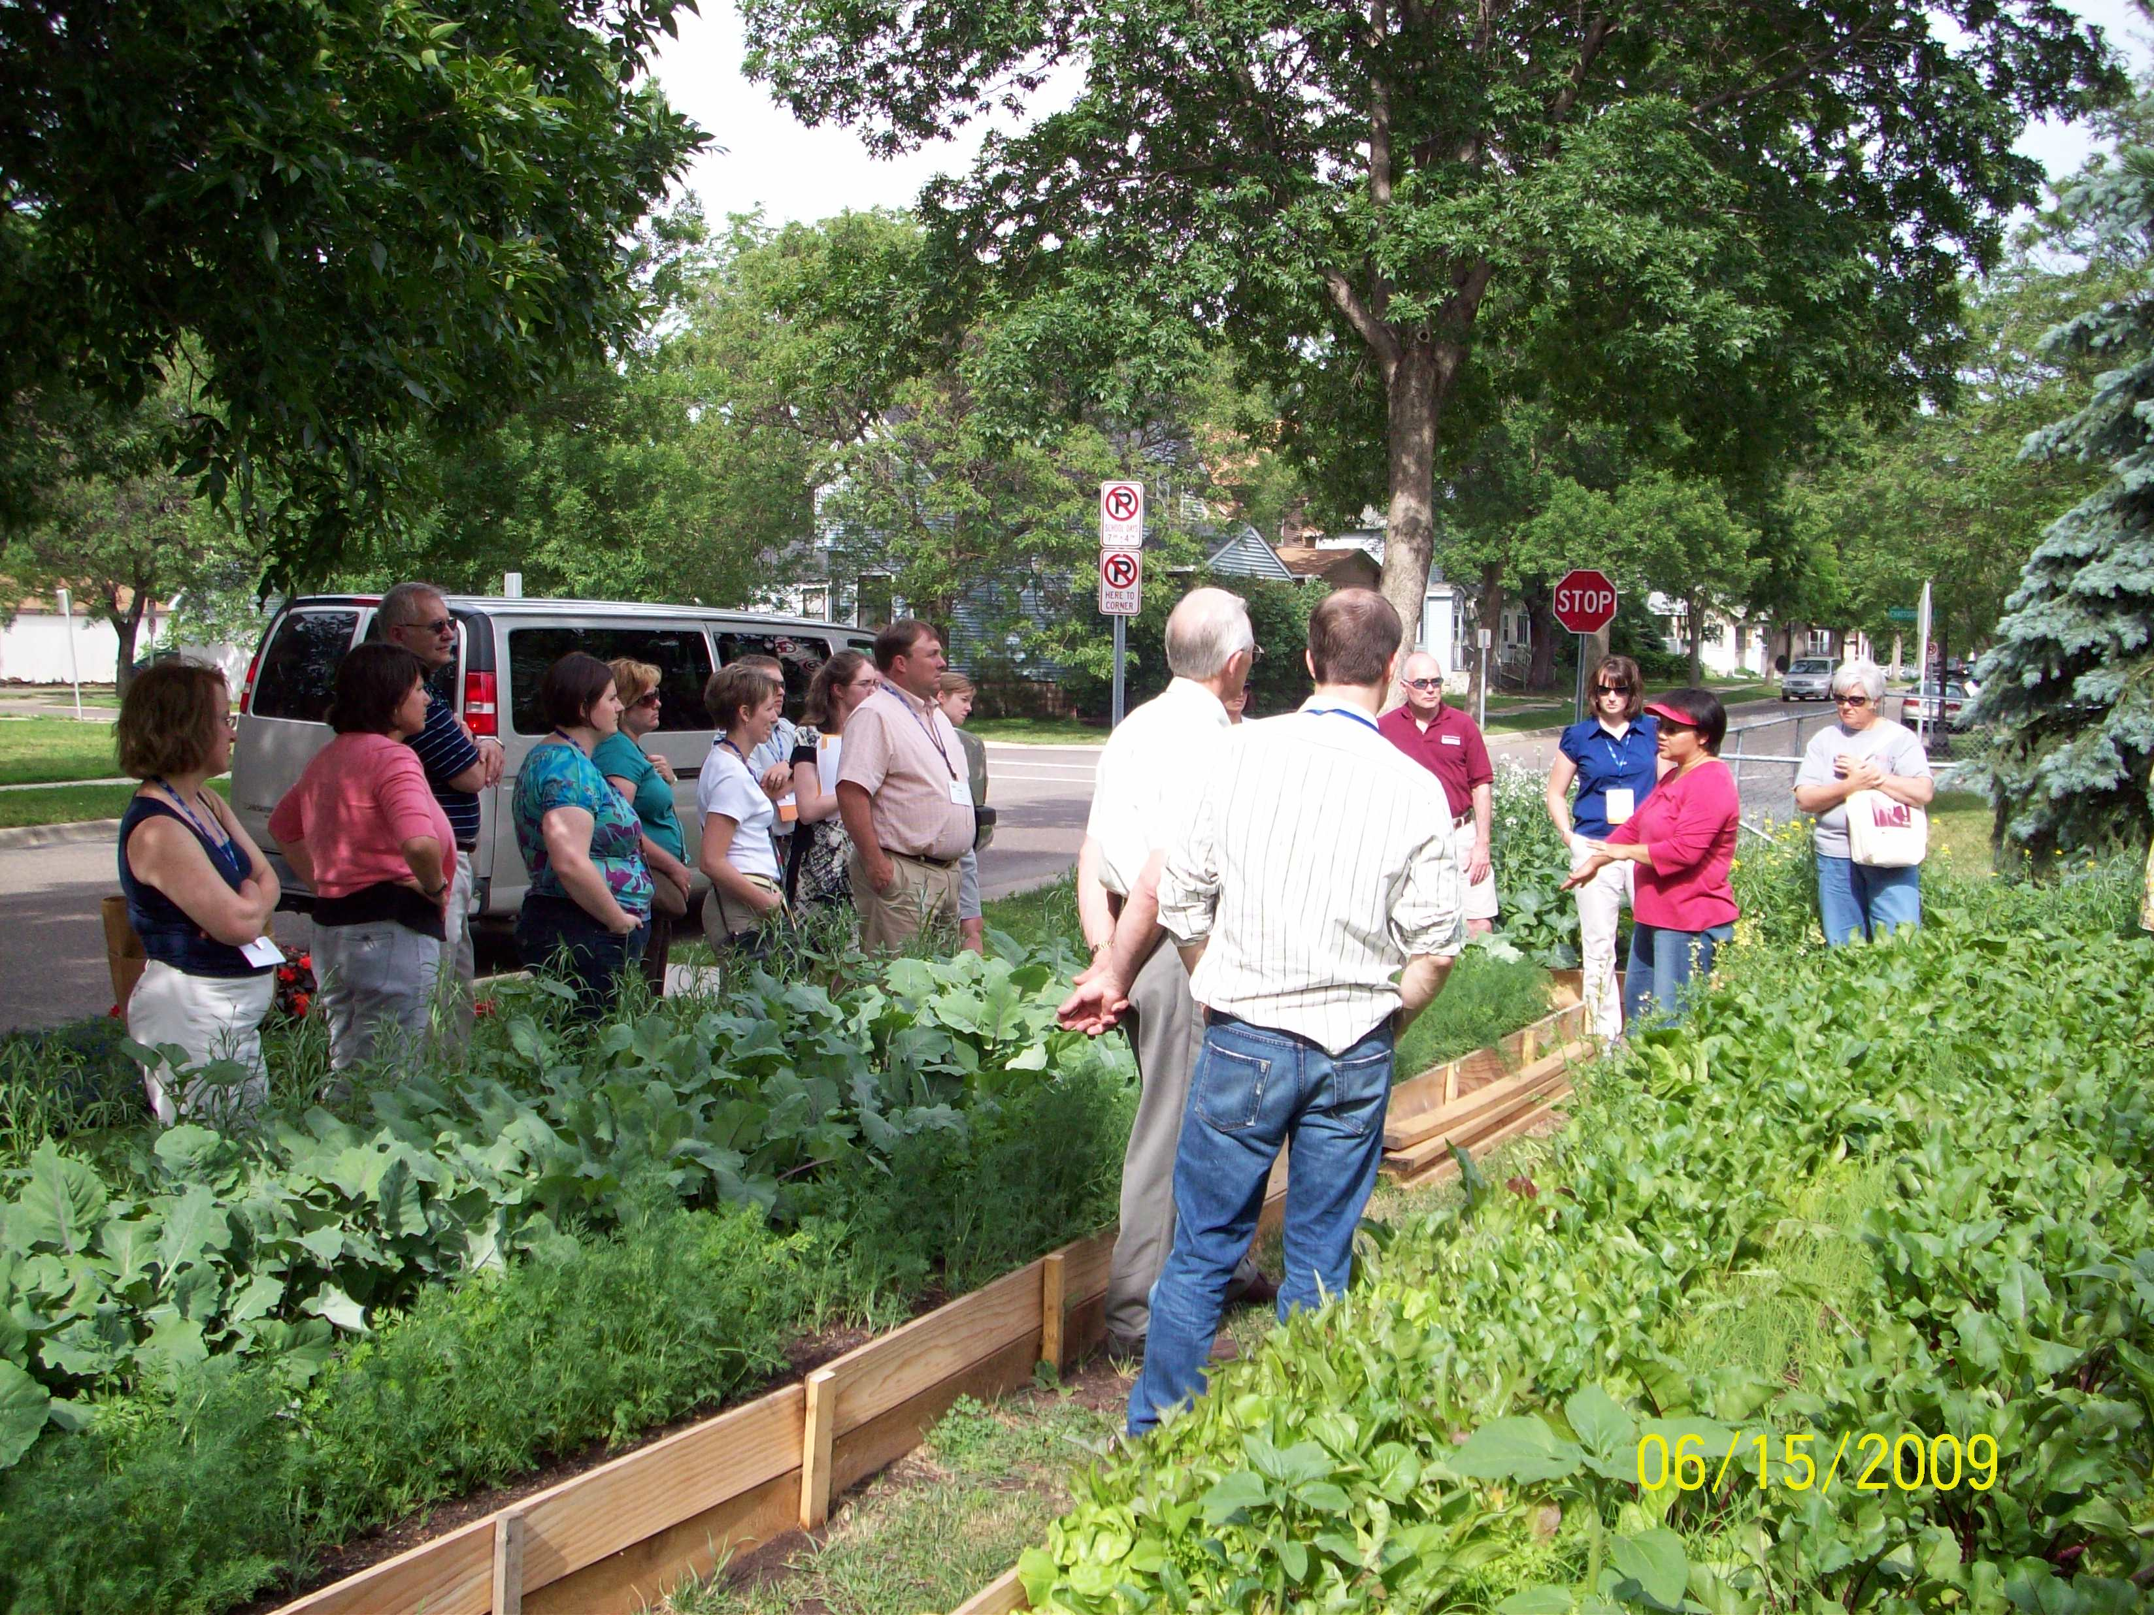
Preproposal Body (cont.)
Team Members
Farmer Rancher Involvement
Statement regarding resubmitted ideas
Notes:
These are additional sections required in your proposal, and details about what we are looking for in each of these sections are outlined in the Call for Preproposals.

Slide 25
Impact on Sustainable Agriculture in the North Central Region
How do your project outcomes align with NCR-SARE’s proposed outcomes?
Improving the profitability of farmers and associated agricultural businesses.
Sustaining and improving the environmental quality and natural resource base on which agriculture depends.
Enhancing the quality of life for farmers/ranchers, communities, and society as a whole.
Notes:
A critical aspect of the preproposal is to indicate how your project outcomes align with NCR-SARE broad-based outcomes:
Even if your project focuses one of these outcomes, you should indicate how the outcomes might impact all three.
Improving the profitability of farmers and associated agricultural businesses. Sustaining and improving the environmental quality and natural resource base on which agriculture depends. Enhancing the quality of life for farmers/ranchers, communities, and society as a whole.

Slide 26
https://projects.sare.org/
Notes:
Now I’d like to run through a few of the screen shots from the new online submission system so that you know what to expect. When you go to projects.sare.org, this is what you’ll see.
If you’ve never had a SARE grant before you will need to first create an account and complete your profile. Click on create account.
If you’ve had a SARE grant previously and filed reports in this system, your profile will already be in the system and you can log in with the username and password you used for reporting.

Slide 27
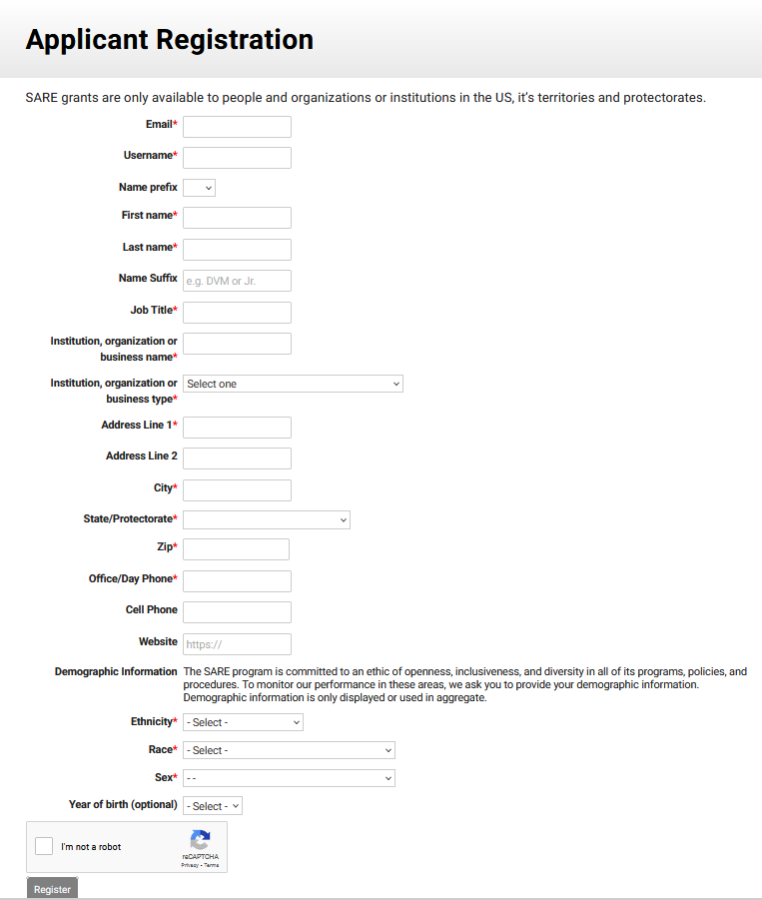
Notes:
To register as a new applicant, complete the requested information—note that we ask for demographic information the first time you use the system. Your demographic information is only aggregated with other proposal demographic information. The people reviewing proposals or determining the proposals funded will not have access to your demographic information. When you’ve finished, click on register

Slide 28
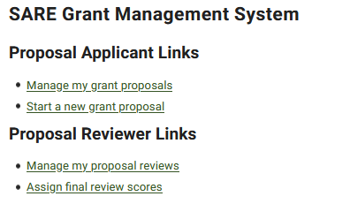
Notes:
Once you log in, you’ll see this screen. Under projects, you’ll see a list of all projects you’ve been associated with. Under the proposal Applicant Links, you’ll see a link to manage applications. This is for you to edit proposals you’ve started but not submitted.
Click on “Start a new grant proposal”.

Slide 29
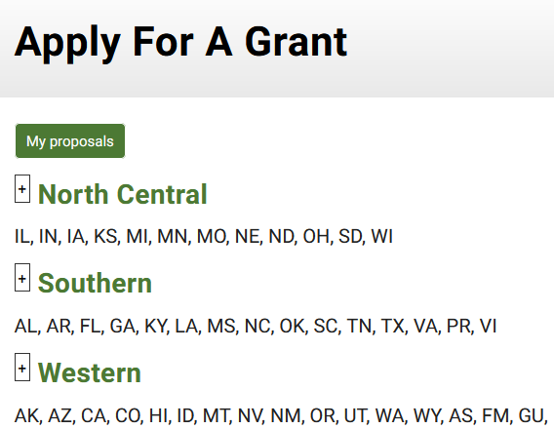
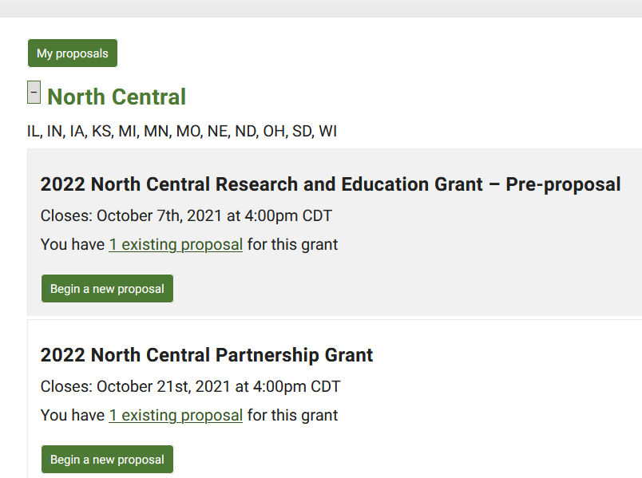
Make sure you choose the North Central Region and the correct grant program
Notes:
You will see a list of all open grant applications, for all regions.
Make sure you choose the correct grant program and the North Central Region. You will be completing the 2022 North Central Research and Education Grant Pre-proposal application.

Slide 30
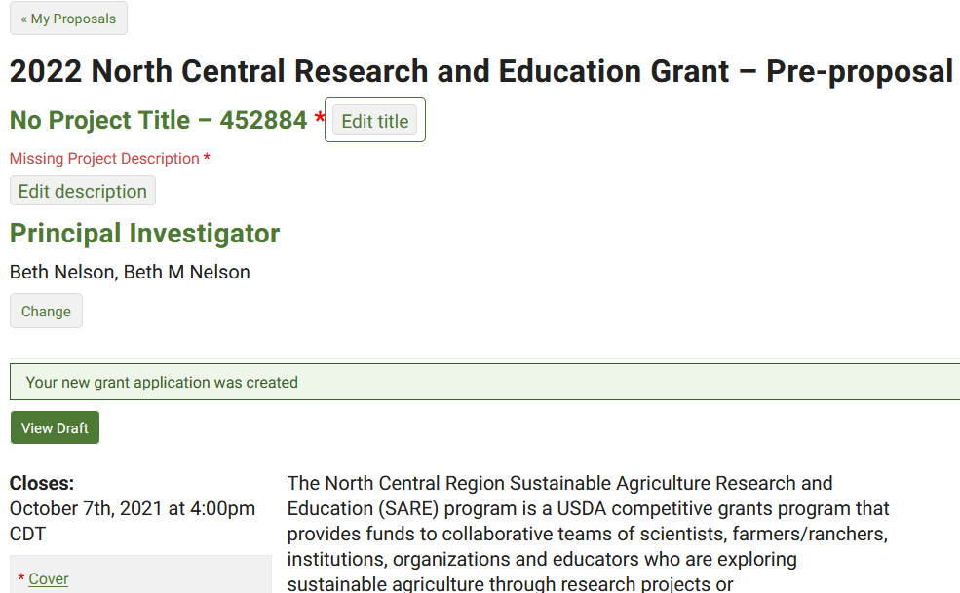
Notes:
Enter the title and brief project description (less than 160 characters). Then click on “cover”

Slide 31
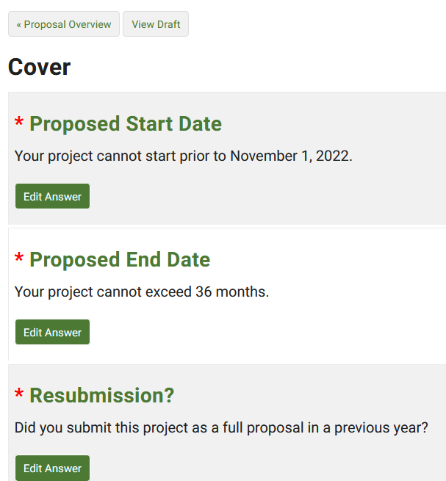
Notes:
Click on “Edit Answer” to complete the requested information—this fills in a “cover page” for your proposal. You will save the answer to each question as it is completed. The system does not store information until you hit “Save.”

Slide 32
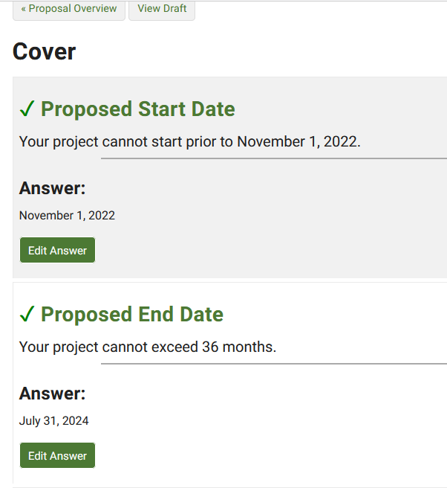
To return to main page
Required completed questions are marked with a green check.
Notes:
Answer each question by clicking on “edit answer” and saving your answer. Once you’ve completed the cover page information, or at any time, you can click on “Proposal Overview” to go back to the main page.

Slide 33
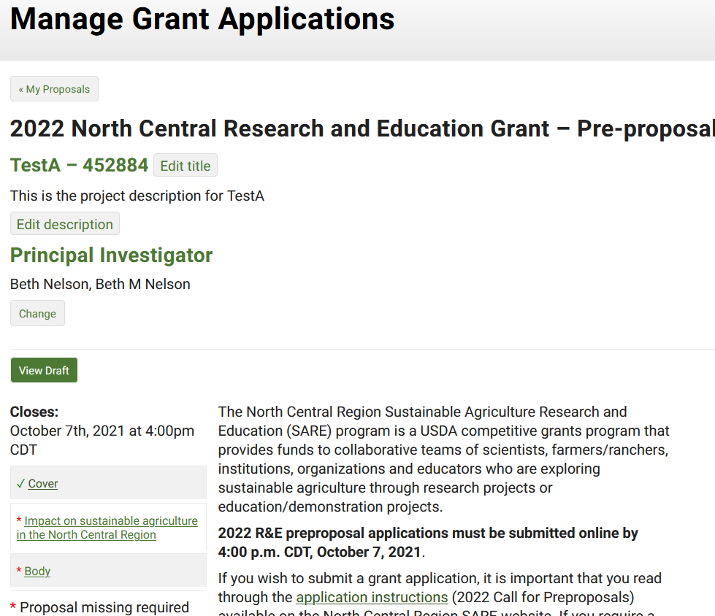
If all required questions in a section are complete, the section will be marked with a green check.
Click on “Body”
Notes:
Once all required questions in a section are complete, the section will be marked with a green check.
Click on “Body” to enter information in the main body of the proposal.

Slide 34
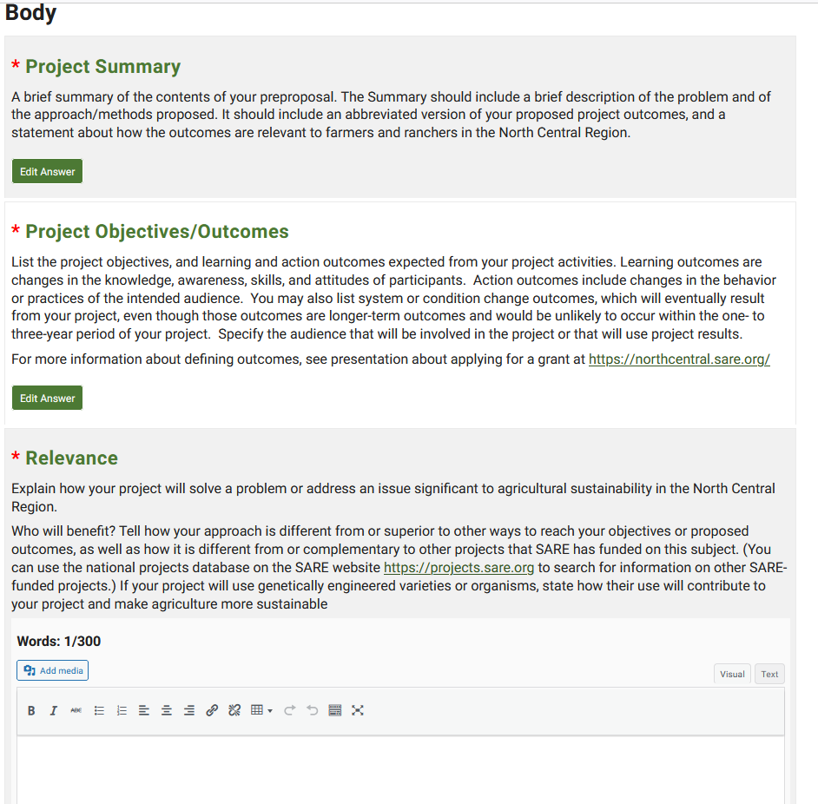
Some sections allow you to add images or tables. Click on “add media”.
Limit images/table to the equivalent of one two-sided page.
Notes:
You will enter the body of your proposal here. Note that most sections have word limits. You can add images in sections that have an “add media” button, but please limit your images to no more than one page (front and back). You can also enter tables in this system.

Slide 35
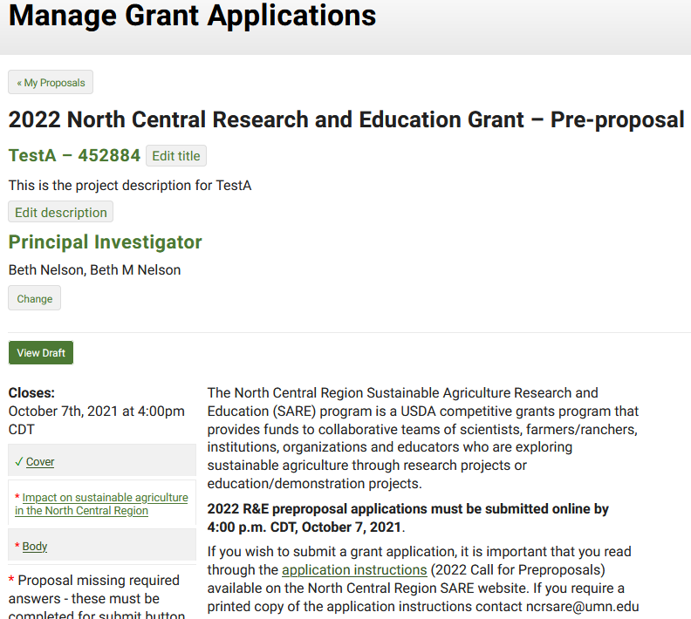
You can view a draft of your proposal at any time.
Notes:
To view or share your draft preproposal, click on “View draft”

Slide 36
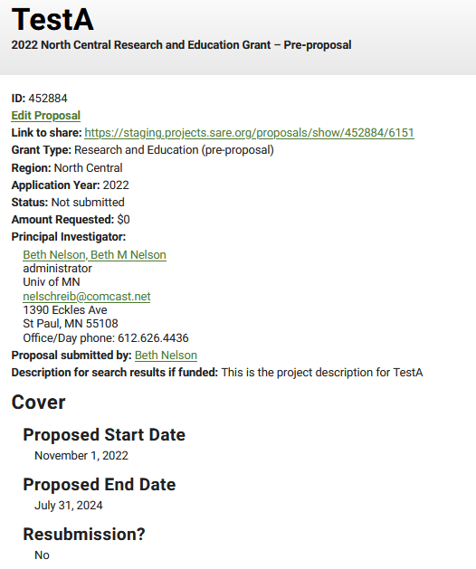
The draft has a link that you can send to others who can then view the draft.
Notes:
You can use the link provided to share your draft preproposal with others.

Slide 37
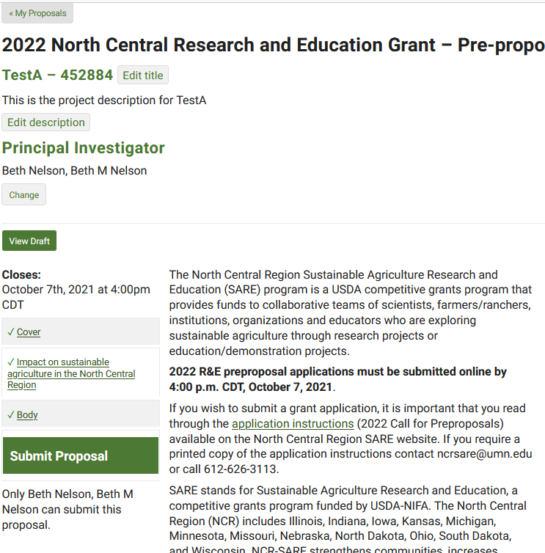
When all required information is complete, the submit proposal button appears.
Once you are satisfied with your proposal, click “submit proposal”
Notes:
Once you have completed all required sections—the “submit proposal” button appears. If you don’t see that button, you are still missing a required component. Check to make sure you’ve completed the project description and the title, which can often be overlooked.
Once you are satisfied with your proposals, click “submit proposal.”

Slide 38
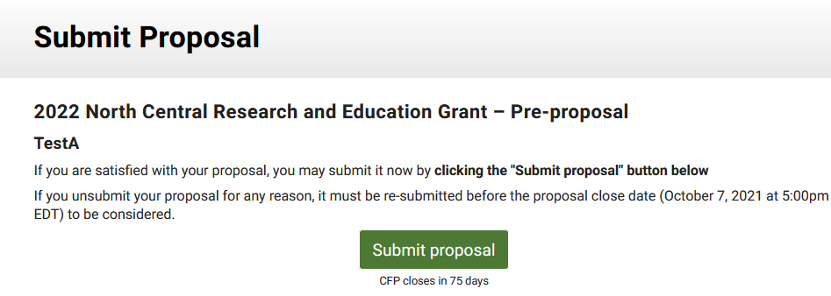
Once you are “submit proposal”. Note that in this system, you do have the ability to “unsubmit” and make corrections BEFORE the close date! satisfied with your proposal, check “I understand” and click
Notes:
You’ll land on this page to complete submission You do have the ability to unsubmit and make changes prior to the closing date for the grant program.

Slide 39
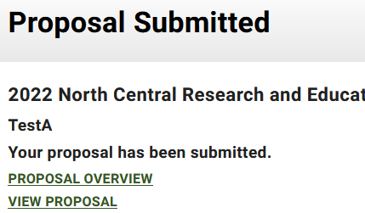
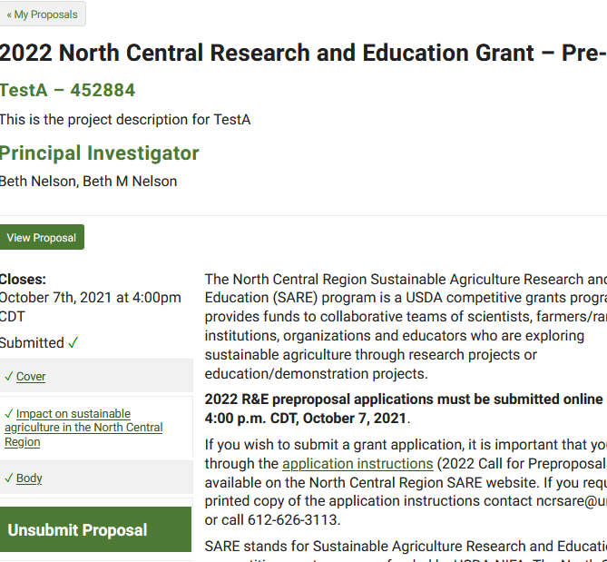
You will land on this web page, confirming your submission. If you click on “Proposal Overview” you’ll be taken back to the overview page with does allow you to “unsubmit” and make corrections and then “submit”, but you must resubmit prior to the close date.
You will also receive an email confirming your submission.
If you don’t receive an email, check that the email address entered in the system is correct—this is how you will receive notification about your proposal.
Notes:
You will see this confirmation page. Note that in this system, you can “unsubmit” and make changes PRIOR to the closing date for the grant program. Make sure you resubmit by the closing date and time.

Slide 40
Timeline
2022 R&E Program
Grant Cycle
Oct. 7, 2021 Preproposals due online by 4:00 pm CDT
Feb. 2022 Applicants notified whether they are invited to submit a full proposal.
April 2022 Full proposals due
July 2022 Technical Committee makes funding recommendation to Administrative Council.
Aug. 2022 Award offers sent.
Aug/Sept 2022 Budgets reviewed and grant contracts finalized
Nov. 2022 Funds available
March 1, 2024 2021 Annual report due (unless project ends prior to December, 2021)
Project end date Final report due 60 days after project end date
Notes:
The preproposals must be submitted online by Thursday, October 7th, at 4:00 p.m. CDT. They’ll be reviewed and a recommendation made to the NCR-SARE Administrative Council in January, and all applicants will be notified whether or not they are being asked to develop a full proposal in late January. Full proposals will be due in early April, with award letters issued in August, and funds available in the fall, contingent upon our receipt of our federal allocation.

Slide 41
Questions?
Beth Nelson
BAE Bldg. Suite 120, 1390 Eckles Ave.
St. Paul, MN 55108
E-mail: bethnelson@umn.edu
Phone: 612.626.4436
North Central SARE Office:
E-mail: ncrsare@umn.edu
Phone: 612.626.3113
www.northcentralsare.org
Advancing sustainable agriculture since 1988
Notes:
Here is my contact information. Please call me or email if you have questions. You can also contact the NCR-SARE office.
Good luck and we look forward to receiving your preproposal.

