Slide 1
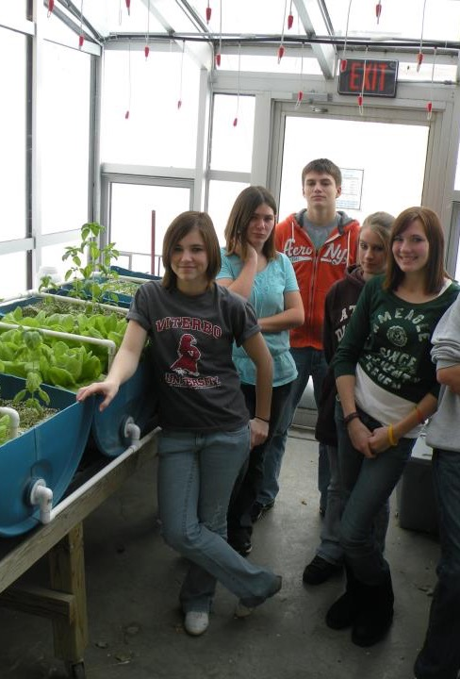
Introduction
NCR-SARE offices:
University of Minnesota
University of Missouri
Lincoln University of Missouri
photo credit: Abram Kaplan
Notes:
Welcome to this PowerPoint presentation about how to apply for an NCR-SARE Youth Educator grant. Youth Educator Grant projects provide opportunities for youth in the North Central Region to learn about Sustainable Agriculture — farming and ranching that is ecologically sound, economically viable, and socially responsible. Educators use these grants to encourage young people and their families to try sustainable practices and see Sustainable Agriculture as a viable career option. My name is Joan Benjamin. I will be walking you through the online application process. This presentation will take approximately 20 minutes.

Slide 2
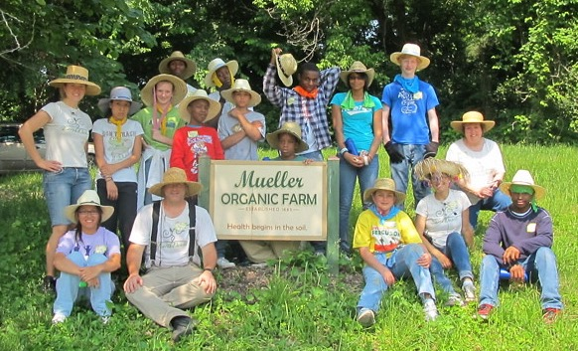
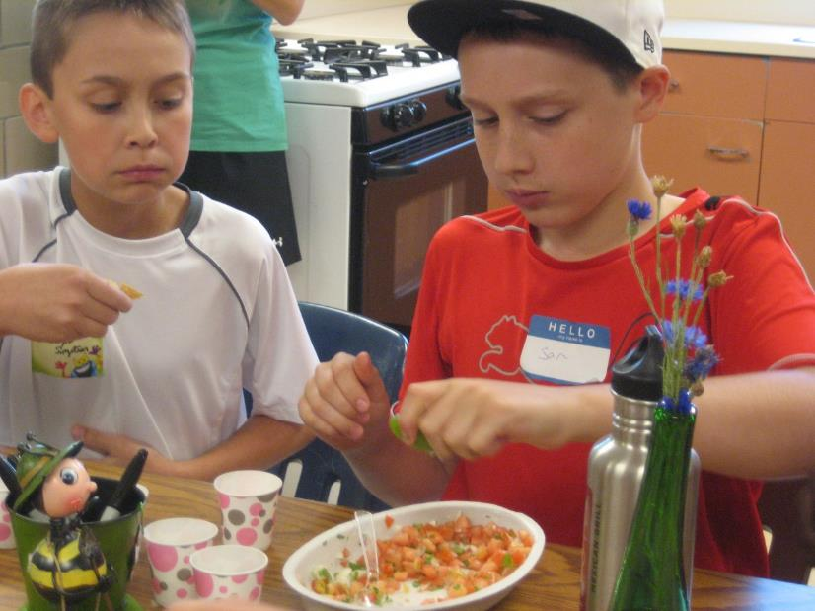
What is SARE?
Grants and outreach to advance sustainable innovations to
the whole of American agriculture.
Photo by Sean McGovern
photo credit: Abram Kaplan
Notes:
SARE is part of USDA and is funded through the National Institute of Food and Agriculture or NIFA program. SARE’s purpose is to provide grants and outreach to advance sustainable innovations to the whole of American agriculture.

Slide 3
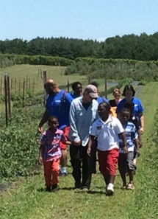
A Different Kind of Grant Program
SARE was started in 1988, conceived as a
decentralized, science-based, grassroots, practical,
problem-solving,
and inclusive
competitive grant-making and outreach program.
photo credit: Joan Benjamin
Notes:
The program is run by four regions—North Central, Northeast, South, and West, each guided by a volunteer Administrative Council that makes grants and sets regional priorities. SARE is a decentralized, grassroots grant program which means that each of the four regions makes its own funding decisions, including what type of grant programs to offer in their respective region. NCR-SARE’s proposal review teams and the governing Administrative Council include regional farmers and ranchers, educators, researchers and personnel from state and federal agencies.
We have a strong commitment to diversity. Proposals that involve farmers, ranchers, and youth from historically-underserved* populations are encouraged.
*USDA defines historically-underserved audiences to include socially-disadvantaged producers, limited-resource producers, beginning farmers/ranchers, and veterans. They further define socially-disadvantaged farmers and ranchers as belonging to the following groups: American Indians or Alaskan Natives, Asians, Blacks or African Americans, Native Hawaiians or other Pacific Islanders, Hispanics, and women.

Slide 4
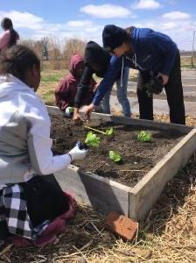
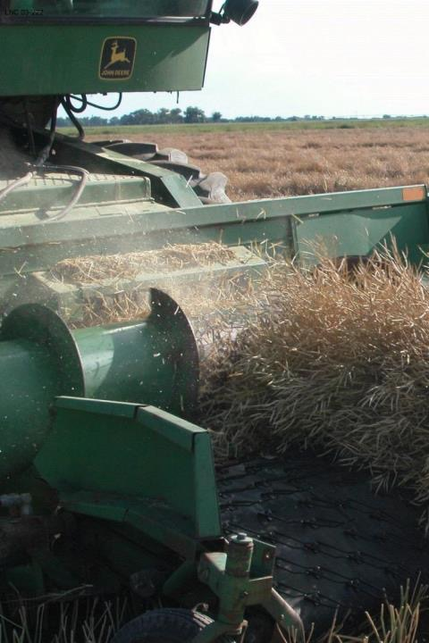
The SARE Model
The SARE Model
Four regional councils set priorities and make grants
SARE Outreach produces practical information
USDA-NIFA supports SARE
Other USDA agencies and land-grant universities are partners
photo credit: David Baltensperger
Notes:
The North Central Region of SARE consists of 12 states: Illinois, Indiana, Iowa, Kansas, Michigan, Minnesota, Missouri, Nebraska, North Dakota, Ohio, South Dakota, and Wisconsin.
National SARE Outreach staff work with SARE's regions to share grantee research results with farmers, ranchers, educators, consumers and others interested in sustainable agriculture. SARE publications cover a variety of sustainable agriculture practices and come in many formats, from books on cover crops and building soil health to bulletins on managing rangeland and water resources to online resources like Topic Rooms and videos.
SARE Outreach materials and information on all funded SARE grant projects can be found on the SARE website: https://www.sare.org/
Before writing a proposal, determine a clear project goal and explore previous research and education done on that topic. It often helps to contact NCR-SARE, local sustainable agriculture groups, the Natural Resources Conservation Service (NRCS) and/or Extension educators to share ideas and invite participation.

Slide 5
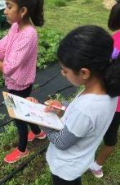
The Three Principles
The SARE Model
Successful SARE grantees are engaged in projects that are guided by the 3 principals of
_{sustainability…}
Stewardship of our nation’s land and water
Economic viability over the long term
Quality of Life for farmers, ranchers, and their communities
Photo by Jean Andreasen
photo credit: Ken Schneider
Notes:
Sustainable agriculture emphasizes the Economic, Environmental, and Social Impacts of agriculture. In your proposal, you should explain how your project addresses each of the three parts of sustainable agriculture, even if it emphasizes one part over the others.
These grants are for sustainable agriculture research, demonstration, and education projects; they are NOT for everyday expenses or start up costs.

Slide 6
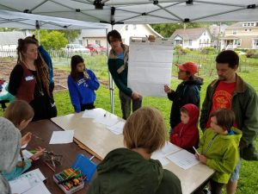
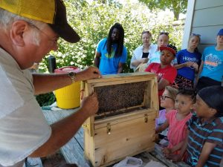
Youth Educator Grants
Grants for educators to help young people and their families understand sustainable practices and see sustainable agriculture as a viable career option
Up to $6,000 per project
Appropriate for vocational-ag teachers and other youth educators
15 projects funded per year
Coordinated by Joan Benjamin
photo credit: Nathan Papendorf
Notes:
North Central Region SARE recognizes that youth programs are a way to introduce new and exciting farming and ranching options to youth, their families, and community members.
The Youth Educator program supports opportunities for youth educators to research, demonstrate, and learn more about sustainable agriculture. Youth Education projects should help youth discover that sustainable farming and ranching is economically viable; good for families, communities, and their quality of life; and good for the environment in the long term.

Slide 7
Grant Writing Help: Each NCR-SARE State has one or more State SARE Coordinators. Find your state coordinator here.
Notes:
Go to the NCR-SARE Home page at: https://northcentral.sare.org/
Click on: SARE IN YOUR STATE

Slide 8
More Grant Writing Help: Grants Advising for Youth Educators in the Midwest
Michael Fields Agricultural Institute (MFAI) provides free Grants Advising services to youth educators applying for NCR-SARE Youth Educator Grants. MFAI Grants Advising services are also open to all Midwestern farmers, agricultural entrepreneurs and institutions. Their services include help applying to SARE and non-SARE grant programs, as well as loan, and cost-share programs of state, federal, and private sources.
For help, contact MFAI Grants Advisor, Wren Almitra at: grants@michaelfields.org or 719-318-7936.
For more information see:
http://www.michaelfields.org/grant-advising-resources/.
Notes:
Michael Fields Agricultural Institute provides free financial assistance advising to youth educators applying for NCR-SARE grants, and agricultural producers and producer groups within the 12-state region of Illinois, Indiana, Iowa, Kansas, Michigan, Minnesota, Missouri, Nebraska, North Dakota, Ohio, South Dakota and Wisconsin.
Contact MFAI Grants Advisor, Wren Almitra, at: grants@michaelfields.org or 719-318-7936. For more information see: https://www.michaelfields.org/grants-advising-resources
About Michael Fields Agricultural Institute
MFAI’s Advisors can help you apply to grant, loan, and cost-share programs of state or federal sources that could help you with specific projects to develop your agricultural, forestry or related business or answer a research question . These can be programs of any federal or state agency, not just the USDA, as well as private sources. They assist individual producers, associations of farmers, and agricultural, fishery and forestry-related businesses to both search for and apply to programs for which they are eligible.
MFAI Grants Advisors help determine what funding opportunities might be appropriate to achieve specific farm goals. They will help identify a funding program that best fits your project and outline a plan of work to meet the application deadline and all application requirements. If your goals do not align with a grant program, they may suggest other resources, such as federal, state or local loan programs, loan guarantees, conservation cost-share programs, or information resources.

Slide 9
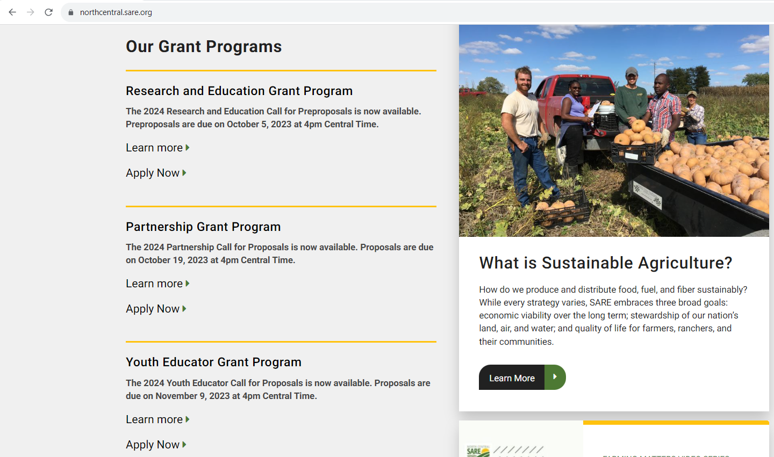
Click on “Learn more” to see the Call for Proposals. It contains important instructions.
Click on “Apply Now” when you have read the instructions and are ready to start your online grant application.
Notes:
NCR-SARE uses an online submission system to take applications. Open “calls for proposals” for the various grant programs can be found on our homepage at: https://northcentral.sare.org/.
A “Call for Proposals” is the instructions and application needed to turn in a grant proposal. Scroll down under “Our Grant Programs,” to the Youth Educator Grant Program. For details, click on “Learn more.”
Click on “Apply Now” to begin an application.
I will now walk you through the application process.

Slide 10
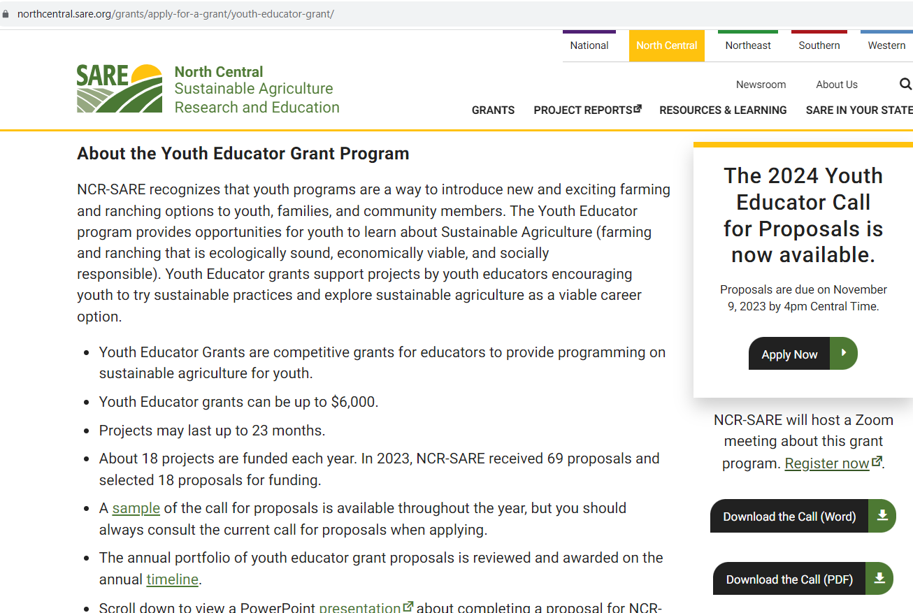
First, download the current Call for Proposals and read the instructions.
Notes:
Look over the information about Youth Educator Grants, then download and read a copy of the current Youth Educator Grant Call for Proposals (CFP). It contains directions, the application, and the link to submit your application.
Make sure you have the current call, as there are typically several changes from the previous call. If you have any problems downloading the proposal, contact the NCR-SARE office and we can email you a copy, or mail you a print copy. The online Submission Deadline is 4:00 p.m. Central Time, Thursday, November 9, 2023. If you are unable to use the online system, you may submit a proposal by mail or e-mail. Mail and e-mail submissions must be received by 4 p.m. Central Time on Thursday, November 9, 2023, at the NCR-SARE Office in Saint Paul, Minnesota. Proposals sent by Fax will NOT be accepted. They are too hard to read.

Slide 11
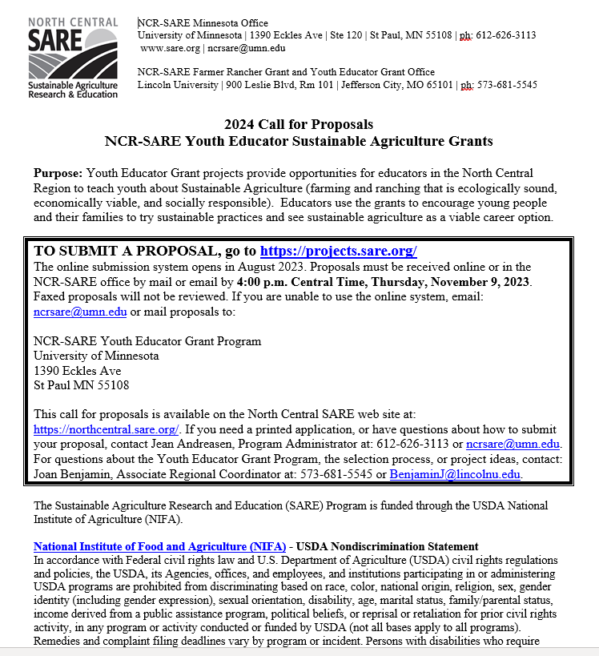
Read the Call for Proposals before starting a grant application. It contains instructions and helpful tips.
Notes:
Whenever you apply for a grant, be sure to read the Call for Proposals first. It contains directions and the application and can help you determine if the grant is a good match for you.
At the top of the Youth Educator Grant Call for Proposals, you will see the link to use to submit a proposal. Or you can click on the “Apply Now” button on the NCR-SARE homepage.

Slide 12
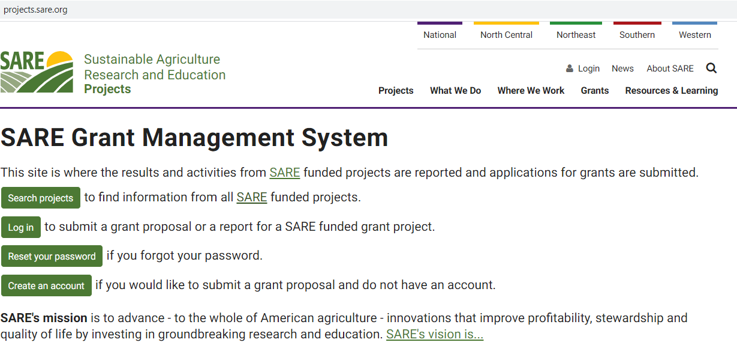
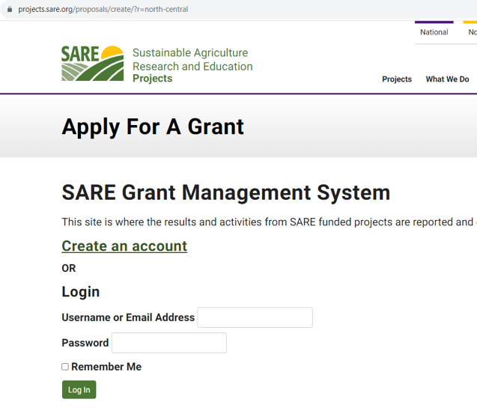
If you are new to the SARE Grant Management System, click on “Create an account” to get started. You can do this on the project.sare.org homepage, or by clicking on “Apply Now.”
Notes:
When you click on the link in the Call for proposals (https://projects.sare.org/), you will see the “SARE Grant Management System” page.
If you click on “Apply Now,” you will see a similar page shown in the inset, with the title, “Apply For A Grant.” You can start your application from either page. If you’ve never had a SARE grant before, you will first need to create an account and complete your user profile. Click on “Create an account.” If you’ve had a SARE grant before and filed reports in this system, your profile will already be in the system, and you can “Log in” with the information you used for reporting. I’ll now guide you through using the online application system.

Slide 13
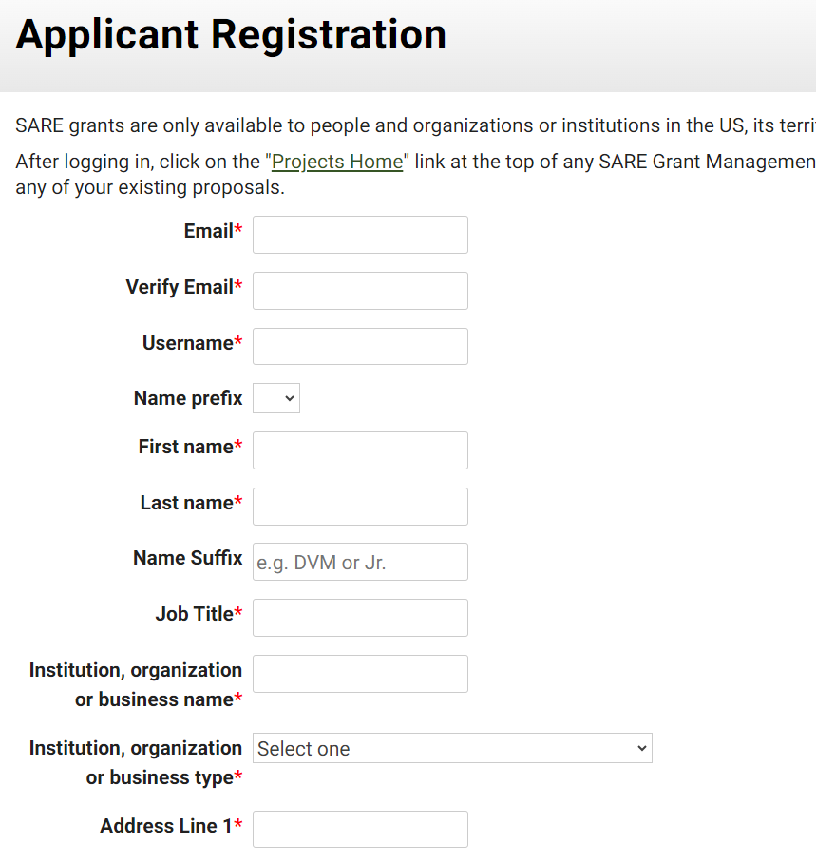
Fill in the Applicant Registration information, then click on “Register.” The email you list is where we will send notifications from the SARE system.
Notes:
To “Create an account,” complete the requested information, then click on “Register” in the lower left-hand side of the webpage. Information about your application will be sent to the email address you provide here. We also request demographic information. The North Central Region SARE program is committed to an ethic of openness, inclusiveness, and diversity in all its programs, policies, and procedures. To monitor our performance in these areas, we collect demographic information. We appreciate your help with this.
Demographic information is not linked to your proposal. You must answer the demographic questions, but you may choose “prefer to not answer” for each question. If you have questions, please contact Joan Benjamin at BenjaminJ@lincolnu.edu or 573-681-5545.

Slide 14
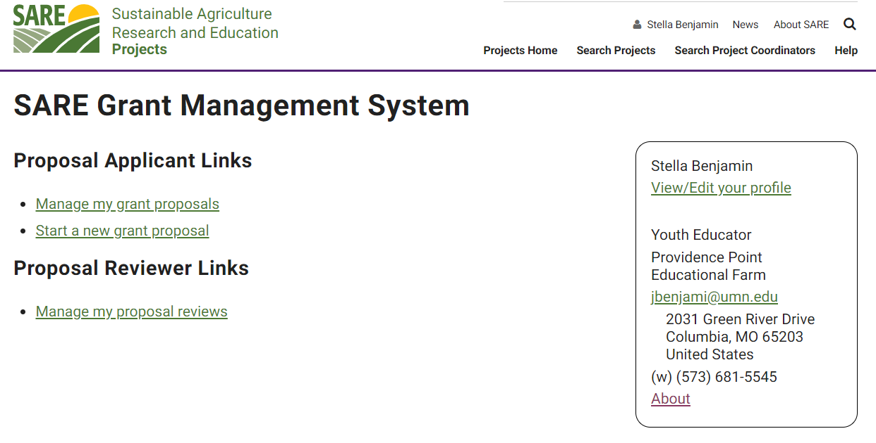
When you have created an account, log in and click on “Start a new grant proposal.”
Notes:
Once you have completed the information and logged into the system, you’ll see this screen.
Click on “Start a new grant proposal” or “Manage my grant proposals” (if you have already started a proposal).”
If you’ve submitted proposals before, or had a project funded before, you’ll see them listed on this page.

Slide 15
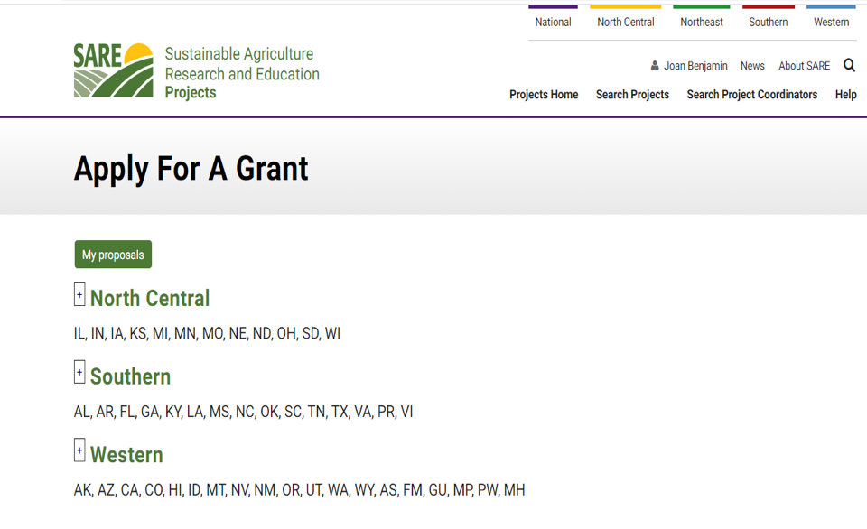
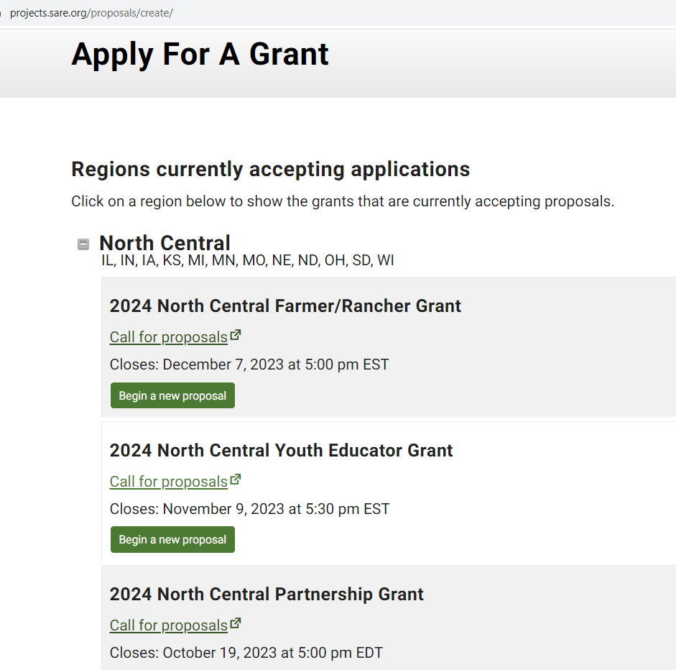
Click on the “North Central” region then choose the North Central Youth Educator Grant. Click on “Begin a new proposal.”
Notes:
You will see a list of all open grant applications, for all four SARE regions. Choose the North Central Region by clicking on the plus sign (+). Then choose the correct grant program. You will be completing the North Central Youth Educator Grant application.
Click on “Begin a new proposal.”

Slide 16
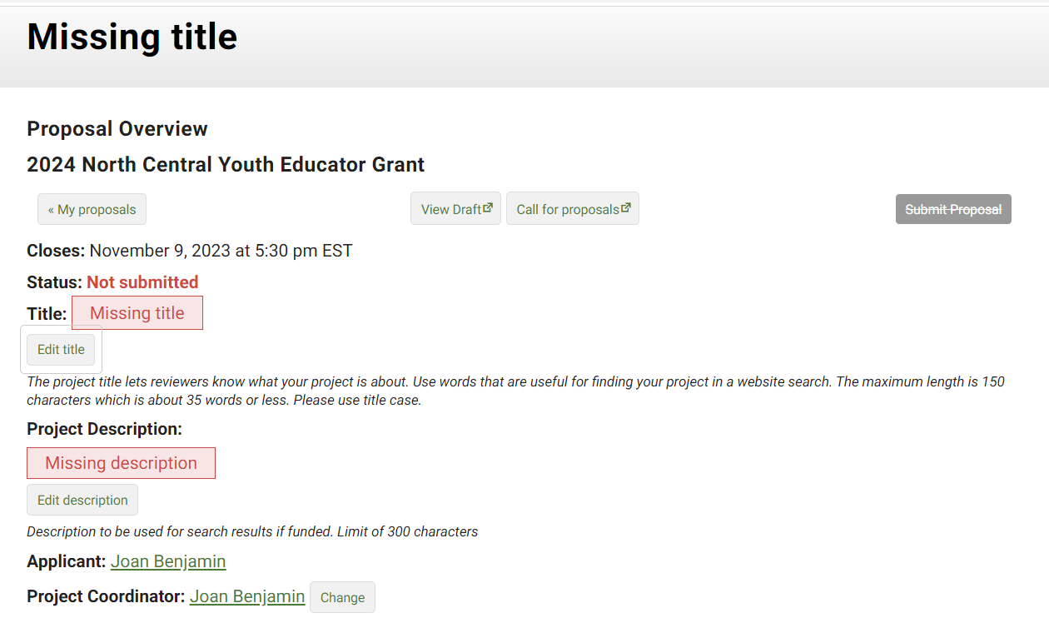
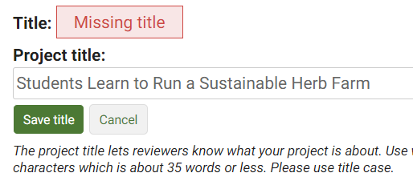
Click on “Edit” to open a box where you can add a title, and description. Click “Save” after each addition.
Notes:
The first items that must be completed are marked as “Missing.” For example, “Missing title” or “Missing description.” Click on “Edit title,” then type in the title of your proposal in the space provided. This lets reviewers know what your project is about – be descriptive but not too wordy. Use key words that are useful for finding your project in a website search. Limit the title to 150 characters or less including spaces (this is about 25 words). Click on “Save title” to save your title. Note that throughout the application, you must click on “Save” after every entry to save the information you’ve entered.
Click on “Edit title” again to change your answer.

Slide 17
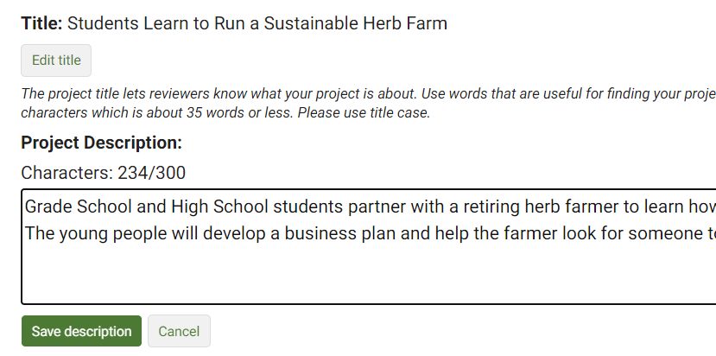
The system shows you how many characters or words you have used and how many are allowed. In this example, 234 characters have been used and up to 300 are allowed.
Click on “Save” to save your work.
Notes:
To fill in the Project Description, click on “Edit description” and provide a brief proposal description of 300 characters or less—including spaces, which is about 35 words. For most answers with a character or word limit, the system tracks the entry so that you know when you’re running out of room. Click on “Save description” to save the text you entered.

Slide 18
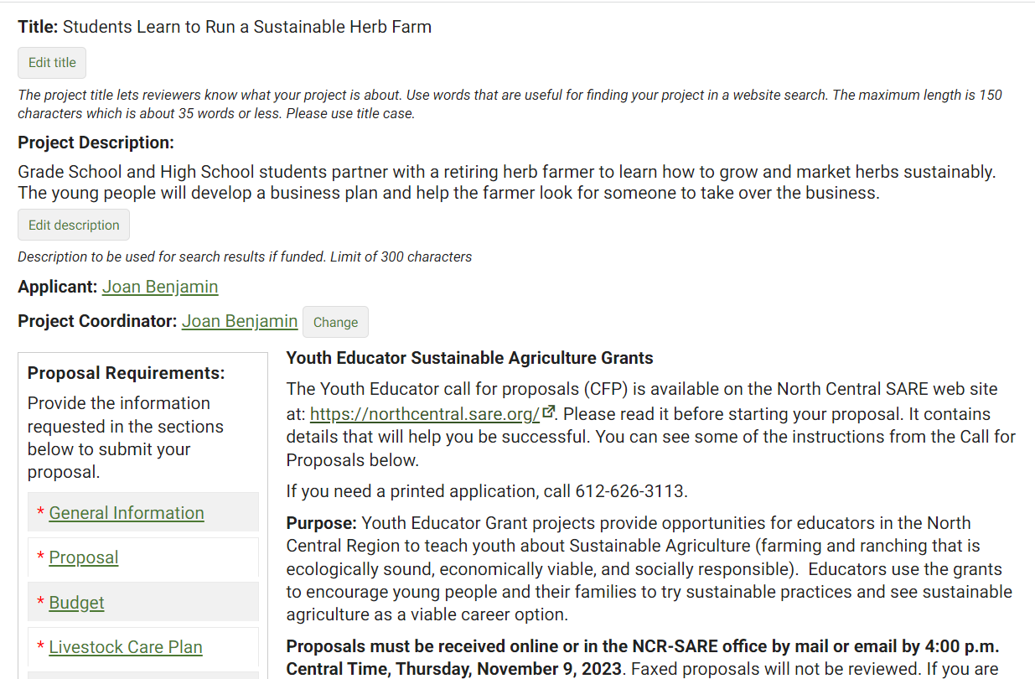
Complete the Proposal Requirements by filling out each required section. Start with “General Information.”
Notes:
You’re ready to move to the first section of the application, “General Information.” Click on “General Information” to answer the questions in that section.

Slide 19
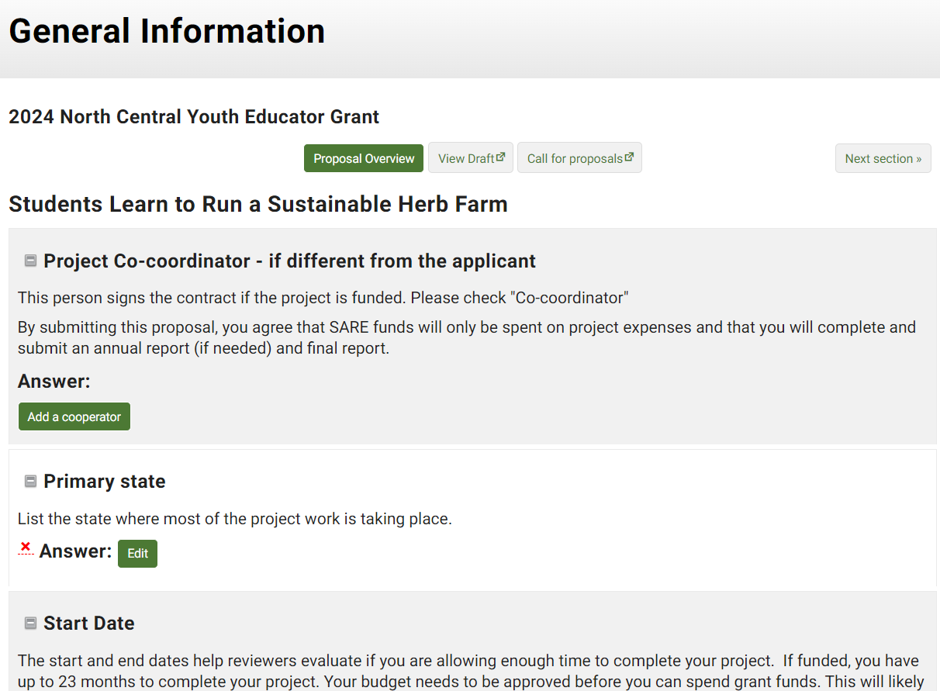
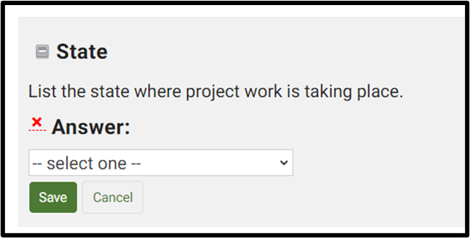
Add project co-coordinators, if there are any, by clicking on “Add a cooperator.” Fill in their contact information, then click on “Save.”
Next, click on “Edit” by each question in this section, answer the question and click “Save” before moving to the next question.
Some questions have a dropdown list to choose from.
Notes:
Add Project Co-coordinators, if there are any, by clicking on “Add a cooperator.” Complete the contact information for Project Co-coordinators or cooperators. Include their email addresses so we can send them a link to confirm their participation. Then click on “Save.”
Next, click on the “Edit” button next to each question and enter your answers. Some boxes give you a list to choose from. For example, when you click on “Edit” to fill in the state where the project work is taking place, you will see “select one” which means there is a drop-down menu that that will appear when you click on the “down” indicator. Be sure to click on “Save” after you answer each question.

Slide 20
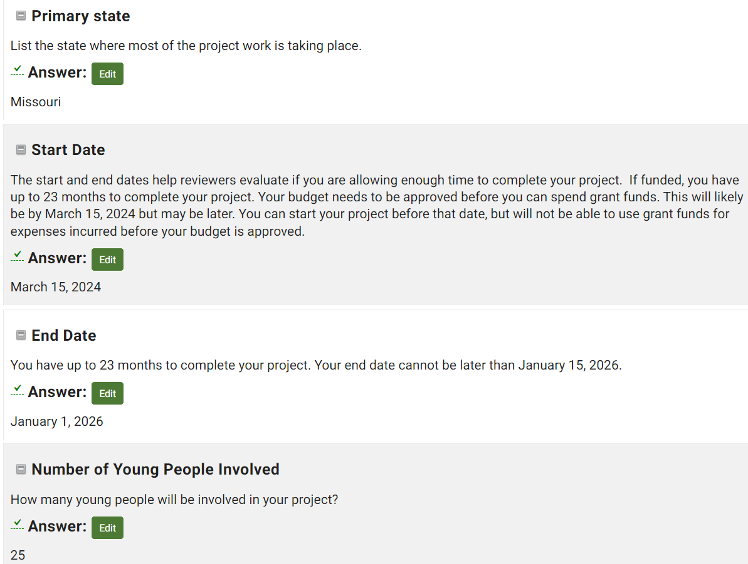
When you complete and save an answer, a green check mark will appear to let you know that question is done.
Notes:
Once you have completed and saved an answer, a green check mark appears next to that question. To change your answer, click on “Edit,” change your answer, and click on “Save.”

Slide 21
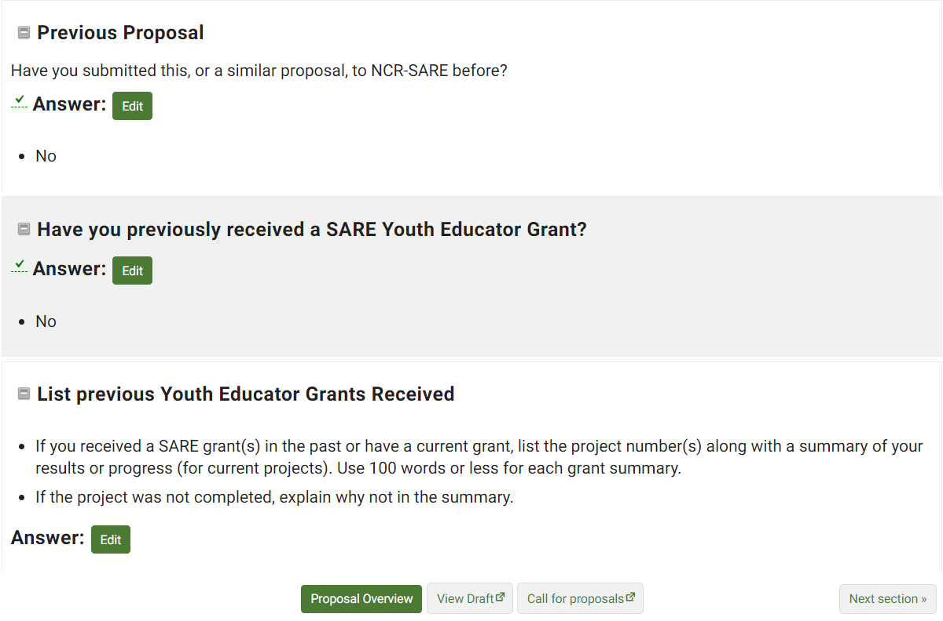
When you complete a section, click on “Next Section” to continue, or click on “Proposal Overview” to see which sections still need to be completed.
Notes:
Once you have answered the questions and saved all information in the “General Information” section, click on “Next Section” to move to the next set of questions, or click on “Proposal Overview” to see which sections are yet to be completed. These options are available at the top and bottom of the web page. You can also click on “View Draft” to see how your proposal looks so far, or “Call for Proposals,” if you want to review instructions.

Slide 22
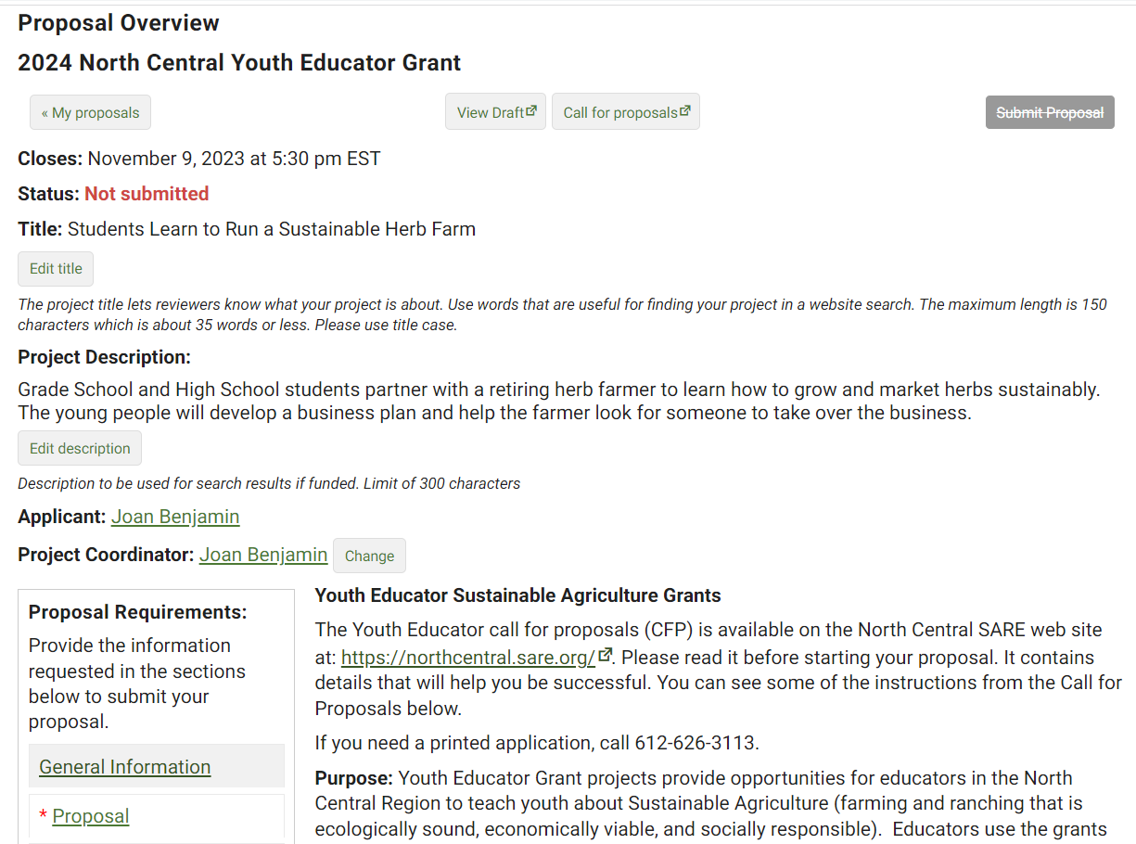
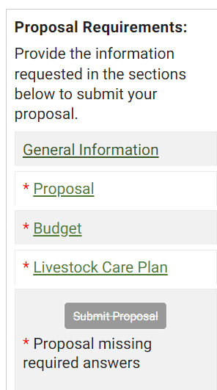
In the Proposal Overview, you will see that sections that have not been completed yet have a red asterisk (*) beside them.
Notes:
If you return to “Proposal Overview,” you will see which sections are completed and which still need to be filled out. Sections that have not been completed have a red asterisk (*) beside them. Click on the next section, which is “Proposal” in this example, and complete that section.
Sections that are completed will not have a red asterisk beside the section heading, like “General Information” in this example.

Slide 23
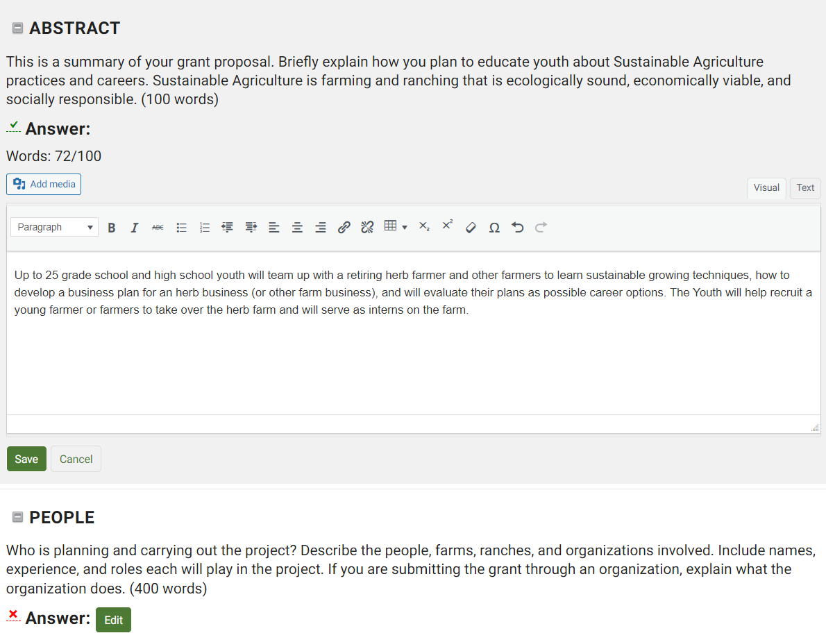
Notes:
Answer each question in the “Proposal” section. The system will show you how many words you have used so you don’t go over the limit. In this example, 72 out of 100 words have been used.
Be sure to save your answers.

Slide 24
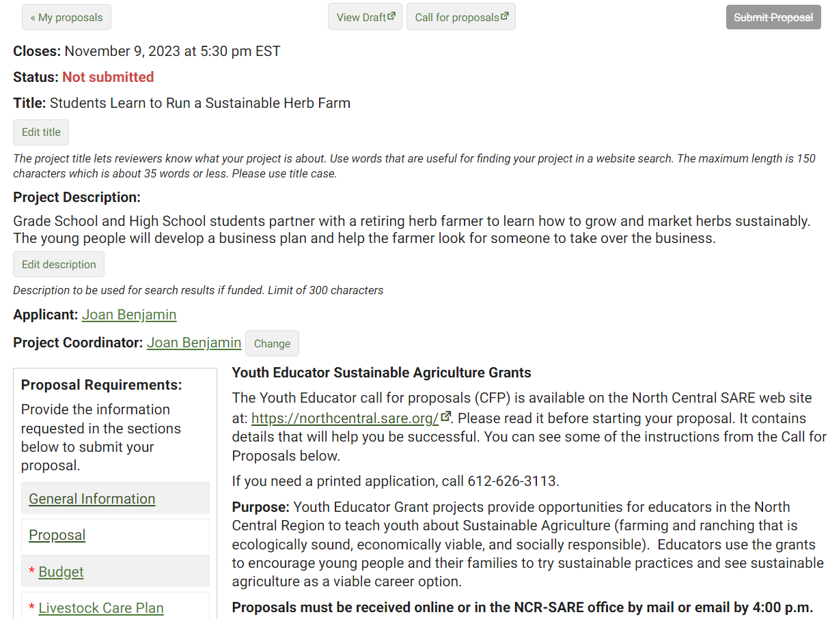
Click on “View Draft” any time you want to see what your proposal looks like, or if you want to share your work with collaborators.
In the “Proposal Overview,” the sections that still need to be filled out have red asterisks beside them. Those that are successfully completed have no asterisk.
Notes:
Return to the Proposal Overview. You’ll see that you’ve successfully completed and saved all required information in the first two sections. The red asterisks (*) are gone.
You can view a draft of your proposal by clicking on “View Draft.” When you click on “View Draft” you will also be provided with a link to the draft that you can share with collaborators.

Slide 25
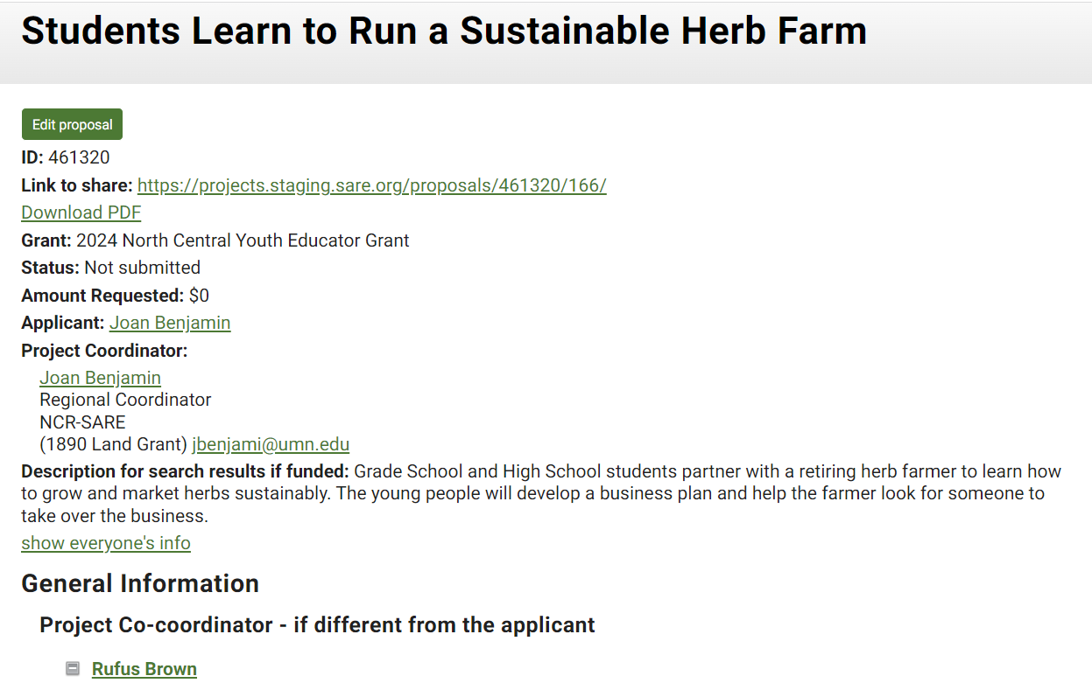
This is the draft. You can share the link with your collaborators or click on “Download PDF” to print the draft.
To return to your proposal, close the “draft” window or click on “Edit Proposal.”
Notes:
When you click on “View Draft”, a new window opens where you can see your draft proposal. Copy the “Link to share” to send to people you are working with so they can see and review the same draft.
To print a copy of your proposal draft, click on “Download PDF,” then print. To return to your proposal, close the draft window or click on “Edit Proposal.”

Slide 26
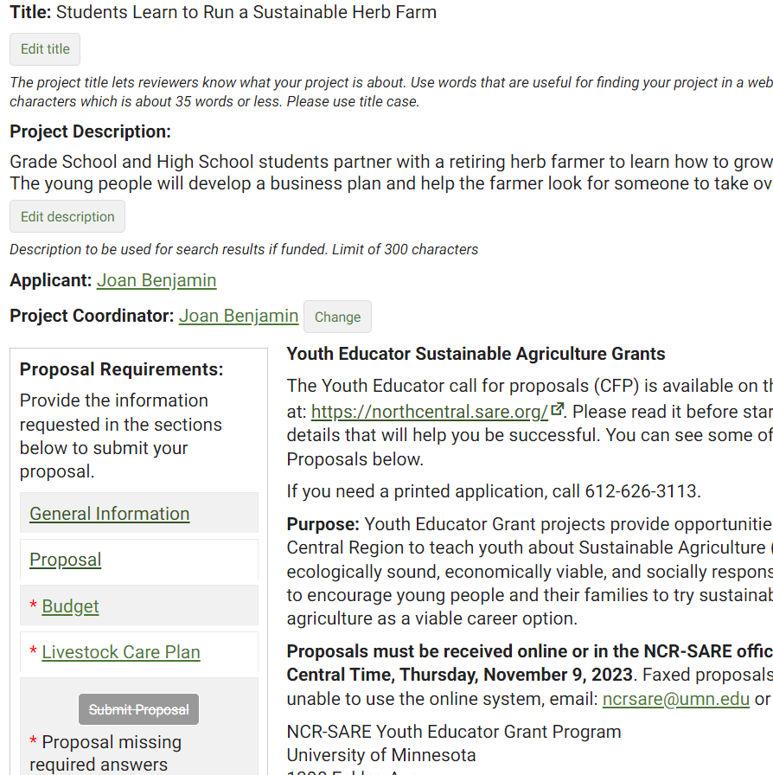
Next you will enter your budget information.
Notes:
You are now ready to complete the budget section. Click on “Budget.”

Slide 27
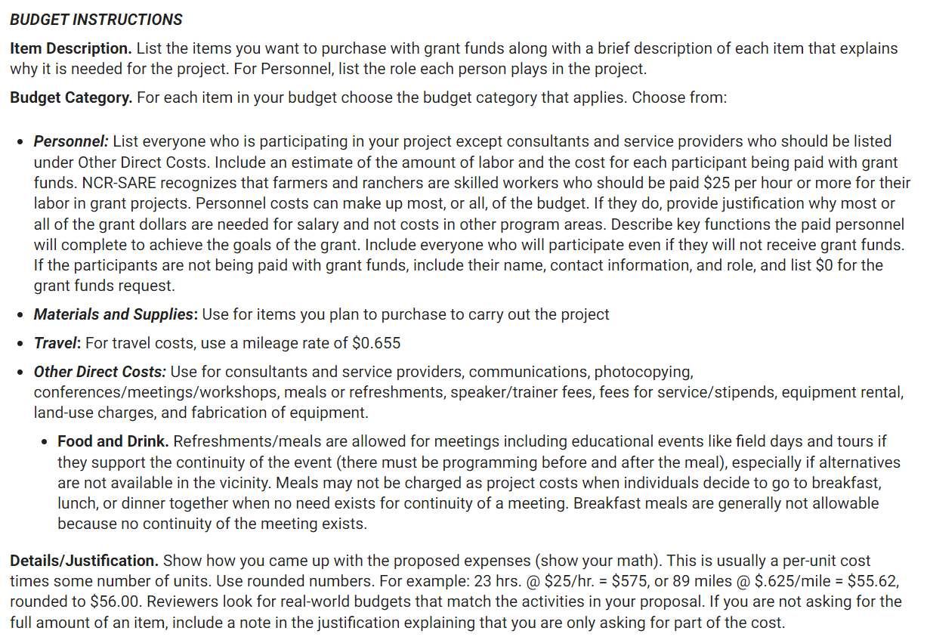
Read the budget instructions, then click on “Add a budget item” to enter each item of your budget. Be sure to save your work.
Notes:
Read the Budget instructions in the Call for Proposals, then enter each item of your budget by clicking on “Add a Budget Item.”
Your budget items should match the materials and labor described in your grant proposal.
Reviewers look for realistic budgets. Use the real cost of items rather than estimates. Look up budget items on the Internet or call suppliers to find out costs.

Slide 28
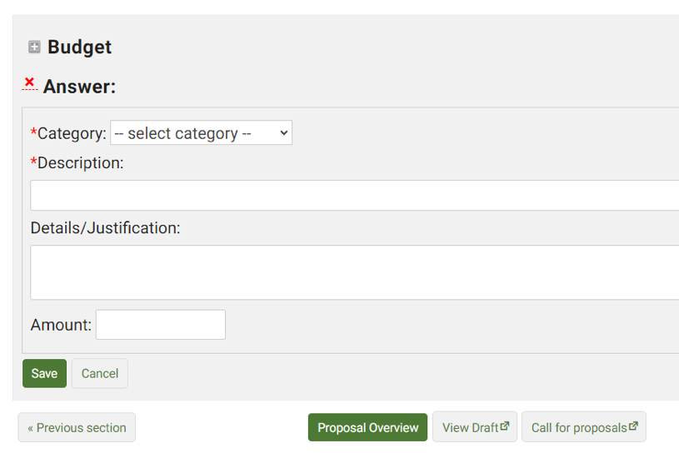
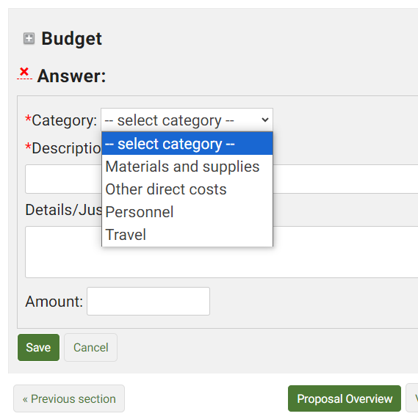
When you click on “Add a budget item,” a new window will open where you can select the budget category from a drop-down menu.
Notes:
Click on “Add a budget item” then click on the down arrow under “Budget Category” to open the drop-down menu of budget categories. Chose the category for the item you want to add.

Slide 29
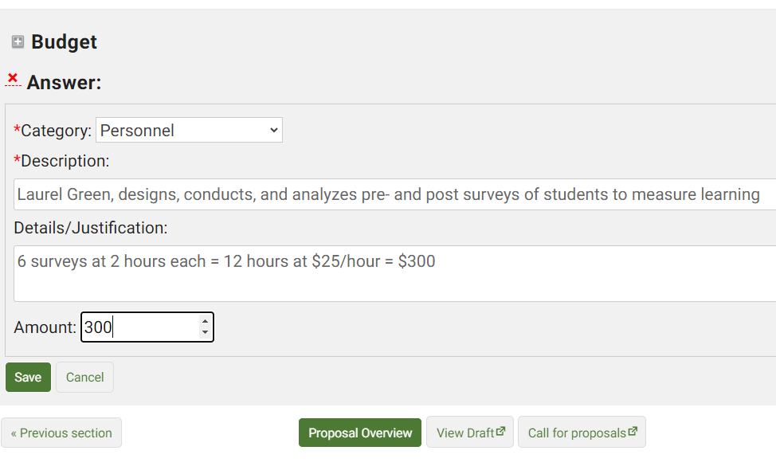
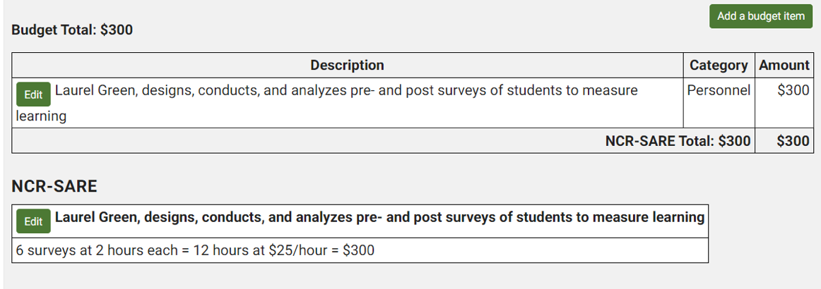
After you select the “Budget Category,” fill in the “Description.” Then, under “Details/Justification,” show how you came up with the amount for that item (show your math). Fill in the “Amount” you want the grant to cover for that item. When you click on “Save” the item appears as shown above.
Saved Budget Item
Notes:
Complete the item “Description.” Under “Details/Justification,” show how you calculated the total cost for that item (show your math). You can add keep adding budget items by clicking on “Add a budget item.” Be sure to click on the “Save” button to save your entries.

Slide 30
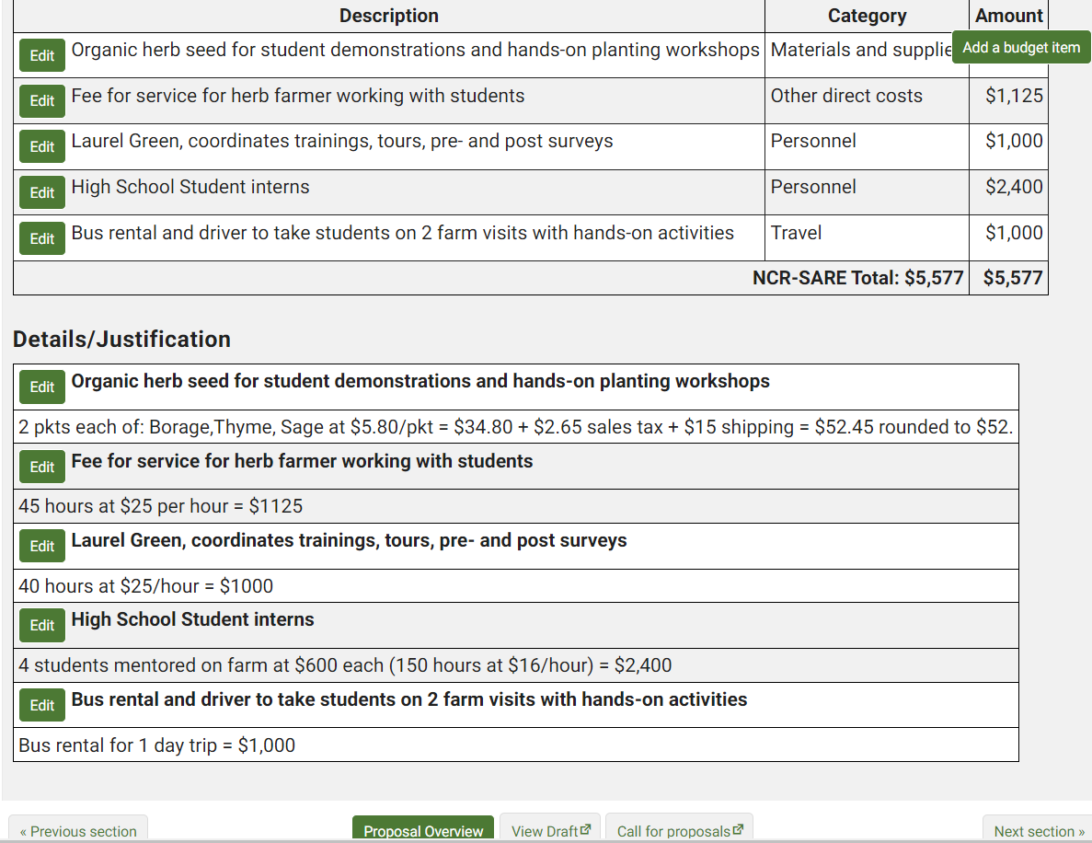
This sample budget shows the Description for each budget item being requested, and the Details/Justification (math) for how you came up with the Amount for each item.
Click on “Next section” or “Proposal Overview” when you are ready to move to the next section.
Notes:
Here is a sample budget. Once you’ve entered all your items and clicked on “Save,” scroll to the top or bottom of the webpage and click on “Proposal Overview” or “Next section.”

Slide 31
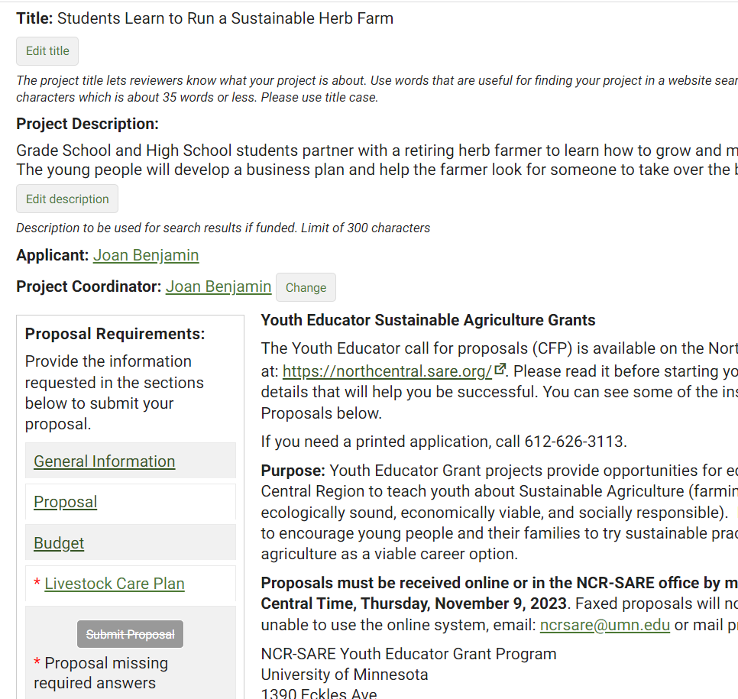
To complete your proposal, click on the “Livestock Care Plan.” All applicants must answer the 1st question. Only those with livestock projects will complete the rest of the form.
Notes:
Once you’ve completed the three required sections, go to the Livestock Care Plan section.
If your project does not involve livestock, open the Livestock Care Plan form and answer “No” to the first question which is: Does your project involve livestock? Click on “Save,” then click on “Proposal Overview.”
If your project does involve livestock, be sure to answer the questions in the Livestock Care Plan form and click on “Save.” Then click on “Proposal Overview.”

Slide 32
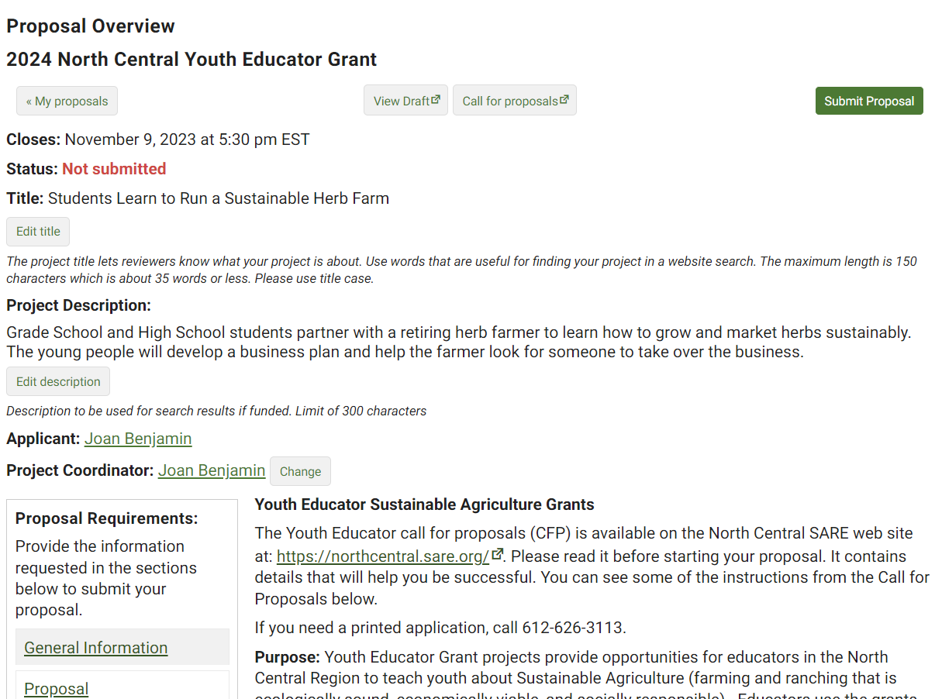
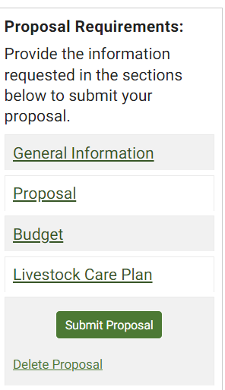
When all the Proposal Requirements are completed, you can click on “Submit Proposal.” It’s a good idea to review your draft before submitting the proposal.
Notes:
Once you’ve completed all required sections, you can submit the proposal. It’s a good idea to click on “View Draft” to review your proposal before you submit it. When you are satisfied with how you have answered the questions, click on “Submit Proposal”.

Slide 33
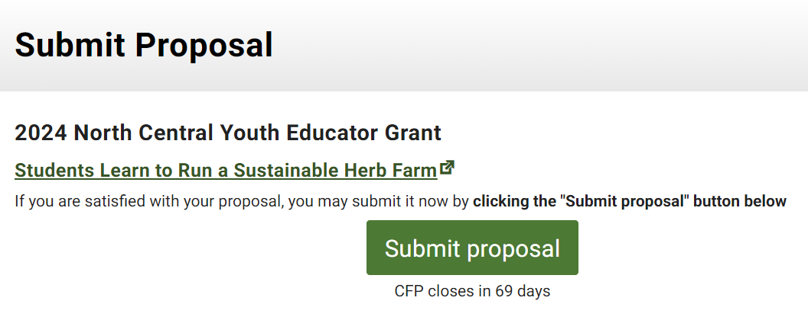
If you are satisfied with your proposal, click “Submit proposal” on this confirmation page. In this system, you can unsubmit your proposal and make corrections BEFORE the close date. If you unsubmit, you must re-submit your proposal before the application deadline.
Notes:
When you click on “Submit Proposal,” you will see another page with a button to “Submit proposal.” This is a safeguard to make sure you are ready to submit. Click on “Submit proposal” to complete your application. You can“unsubmit” and make changes prior to the closing date for the grant program.

Slide 34
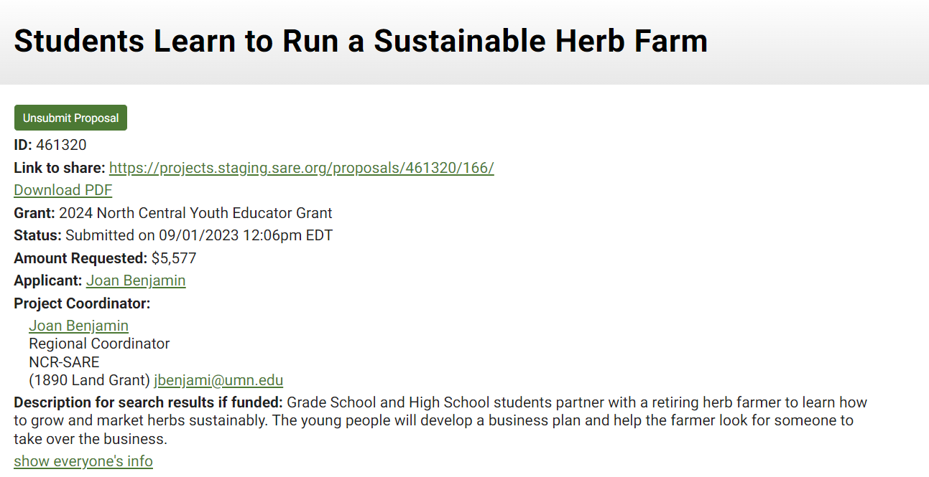
You will see this web page, confirming your submission. You will also receive an email from the SARE system confirming your submission.
If you need to make changes, you can unsubmit and make corrections. You must resubmit before the grant application close date.
To unsubmit, click on “Unsubmit Proposal.” To review or print a copy of your proposal, click on “Download PDF.”
Notes:
After you submit your proposal, you will see this confirmation page. Note that in this system, you can Unsubmit and make changes PRIOR to the closing date for the grant program. Make sure you resubmit by the closing date and time, or your proposal will not be considered for funding.
Once your proposal is submitted, you can click on “Unsubmit Proposal” to unsubmit your proposal or “Download PDF” to review or print your application.

Slide 35
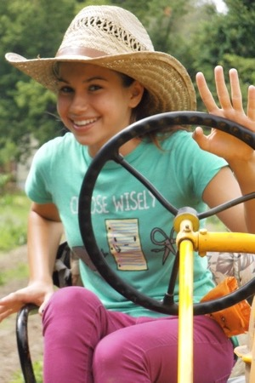
Good luck with your proposal!
If you have questions, contact Joan Benjamin at:
573-681-5545
or
benjaminj@lincolnu.edu
https://northcentral.sare.org/
Follow @NCRSARE on social media:
photo credit: Joan Benjamin
Notes:
Congratulations! You have now successfully submitted your Youth Educator Grant Proposal. A committee of farmers, ranchers, educators, researchers, and others with an interest in youth education will review the proposals and make funding recommendations to the NCR-SARE Administrative Council. The Administrative Council members make the final funding decisions. Awards will be announced by the end of February 2024. Good luck with your proposal. If you have any questions, contact NCR-SARE.
On the web: http://www.northcentral.sare.org/
On Facebook: https://www.facebook.com/NCRSARE
On Twitter: https://twitter.com/ncrsare
On Instagram: https://www.instagram.com/ncrsare
On YouTube: http://www.youtube.com/user/NCRSAREvideo

