Slide 1
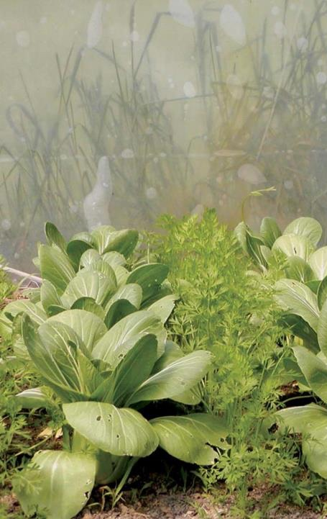

Introduction
NCR-SARE offices:
University of Minnesota
University of Missouri
Lincoln University in Missouri
Find this PowerPoint presentation at:
https://northcentral.sare.org/grants/apply-for-a-grant/farmer-rancher-grant/
photo credit: Abram Kaplan
Notes:
Welcome to this PowerPoint presentation about how to apply for an NCR-SARE Farmer Rancher grant.
The Farmer Rancher grant program is a competitive grant program to fund on-farm research and education projects in the North Central region. The grants are intended to help you solve a problem on the farm or ranch using innovative sustainable agriculture practices and to help you share your project results with others.
My name is Joan Benjamin and I coordinate the NCR-SARE Farmer Rancher Grant program. I will tell you briefly about the SARE program, I’ll go over a few grant-writing basics, then will give you specifics about the Farmer Rancher grant and the online application process. This PowerPoint is available on the NCR-SARE website at: https://northcentral.sare.org/grants/apply-for-a-grant/farmer-rancher-grant/

Slide 2
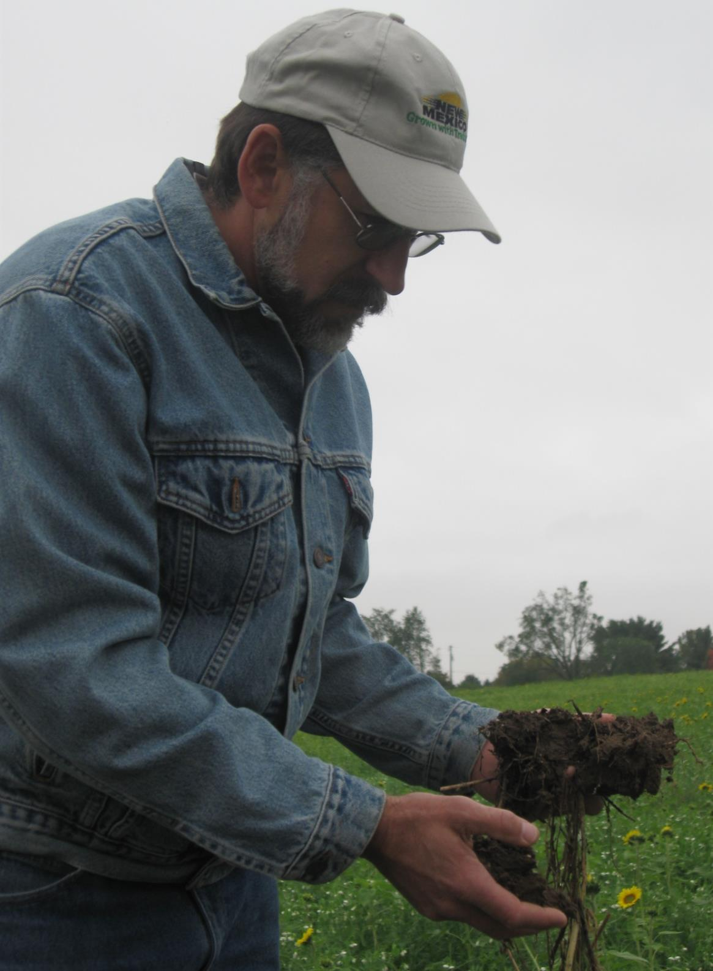

What is SARE?
Grants and outreach to advance sustainable innovations to
the whole of American agriculture.
Photo by Sean McGovern
photo credit: Abram Kaplan
Notes:
SARE is part of USDA and is funded through the National Institute of Food and Agriculture or NIFA program.
SARE’s purpose is to provide grants and outreach to advance sustainable innovations to the whole of American agriculture.

Slide 3
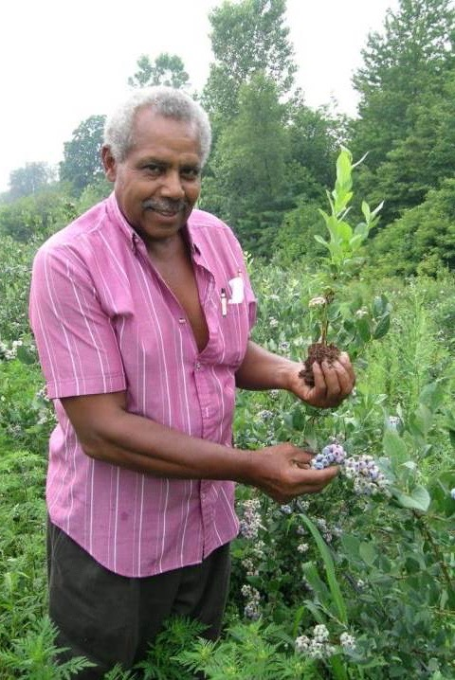

A Different
Kind of
Grant Program
SARE was started in 1988, conceived as a
decentralized, science-based, grassroots, practical,
problem-solving,
and inclusive
competitive grant-making and outreach program.
photo credit: Joan Benjamin
Notes:
The program is run by four regions—North Central, Northeast, South, and West, each guided by a volunteer Administrative Council that makes grants and sets regional priorities. SARE is a decentralized, grassroots grant program which means that each of the four regions makes its own funding decisions, including what type of grant programs to offer in their respective region.
NCR-SARE’s proposal review teams and the governing Administrative Council include farmers and ranchers, educators, researchers and personnel from state and federal agencies.
The Farmer Rancher Grant Review committee is made up mostly of farmers and ranchers representing all 12 states in the North Central Region. When you write a Farmer Rancher Grant, this is the audience you are addressing: farmers and ranchers from the North Central Region. They are interested in practical proposals and accurate budgets.
We have a strong commitment to diversity. Proposals that involve farmers, ranchers, or youth from historically-underserved* populations are encouraged. *USDA defines historically-underserved audiences to include socially-disadvantaged producers, limited-resource producers, beginning farmers/ranchers, and veterans. They further define socially-disadvantaged farmers and ranchers as belonging to the following groups: American Indians or Alaskan Natives, Asians, Blacks or African Americans, Native Hawaiians or other Pacific Islanders, Hispanics, and women.

Slide 4
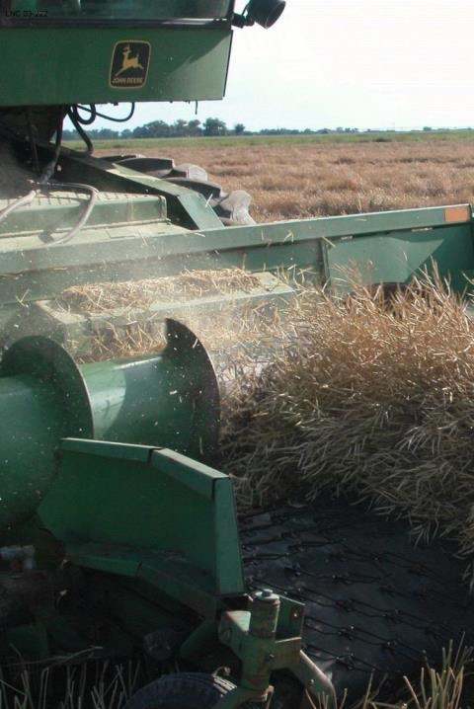
The SARE Model
The SARE Model
Four regional councils set priorities and make grants
SARE Outreach produces practical information
USDA-NIFA supports SARE
Other USDA agencies and land-grant universities are partners
photo credit: David Baltensperger
Notes:
The North Central Region of SARE consists of 12 states: Illinois, Indiana, Iowa, Kansas, Michigan, Minnesota, Missouri, Nebraska, North Dakota, Ohio, South Dakota, and Wisconsin.
SARE Outreach is the national outreach group for SARE. They work with SARE's regions to share grantee research results with farmers, ranchers, educators, consumers and others interested in sustainable agriculture. SARE publications cover a wide variety of sustainable agriculture topics in many formats, from books on cover crops and building soil health to bulletins on managing rangeland and water resources to online resources like YouTube videos and Topic Rooms that cover subjects such as high tunnels and small ruminants.
SARE Outreach materials and information on all funded SARE grant projects can be found on the SARE website: www.sare.org
Most resources are free to download and print bulletins can also be ordered for free.
Look at the Project Reports tab on the NCR-SARE website to see reports from funded projects at: https://northcentral.sare.org/project-reports/
When you first start thinking about your grant idea, check the SARE project reports and other resources to see how you can build on previous work instead of repeating it. This will make your grant proposal more competitive.

Slide 5
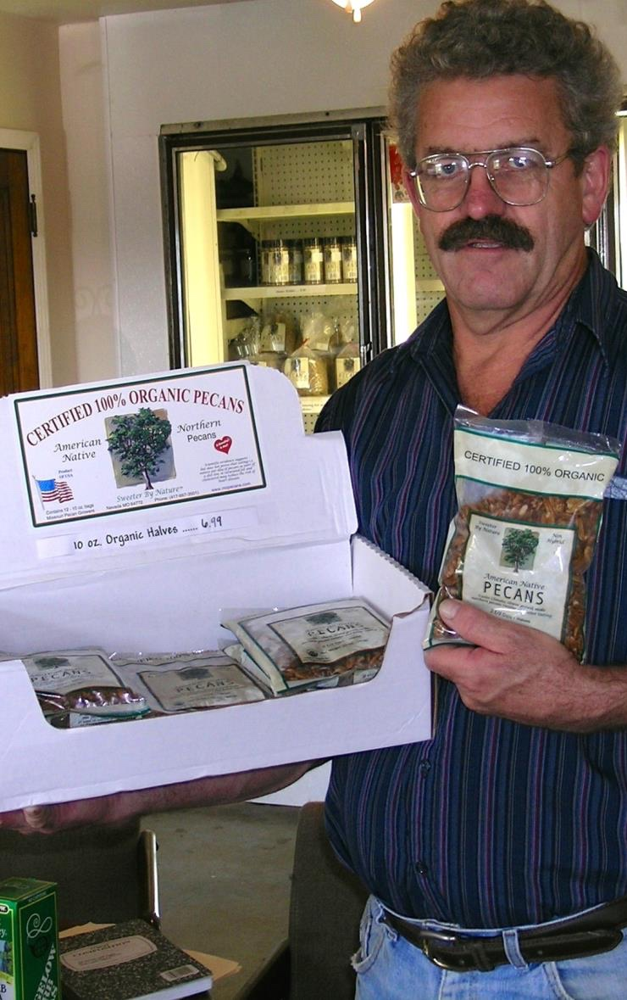
The Three Principles
The SARE Model
  Successful SARE grantees have projects that are guided by the 3 principals of
  _{sustainability…}
Stewardship of our nation’s land and water
Economic viability over the long term
Quality of Life for farmers, ranchers, and their communities
photo credit: Ken Schneider
Notes:
Sustainable agriculture emphasizes the Economic, Environmental, and Social Impacts of agriculture. In your proposal, you should explain how your project addresses each of the three parts of sustainable agriculture, even if it emphasizes one part over the others.
Simply put, Sustainable Agriculture is:
Ecologically sound
Economically viable
Socially responsible
Or to put it another way, it involves:
Sustaining and improving the environmental quality and natural resource base on which agriculture depends
Improving the economic viability of farmers/ranchers and associated agricultural businesses
Enhancing the quality of life for farmers/ranchers, communities, and society as a whole

Slide 6
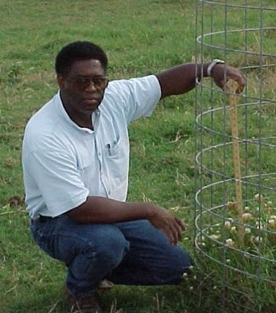
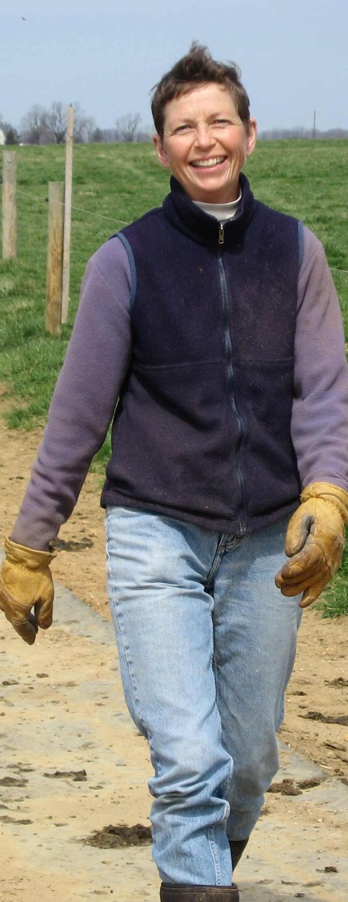
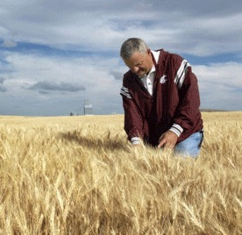
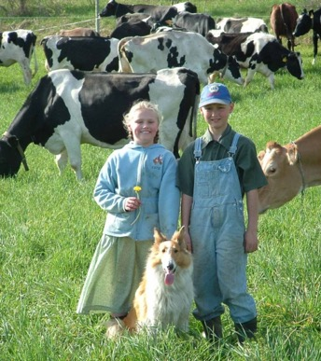
Stakeholder Involvement
Stakeholder Involvement
Exploring problems identified by farmers and ranchers
Farmers and ranchers are involved in research
and outreach
Photo by Beth Nelson
Notes:
As in all successful SARE projects, farmers and ranchers are considered major stakeholders in the project’s research, demonstration and outreach process.
Applicants for the Farmer Rancher Grant Program must identify specific problems and potential solutions to those problems.
This grant program is for sustainable agriculture research or demonstration and education projects; NOT for start up costs or everyday farming expenses except those directly related to the project.
Projects that involve whole farm systems research and education are encouraged.
Livestock projects need to comply with reasonable animal care requirements to ensure that animals are properly cared for.
Projects that include a youth component are also welcome and encouraged.

Slide 7
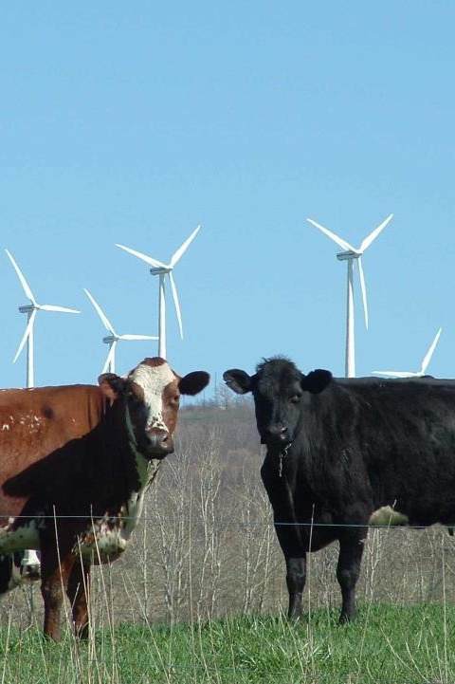
The SARE Portfolio
The SARE Portfolio
Sustainable pest/weed management
Clean energy
Marketing
Food Sovereignty
Stewardship of land and water
Systems research
Community development
Crop diversification
Soil quality
Nutrient management
Rotational grazing
…and much more
Photo by Troy Bishopp
Notes:
Since 1992, NCR-SARE has awarded over $10.5 million to fund farmer and rancher research and education through the Farmer Rancher Grant Program. Past Farmer Rancher award recipients have been given grants to studying topics such as:
Agroecology; Agroforestry
Alternative Grains as Animal Feed
Beneficial Insects, Pollinator Habitat
Cover Crops; Crop/Landscape Diversity
Educating/Mentoring New Farmers/Ranchers
Farmland Access
Food Sovereignty
Holistic Farming & Ranching
Integrated Pest Management (IPM)
Labor Needs and Issues
Organic Agriculture; Permaculture
Poultry, Small-Scale Livestock
Proactive Weed Management
Quality of Life Issues for Family/Community
Regenerative Agriculture
Renewable Energy
Managed Grazing; Soil Health
Value-Added & Direct Marketing
Water Quality Improvement/Wetlands

Slide 8
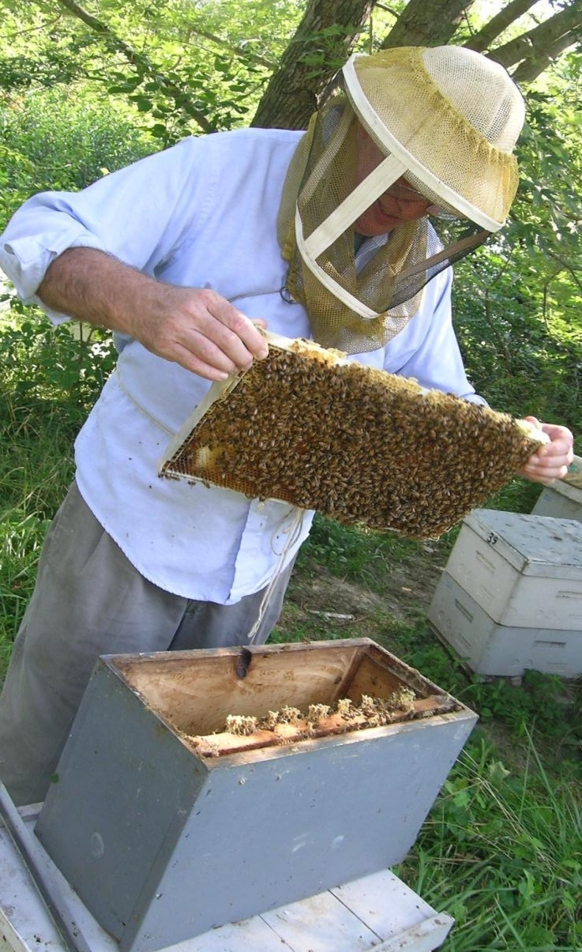
Farmer Rancher
Grant Program
Grants directly fund farmers and ranchers who are looking for innovative sustainable agriculture solutions to production or marketing problems on the farm or ranch
Up to $15,000 for an Individual farmer or rancher and up to $30,000 for Teams (two or more farmers or ranchers)
Applicants are encouraged to work with university or non-profit partners
About 40 projects funded per year
Coordinated by Joan Benjamin
photo credit: Joan Benjamin
Notes:
Any farmer or rancher or group of farmers or ranchers who farm or operate a ranch in the North Central Region may apply. For this program, a farmer or rancher is defined as someone who raises crops or livestock, especially as a business.
Applicants may be just beginning the transition to a more sustainable operation or may already be using some sustainable practices and want to make additional changes. The grants help reduce the risk of trying out new ideas. These grants do not require matching funds.
Farmers and Ranchers are invited to submit proposals that test, evaluate, and adapt sustainable agriculture practices for their operations; to conduct learning circles, educational events, field days or demonstrations to further disseminate information to other farmers and ranchers; develop new technologies; or create or modify equipment. If you’ve never applied for a grant before, this is a good one to start with.
I am the Farmer Rancher Grant Coordinator for the North Central region and I’m located at Lincoln University in Jefferson City, Missouri. Most of our staff is located at the University of Minnesota in St. Paul.
Feel free to contact me with specific questions regarding the Farmer Rancher Grant.

Slide 9
Grant Writing Basics: top ten tips
Determine if this is the right grant for you. Make sure your idea fits program priorities.
Read the Call for Proposals carefully. Highlight important points & deadlines.
Plan ahead on how to accomplish your project. Think about the details before you fill out the proposal.
Keep the writing simple and explain terms. A grant proposal is not a mystery novel - get to the point quickly, concisely, logically.
Notes:
Make sure your idea fits the grant priorities or it won’t get funded. Call the grant coordinator for additional details and advice.
Understand review process and the criteria for evaluating your proposal so you know where to put the most effort.
Follow the guidelines in the Call for Proposals. Calls change each year. Be sure you're using the most current call.
Develop clear goals. Whether you are trying to solve an insect pest problem, conduct a marketing project or do something no one’s even thought of yet, simple and clear goals let the reviewers know WHAT your goal is. Then—as they read your application—they can see HOW you are going to reach your goal.
Proposals with clear objectives and methods are the most successful. Focus on what you can accomplish during the project time period. Do not promise more than you can deliver.
Plan ahead on how to accomplish your project. Think about the details before you fill out the proposal. If you are doing a research project and choose to use an experimental design, make sure the design is capable of yielding conclusive results. If you need help on a research design, include a cooperator with experience in on-farm research. Also see the SARE bulletin: How to Conduct Research on Your Farm or Ranch. If you are planning an education project, you may want to involve other educators to help you develop surveys or other methods to evaluate the success of your education efforts.
Keep the writing simple Write your proposal logically - make it easy for reviewers. Avoid acronyms.

Slide 10
Grant Writing Basics: top ten tips
Measure your results. Be sure that what you are measuring will give you the information you need to tell if you have accomplished your objectives.
Timing is everything. Let reviewers know WHEN you will be doing the things you plan to do.
Involve other groups and people who can complement your skills. Pick cooperators carefully, and make sure each one has the skills you need, whether that’s research, marketing, outreach or another skill.
Notes:
Measure your results. Whether it is crop yield, reduced erosion, milk protein content, bigger tomatoes, increased market share for a cooperative, or community involvement, make sure that what you are measuring will give you the information you need to tell if you have accomplished your objectives. If you take samples—for example, plants or insects—make sure that your samples are representative of the whole field or plot.
Timing is everything. A detailed timetable lets reviewers know that you have given this work some thought and that you have a clear idea of the time it will take.
Choose cooperators to complement your skills. When you enlist the cooperation of people who have expertise in areas that you don’t—research, marketing, education, outreach, etc. — they’ll help you make your project better and increase your chances of receiving funding. Pick your cooperators carefully, and make sure each one has the skills you need.
The strongest proposals demonstrate that the project will be planned and carried out by a variety of individuals or organizations. Successful grant projects have involved Extension educators; Natural Resource Conservation Service (NRCS) staff including Resource, Conservation & Development (RC&D) Council staff; nonprofit group participants; other farmers or ranchers; youth, and/or other members of the community.

Slide 11
Grant Writing Basics: top ten tips
Develop a clear outreach plan to share what you learn from your project.
Develop a realistic budget. Include a strong justification for each budget item.
Follow directions. Proposals can be disqualified if the applicant does not answer all questions or follow general format directions regarding word counts, etc.
Notes:
Develop a clear outreach plan. Outreach activities can include field days, workshops, publications, social media or any method to get the results of your project to people who can use those results to practice sustainable agriculture. Try to use more than one method of outreach to reach a broader audience.
Develop a realistic budget. Itemize your expenses and include a budget justification. This should show how you arrived at the figures in your budget. Make phone calls or search the web to find accurate cost estimates. Explain why the items in your budget are needed for your project.
Whether you are funded or not:
You will receive reviewer comments. They can provide you with valuable advice for future grant applications. Not all good proposals are funded – there isn’t enough funding.

Slide 12
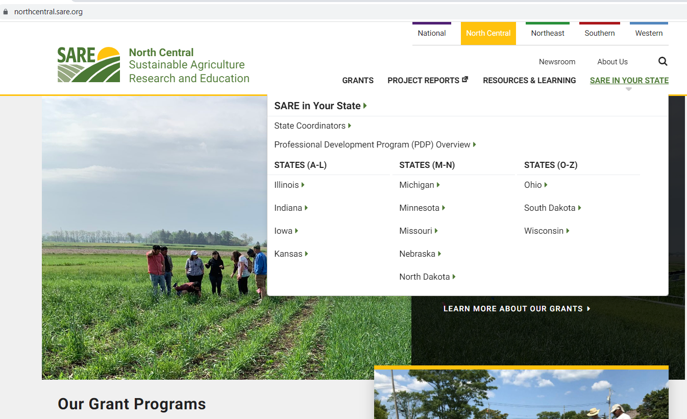
Grant Writing Help: Each NCR-SARE State has one or more State SARE Coordinators. Find your state coordinator here.
Notes:
Go to the NCR-SARE Home page at: https://northcentral.sare.org/
Click on: “SARE IN YOUR STATE” then click on your state.

Slide 13

More Grant Writing Help:
Grants Advising for Farmers and Ranchers in the Midwest
Michael Fields Agricultural Institute (MFAI) provides free Grants Advising services to farmers and ranchers applying for NCR-SARE Farmer Rancher Grants. MFAI Grants Advising services are open to all Midwestern farmers, agricultural entrepreneurs and institutions and include help applying to non-SARE grant programs, as well as loan, and cost-share programs of state, federal, and private sources.
For help, contact MFAI Grants Advisor, Wren Almitra at: grants@michaelfields.org or 719-318-7936.
For more information see:
http://www.michaelfields.org/grant-advising-resources/.
Notes:
Michael Fields Agricultural Institute provides free financial assistance advising to agricultural producers and producer groups within the 12-state region of Illinois, Indiana, Iowa, Kansas, Michigan, Minnesota, Missouri, Nebraska, North Dakota, Ohio, South Dakota and Wisconsin.
Contact MFAI Grants Advisor, Wren Almitra, at: grants@michaelfields.org or 719-318-7936. For more information see: https://www.michaelfields.org/grants-advising-resources
About Michael Fields Agricultural Institute
MFAI’s Advisors can help you apply to grant, loan, and cost-share programs of state or federal sources that could help you with specific projects to develop your agricultural, forestry or related business or answer a research question. These can be programs of any federal or state agency, not just the USDA, as well as private sources. They assist individual producers, associations of farmers, and agricultural, fishery and forestry-related businesses to both search for and apply to programs for which they are eligible.
MFAI Grants Advisors help determine what funding opportunities might be appropriate to achieve specific farm goals. They will help identify a funding program that best fits your project and outline a plan of work to meet the application deadline and all application requirements. If your farm goals do not align with a grant program, they may suggest other resources, such as federal, state or local loan programs, loan guarantees, conservation cost-share programs, or information resources.

Slide 14
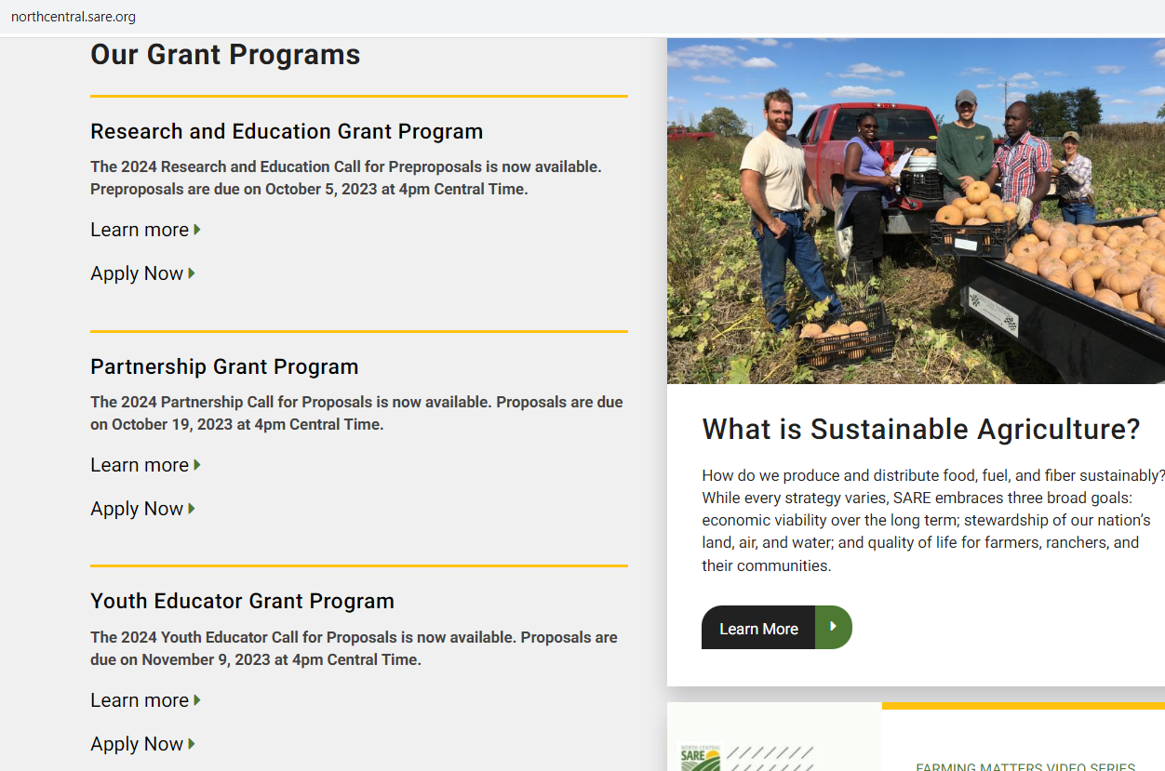
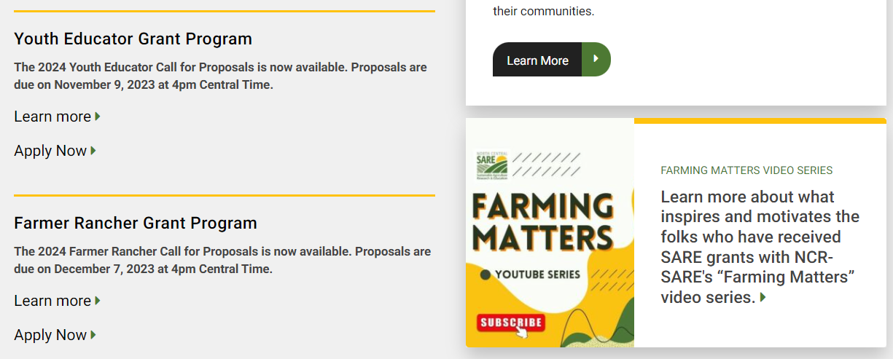
Click on “Learn more” to see the Call for Proposals. It contains important instructions.
Click on “Apply Now” when you have read the instructions and are ready to start your online grant application.
Notes:
NCR-SARE uses an online submission system to take applications. Open “calls for proposals” for the various grant programs can be found on our homepage at: https://northcentral.sare.org/.
A “Call for Proposals” is the instructions and application needed to turn in a grant proposal.
Scroll down under “Our Grant Programs,” to the Farmer Rancher Grant Program. For details, click on “Learn more.” Click on “Apply Now” to begin an application.

Slide 15
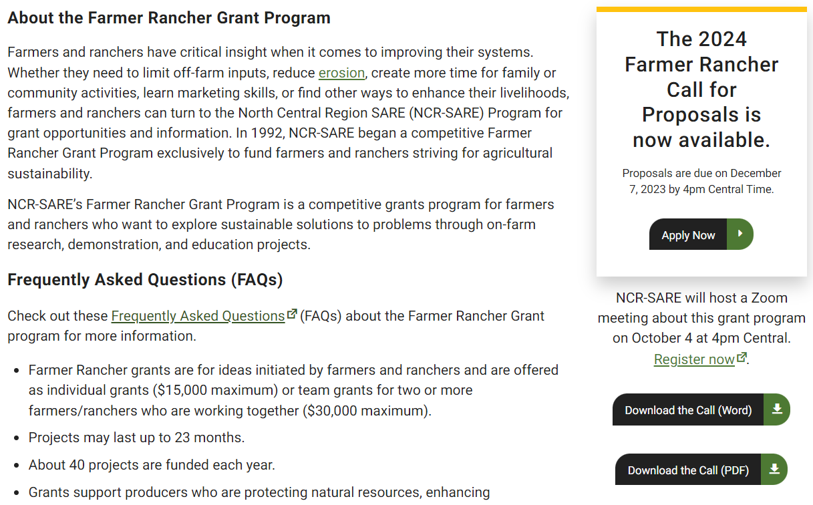
First, download the current Call for Proposals and read the instructions.
Notes:
When you click on “Learn More,” you will see helpful information about Farmer Rancher Grants. The instructions on how to apply are in the Call for Proposals. Click on “Download the Call” to read a copy of the current call for Farmer Rancher grant proposals. It is available as a Word document that you can use to prepare a draft of your application or as a PDF file.
Make sure you have the current call, as there are typically a number of changes from the previous call. If you have any problems downloading the proposal, contact the NCR-SARE office and we can email you a copy, or send you a hard copy.
The Online Submission Deadline is 4:00 p.m. Central Time, Thursday, December 7, 2023. If you are unable to use the online system, you may submit a proposal by mail or e-mail. Mail and e-mail submissions must be received by 4:00 p.m. Central Time on Thursday, December 7, 2023, at the NCR-SARE main office in Saint Paul, Minnesota.
Proposals sent by Fax will NOT be accepted. They are too hard to read.

Slide 16
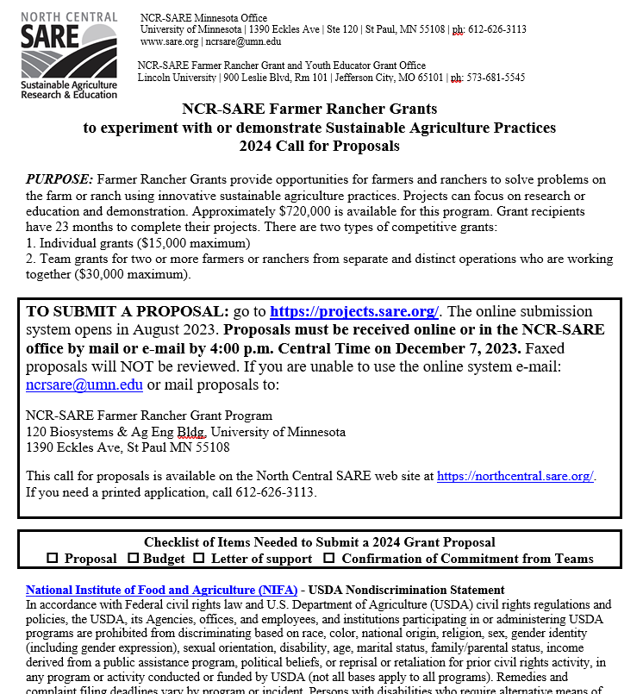
Read the Call for Proposals before starting a grant application. It contains instructions and helpful tips.
Notes:
When you apply for a grant, be sure to read the Call for Proposals first. It contains directions and the application and can help you determine if the grant is a good match for you.
At the top of the Farmer Rancher Grant Call for Proposals, you will see the link where you can submit a proposal. Or you can click on the “Apply Now” button on the NCR-SARE homepage.

Slide 17
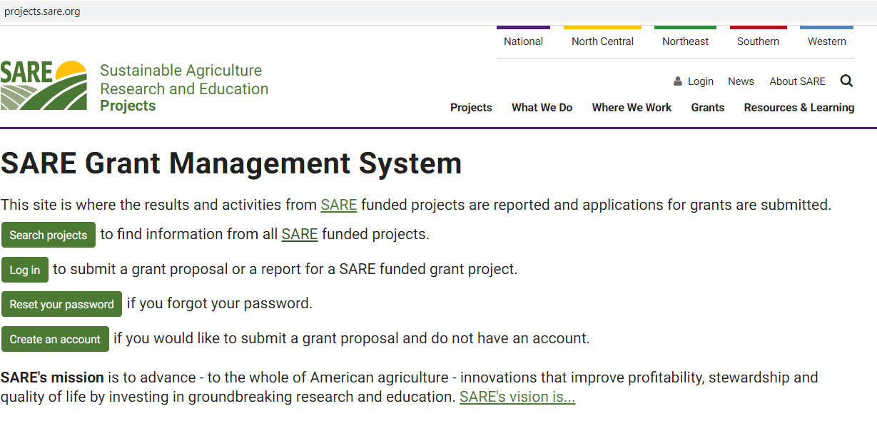
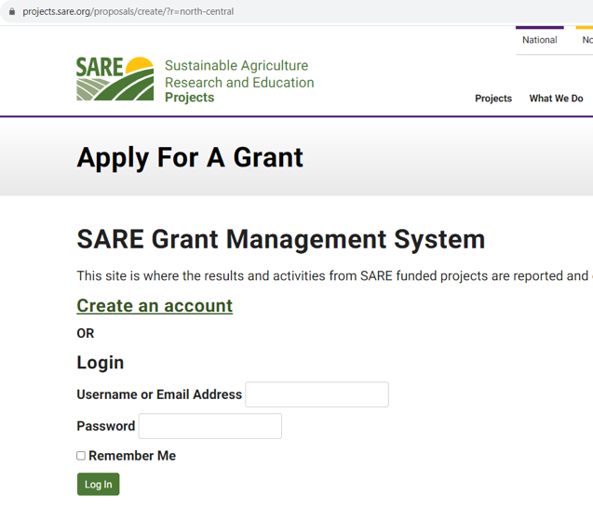

If you are new to the SARE Grant Management System, click on “Create an account” to get started. You can do this on the project.sare.org homepage, or by clicking on “Apply Now.”
Notes:
When you click on the link in the Call for proposals (https://projects.sare.org/), you will see the “SARE Grant Management System” page.
If you click on “Apply Now,” you will see a similar page shown in the inset, with the title, “Apply For A Grant.” You can start your application from either page.
If you’ve never had a SARE grant before, you will first need to create an account and complete your user profile. Click on “Create an account.”
If you’ve had a SARE grant before and filed reports in this system, your profile will already be in the system, and you can “Log in” with the information you used for reporting.
I’ll now guide you through using the online application system.

Slide 18
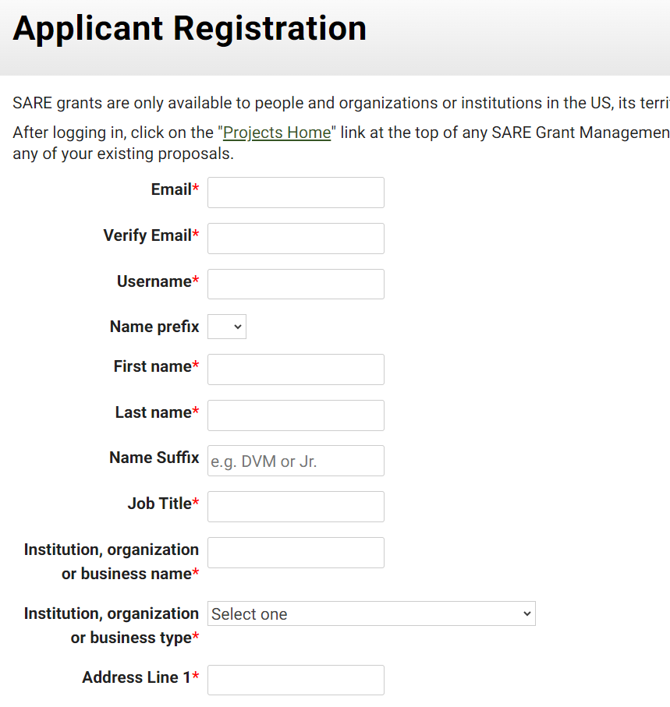
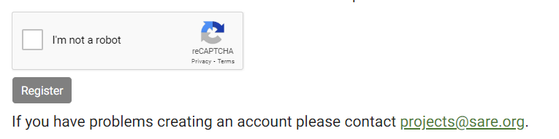
Fill in the Applicant Registration information, then click on “Register.” The email you list is where we will send notifications from the SARE system.
Notes:
To “Create an account,” complete the requested information, then click on “Register” in the lower left-hand side of the webpage. Information about your application will be sent to the email address you provide here.
We also request demographic information. The North Central Region SARE program is committed to an ethic of openness, inclusiveness, and diversity in all its programs, policies, and procedures.
To monitor our performance in these areas, we collect demographic information. We appreciate your help with this.
Demographic information is not linked to your proposal. You must answer the demographic questions, but you may choose “prefer to not answer” for each question. If you have questions, please contact Joan Benjamin at BenjaminJ@lincolnu.edu or 573-681-5545.

Slide 19
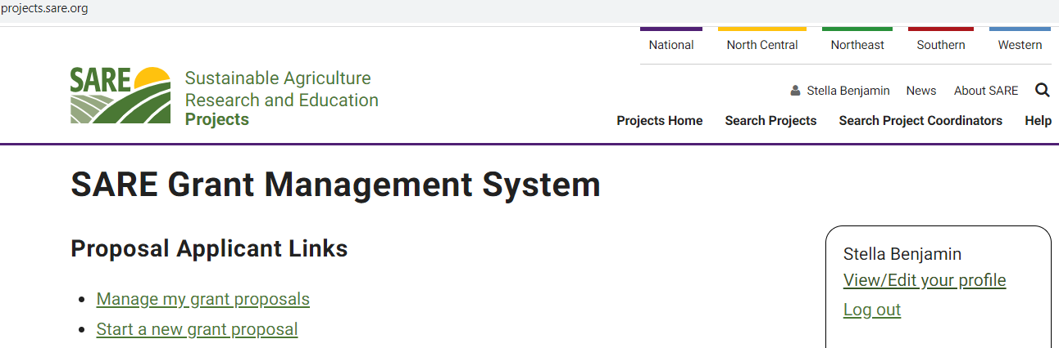
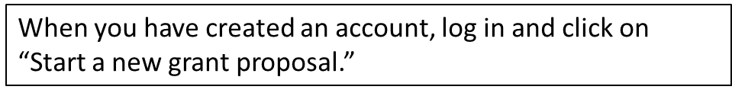
Notes:
Once you have completed the information and logged into the system, you’ll see this screen.
Click on “Start a new grant proposal” or “Manage my grant proposals” (if you have already started a proposal).”
If you’ve submitted proposals before, or had a project funded before, you’ll see them listed on this page.

Slide 20
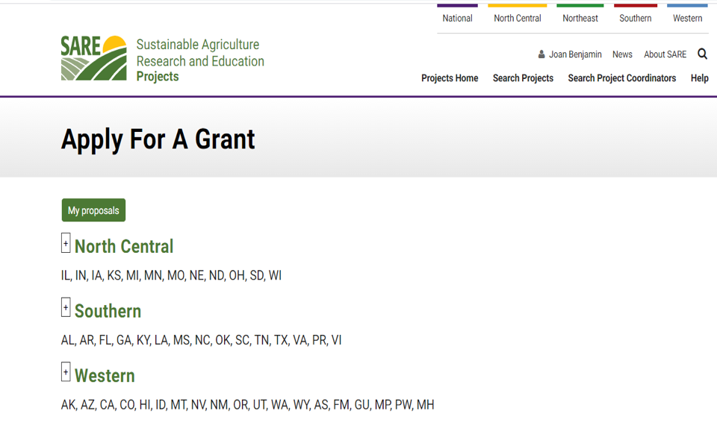
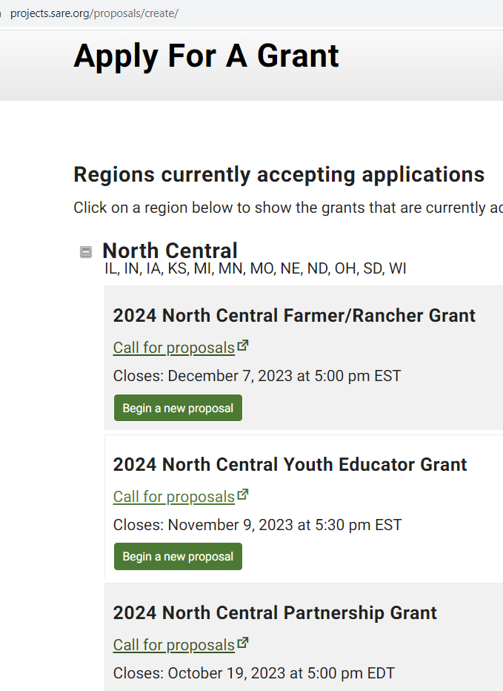
Click on the “North Central” region then choose the North Central Farmer Rancher Grant. Click on “Begin a new proposal.”
Notes:
You will see a list of all open grant applications, for all four SARE regions.
Choose the North Central Region by clicking on the plus sign (+). Then choose the correct grant program. You will be completing the North Central Farmer/Rancher Grant application.
Click on “Begin a new proposal.”

Slide 21
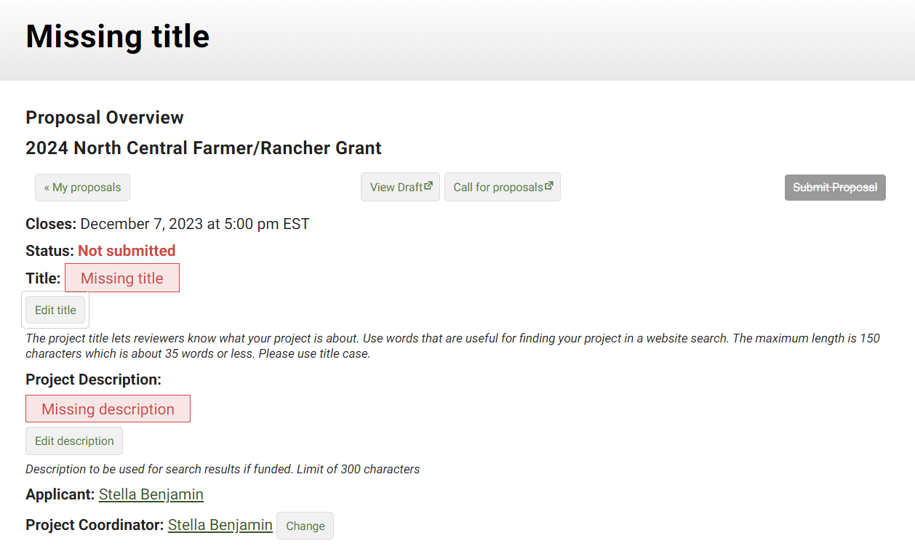
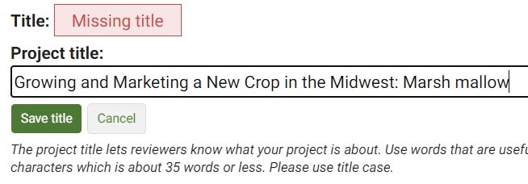

Click on “Edit” to open boxes where you can add a title and description. Click “Save” after each addition.
Notes:
The first items that must be completed are marked as “Missing.” For example, “Missing title” or “Missing description.”
Click on “Edit title,” then type in the title of your proposal in the space provided. This lets reviewers know what your project is about – be descriptive but not too wordy.
Use key words that are useful for finding your project in a website search, keeping the title to 150 characters or less including spaces (this is about 25 words).
Click on “Save” to save your title. Note that throughout the application, you must click on “Save” after every entry to save the information you’ve entered.
Click on “Edit Title” again to change your answers.

Slide 22
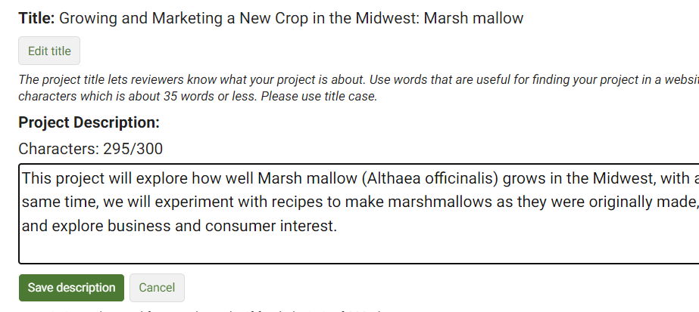
The system shows you how many characters or words you have used and how many are allowed. In this example, 295 characters have been used and up to 300 are allowed.
Click on “Save” to save your work.
Notes:
To fill in the Project Description, click on “Edit description” and provide a brief proposal description of 300 characters or less—including spaces, which is about 45 words. For most answers with a character or word limit, the system tracks the entry so that you know when you’re running out of room. Click on “Save description” to save the text you entered.

Slide 23
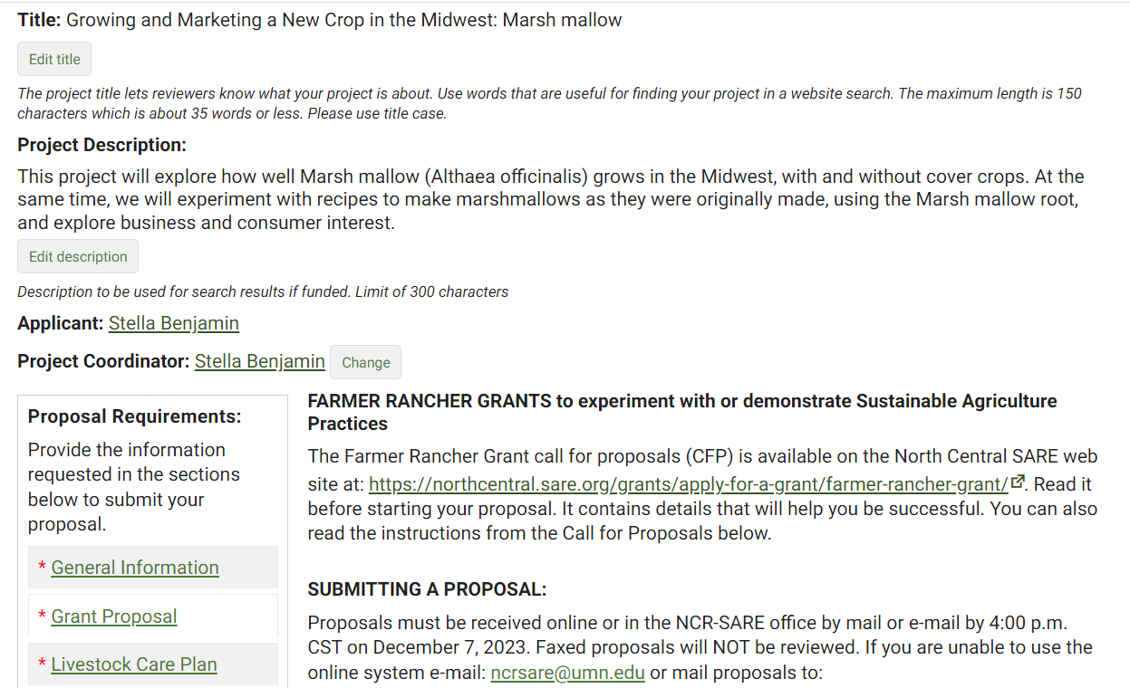
Complete the Proposal Requirements by filling out each required section. Start with “General Information.”
Notes:
You’re ready to move to the first section of the application, “General Information.” Click on “General Information” to answer the questions in that section.

Slide 24
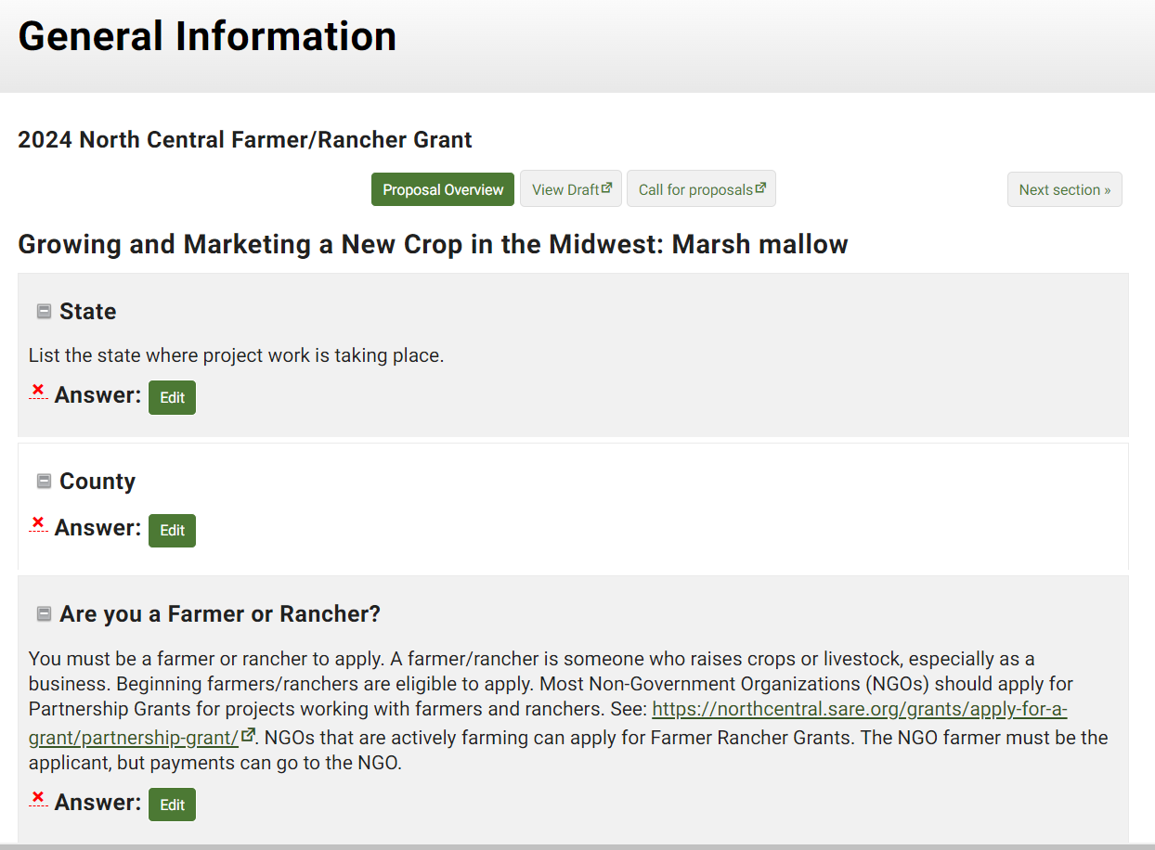
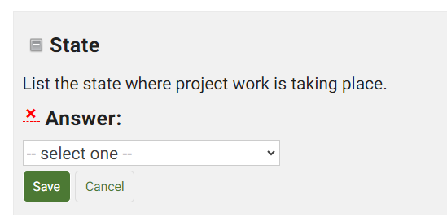
Click on “Edit” by each question in this section, answer the question and click “Save” before moving to the next question.
Some questions have a dropdown list to choose from.
Notes:
Click on the “Edit” button for each question and enter your answer. Note that some boxes give you a list to choose from. For example, when you click on “Edit” to fill in the state where the project work is taking place, you will see “select one” which means there is a drop-down menu that that will be visible when you click on the “down” indicator. Be sure to click on “Save” after you answer each question.

Slide 25
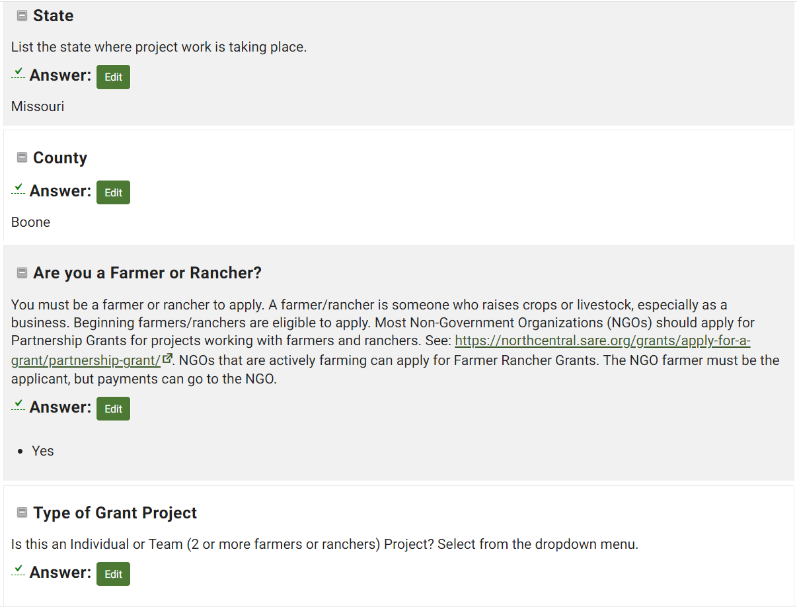
When you complete and save an answer, a green check mark will appear to let you know that question is done.
Notes:
Once you have completed and saved an answer, a green check mark appears next to that question. To change your answer, click on “Edit,” change your answer, and click on “Save.”

Slide 26
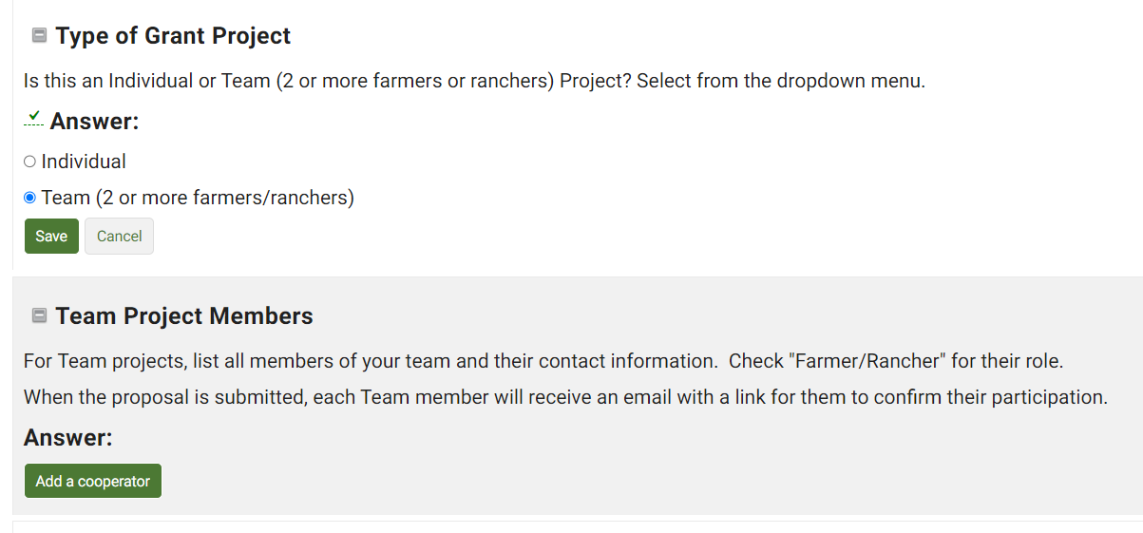
For a “Team Grant,” you must complete contact information for each of your team members by clicking on “Add a cooperator.” Let your team members know that they will be sent an email to confirm their participation in the grant project.
Notes:
You must provide contact information for your fellow farmers and ranchers if you are applying for a Team grant with 2 or more farmers or ranchers. Click on “Add a cooperator” to add each team member’s information.
Once the application is submitted, cooperators will be sent an email message asking them to confirm their participation on your grant. They must confirm within a week for your project to keep moving through the review process.

Slide 27
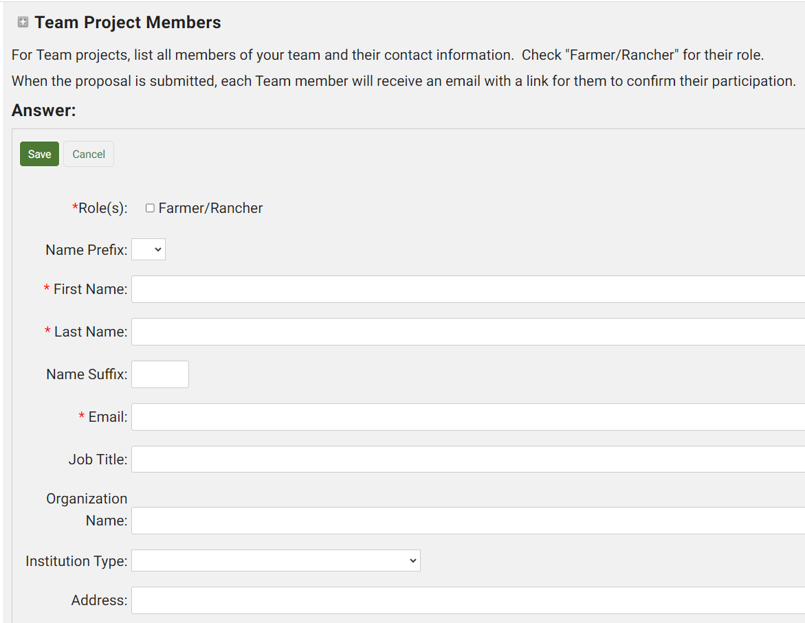
Check the box Farmer/Rancher for the Role the team member has in your project.
Fill in the contact information for your team members. Be sure to fill in the email. If they do not have an email address, they will need to provide a brief (1 paragraph) statement explaining their role in the project. You can attach this statement to your proposal.
Notes:
Complete the contact information for your team members. Include their email addresses so we can send them a link to confirm their participation. If they do not have an email address, ask them to write or type a brief (1 paragraph) statement explaining their role in the project and have them include their contact information. Attach the statement to your grant proposal.

Slide 28
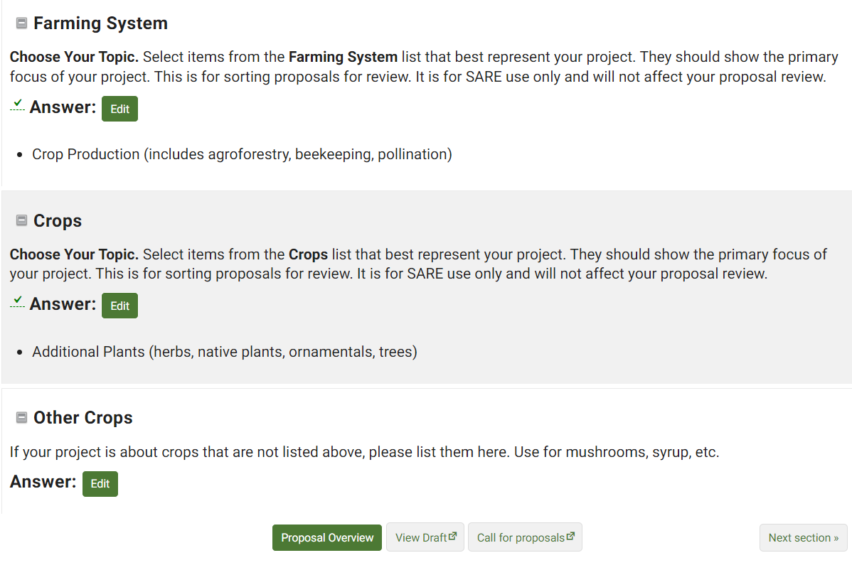
When you complete a section, click on “Next Section” to continue, or click on “Proposal Overview” to see which sections still need to be completed.
Notes:
Once you have answered the questions and saved all information in the “General Information” section, click on “Next Section” to move to the next set of questions, or click on “Proposal Overview” to see which sections are yet to be completed. These options are available at the top and bottom of the web page. You can also click on “View Draft” to see how your proposal looks so far, or “Call for Proposals,” if you want to review instructions.

Slide 29
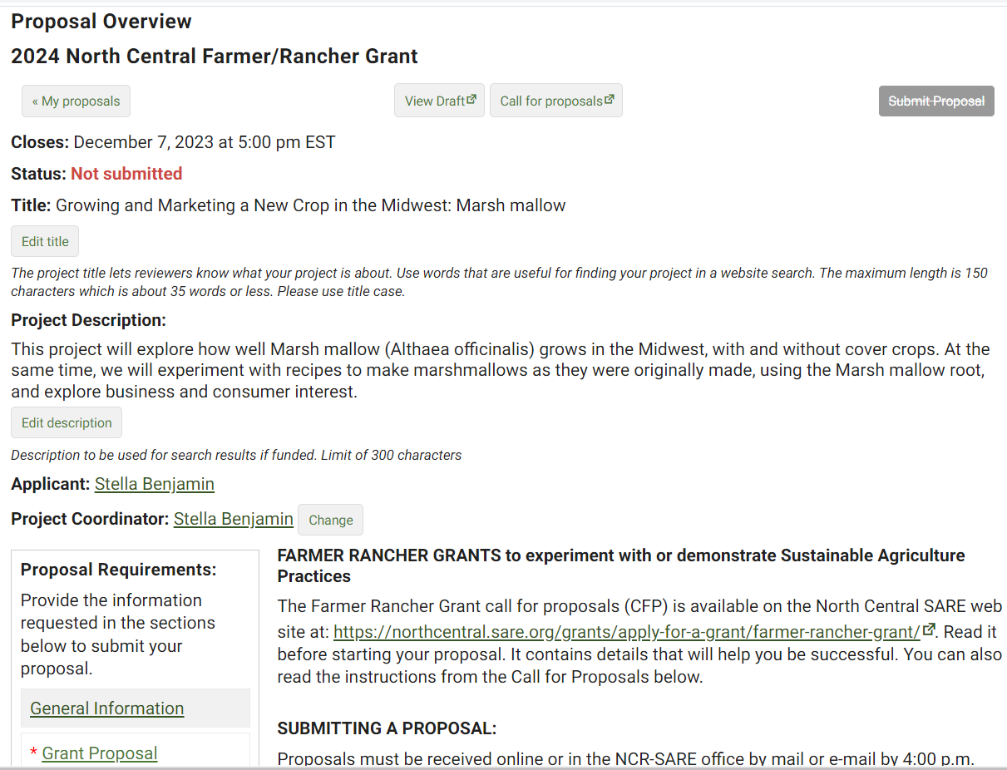
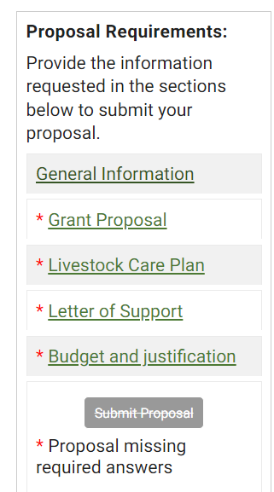
In the Proposal Overview, you will see that sections that have not been completed yet have a red asterisk (*) beside them.
Notes:
If you return to “Proposal Overview,” you will see which sections are completed and which still need to be filled out. Sections that have not been completed have a red asterisk (*) beside them. Click on the next section, which is “Grant Proposal” in this example. Answer each question in the Grant Proposal section.
Sections that are completed will not have a red asterisk beside the section heading, like “General Information” in this example.

Slide 30
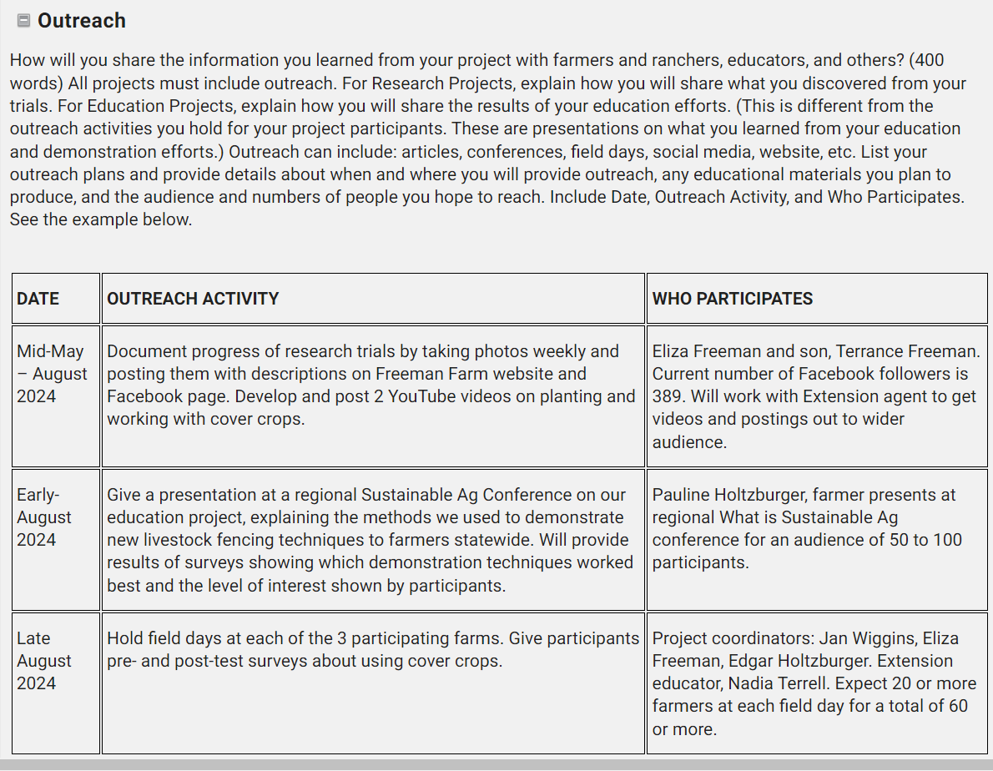
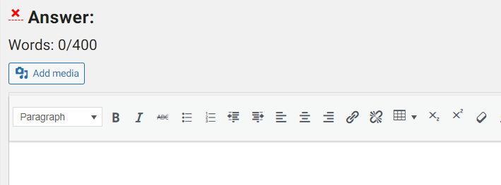
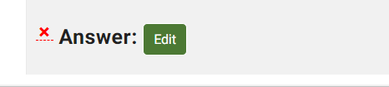
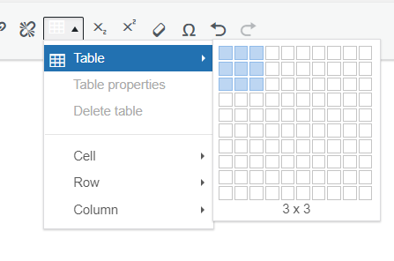
Table icon
Tables are a good way to add information in sections like “Outreach.” To create a table, click on “Edit” to open the answer box. Next, click on the table icon, and use the computer mouse to choose (highlight) the number of rows and columns you want. Left click the mouse. The table will appear in the answer box.
Notes:
A table works well for the “Measuring Results” and “Outreach” sections.
You have several options for including a table. You can copy and paste a Word or Excel table into the answer box, or you can create a table in the application.
I’ll demonstrate how to create a table in your application in this question about “Outreach.”
First, click on “Edit” to open the answer box. Next, click on the table icon, and use the computer mouse to choose (highlight) the 3 columns by 3 row grid and left click the mouse. The table will appear in the answer box, and you can fill in the information.
For more information on creating a table in the online application system, See: https://projects.sare.org/inserting-tables-into-your-report/.

Slide 31
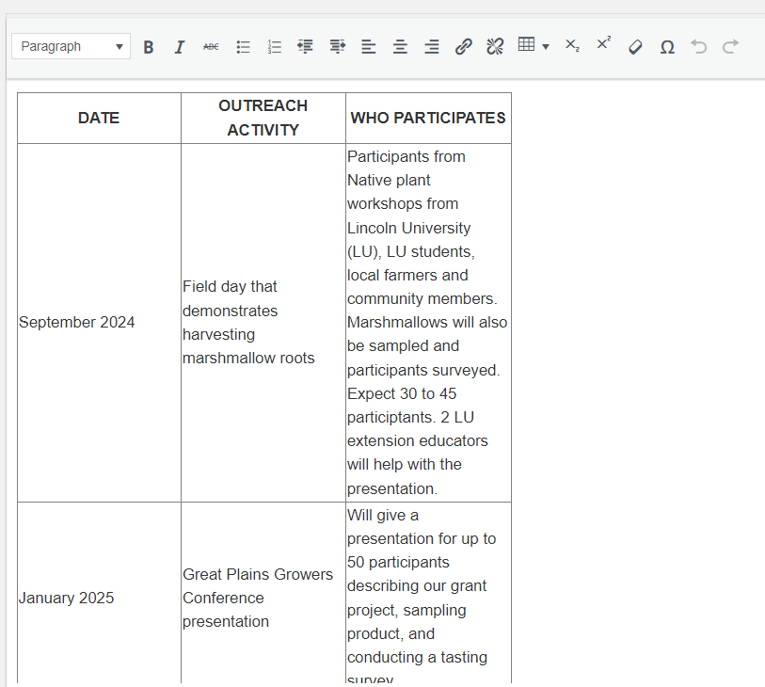
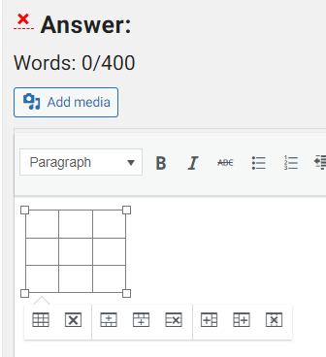
When the blank table appears, icons below the table allow you to add rows or delete rows from the table. Fill in the table and click “Save.”
Notes:
When the blank table appears, icons below the table allow you to add rows or delete rows from the table. Fill in the table and click “Save.”
You can also upload a completed table as an attachment, but it must be in pdf format. See the next slide for instructions for uploading attachments.

Slide 32
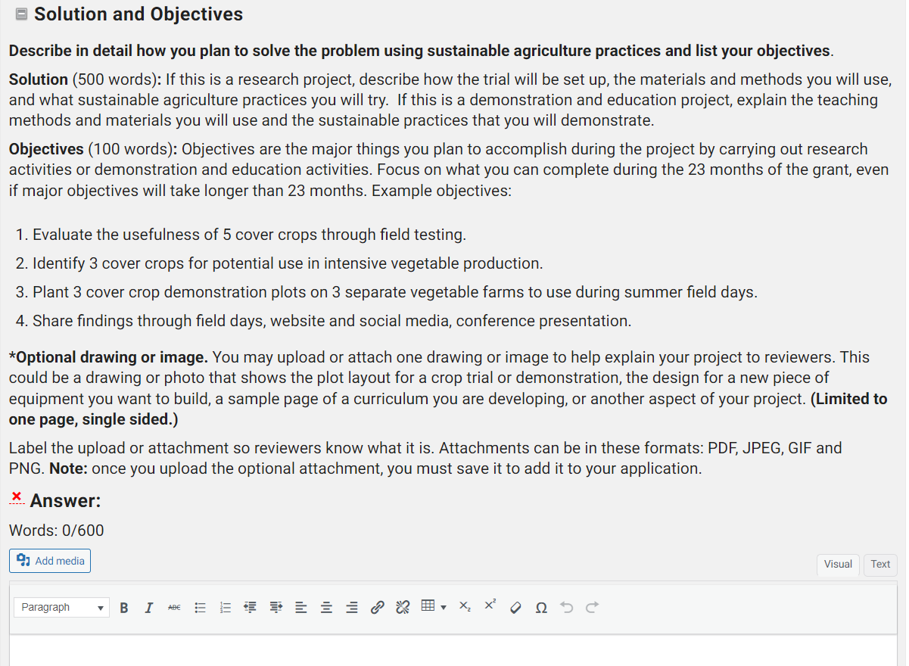
In some sections, you can add an attachment or insert images by clicking on the "Add Media" button. This allows you to upload attachments including pictures or diagrams to those sections.
Notes:
For the Solutions and Objectives” question, you might want to attach an “Optional drawing or image.” This could be a drawing of your research plot layout, a map or photo of your test area, or a sample page of a curriculum you are developing. For the “Solution and Objectives” question, the attachment is optional, but this addition can help reviewers understand your grant project better. Limit your optional attachment to one page, single sided.

Slide 33
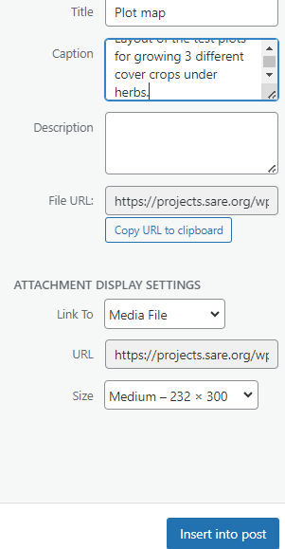
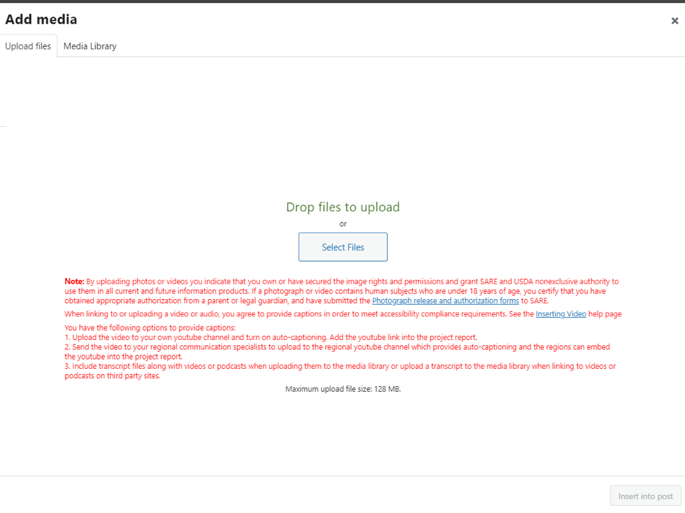
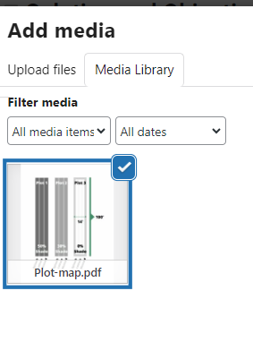
To add an image or photo to a section that has an “Add Media” button, place your cursor in the text box where you want the item to appear. Click on “Add Media”, then click on “Select Files." Open the file from your computer. Click on “Insert into post” to add the file to your application.
Notes:
To add an image or photo to a section that has an “Add Media” button, place your cursor in the text box where you want the item to appear. Click on “Add Media”, then click on “Select Files." Open the file from your computer, add a caption, and click on “Insert into post” in the lower right-hand corner to add it to your application. You’ll see the uploaded file listed in your media library.

Slide 34
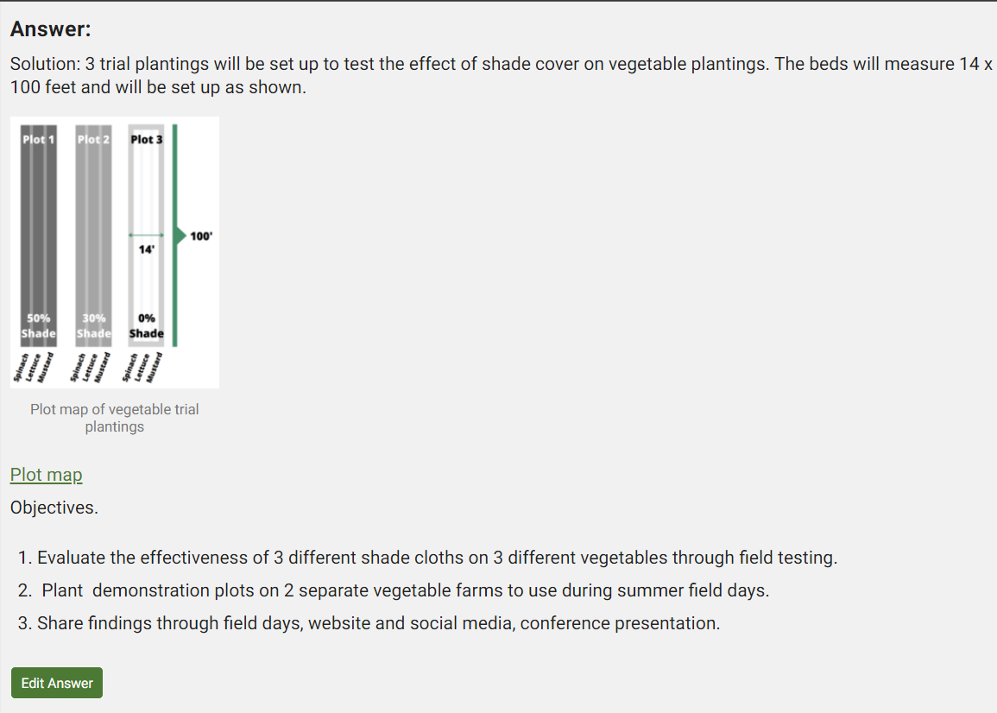
The image will be embedded as you see here (see red arrow). If the attachment is a PDF file, it will appear as a link (see blue arrow).
Notes:
The image will be embedded as you see here (see red arrow). If the attachment is a PDF file, it will appear as a link (see blue arrow).

Slide 35
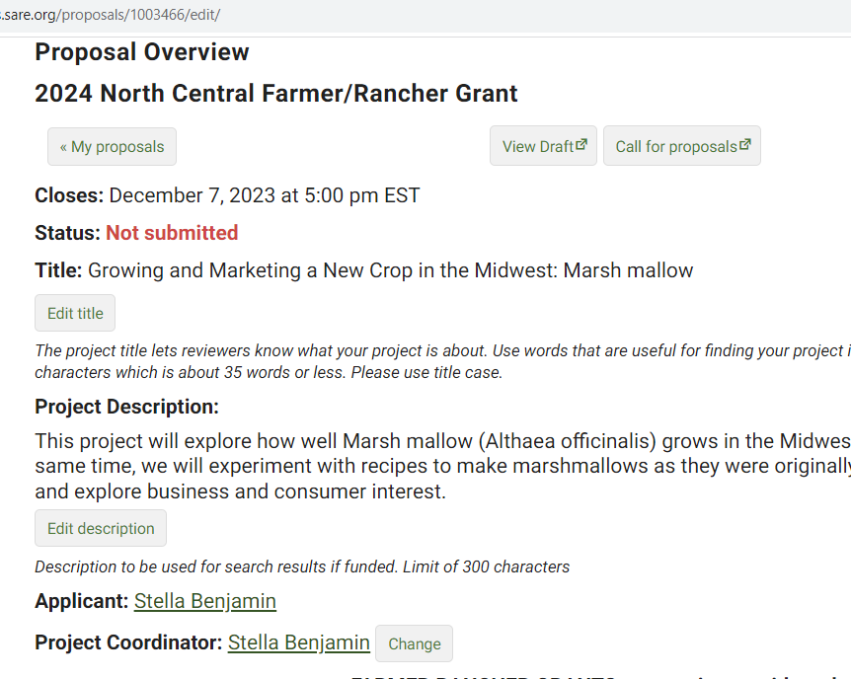
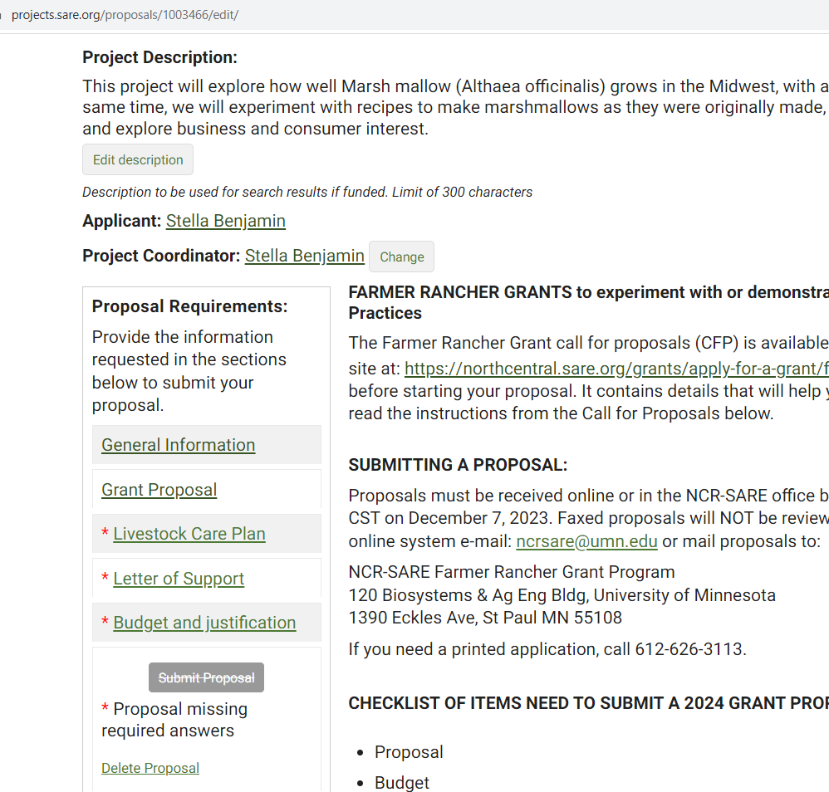
Return to the “Project Overview,” and you’ll see that you have successfully completed and saved all required information in the first two sections; they no longer have red asterisks.
You can view a draft of your proposal by clicking on “View Draft.” A new window will open where you can see your draft proposal and a link to the draft that you can share with others.
Notes:
Again, you have the choice of going on to the Next Section or returning to the Project Overview. If you return to the Project Overview, you’ll see that you’ve successfully completed and saved all required information in the first two sections; they no longer have red asterisks.
You can view a draft of your proposal at any time by clicking on “View Draft.” This will open a new window where you’ll see the draft of what you’ve entered. This page also provides a link to the draft that you can share with collaborators.

Slide 36
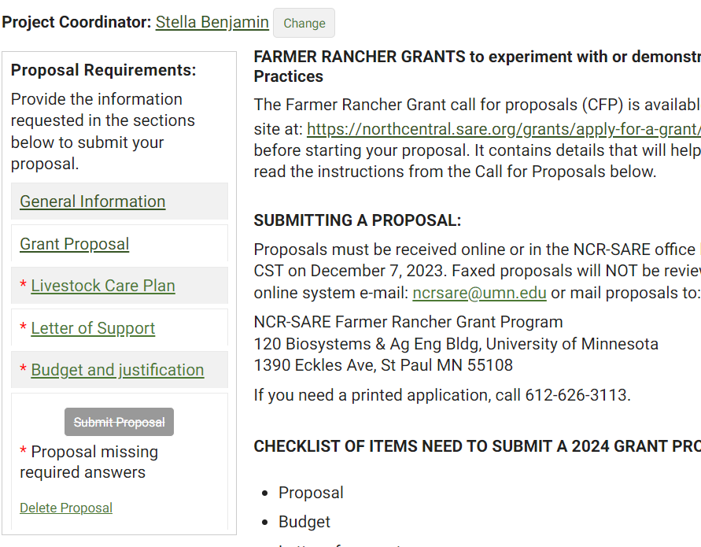

Open the “Livestock Care Plan” section even if your project doesn’t involve livestock. All applicants must answer the 1st question: “Does this project involve livestock?” If your answer is “No,” select “No,” click on “Save,” then move to the next section. If your answer is “Yes,” answer all of the questions in the Livestock Care Plan, click on “Save,” then move to the next section.
Notes:
If your project does not involve livestock, open the Livestock Care Plan form and answer “No” to the first question which is: Does this project involve livestock? Click on “Save,” then click on “Next Section” to go to the “Letter of Support” section.
If your project does involve livestock, answer all of the questions in the Livestock Care Plan form and click on “Save.” Then move to the next section: “Letter of Support.”

Slide 37



Each proposal must include 1 Letter of Support. You can add up to 2 letters but no more than 2. To add your letter, click on “Letter of Support,” then click on “Add a file.” Select a file from your computer (it must be in PDF format). The process is the same as adding any other attachment. When the Letter of Support is added, be sure to click on “Save” to add it to your proposal.
Notes:
In addition to completing the proposal, you must also upload a letter of support for the project to your application. Do this by Clicking on “Letter of Support” and using the “Add a file” button. Click on “Select file” to select a file from your computer. This section will only accept PDF files. Your letter must be saved as a PDF file to attach it. The process is the same one used for adding an Optional drawing or image.
Be sure to “Save” after you upload the letter. You will see the Letter of Support listed, but you must click on “Save” to add it to your application.
Do not add more than 2 letters since additional letters will not be reviewed.
When you are done, click on “Next section” to go to the final section: “Budget and Justification.”

Slide 38


The last section is “Budget and justification.” Read the instructions in the Call for Proposals. Add each item of your budget by clicking on “Add a budget item.” Choose the budget “Category,” include a brief “Description,” the “Amount” you are requesting for that item, and the “Details/Justification” which shows how you came up with the amount for that item.
Notes:
Read the Budget instructions in the Call for Proposals.
Add each item of your budget by clicking on “Add a budget item.” Choose the budget “Category,” include a brief “Description” of the item, the “Amount” you are requesting for that item, and the “Details/Justification” which shows how you came up with the amount for that item (show your math).
Your budget items should match the materials and labor described in your grant proposal.

Slide 39


When you click on “add a budget item,” you will see this form. Select a “Category” from the drop-down list, fill in the rest of the form and “Save.” Keep adding items to complete your budget.
Notes:
Click on “Add a budget item” then click on the down arrow under “Category” to open the drop-down menu of budget categories. Choose the category for the item you want to add.
Choices include:
Equipment, permanent fencing, perennial seeds and plants or livestock (Only 50% of the cost of these items can be included in your grant budget.)
Materials and Supplies
Other direct costs
Personnel
Travel
“Equipment” is defined as items that cost $5,000 or more and have a useful life of more than 1 year. Items that cost less than $5,000 are considered “Materials and Supplies.”

Slide 40


This is what a saved Budget Item looks like
Notes:
Choose the budget “Category,” then fill in the item “Description.”
Under “Details/Justification,” show how you calculated the cost for that item (show your math). Enter the “Amount” you want to include in the grant budget. Be sure to click on “Save” to save your work. You can keep adding budget items by clicking on “Add a budget item.”
In this example, only 50% of the cost of the item (perennial plants) can be included in the budget. This is because only 50% of the cost of the following items can be included in the grant budget:
Equipment, permanent fencing, perennial seeds, perennial plants, and livestock.

Slide 41

This is part of a sample budget. When you are done entering your budget items, click on “Save,” then scroll to the top or bottom of the page and click on “Proposal Overview.”
Notes:
Here is part of a sample budget. Once you’ve entered all your items and clicked on “Save,” scroll to the top or bottom of the webpage and click on “Proposal Overview.”
Do not go over the budget limits. Individual projects are limited to $15,000 and Team projects are limited to $30,000.

Slide 42


When all required sections are completed, click on “View Draft” to make sure your proposal looks the way you want it to. Check your spelling and budget figures. Make any changes needed and “Save.” Next, click on “Submit proposal.” Confirm that you want to submit the proposal.
Notes:
You’ve now completed all required sections and are ready to submit the proposal. It’s a good idea to click on “View Draft” before you submit your proposal. Review your proposal. When you are satisfied with how you have answered all the questions, click on “Submit Proposal”.
You will see a screen titled, “Submit Proposal.” Click on “Submit proposal” again to confirm that you want to submit the proposal.
You will get an email from: “SARE Grant Management System <projects@sare.org>,” confirming that your proposal was submitted.

Slide 43

When you confirm that you want to submit your proposal, you will see this screen. It shows the date and time your proposal was submitted.
If you need to make changes after submitting your proposal, click on the “Unsubmit Proposal” button, make your changes, and be sure to “Submit” before the grant deadline.
Notes:
Once your proposal is submitted, you will see this screen. The “Status” line (4th line down) shows the date and time your proposal was submitted.
You will also see an “Unsubmit Proposal” button. Use this button if you need to make changes to your proposal after you submit it. After you make changes, be sure to “Save” and “Submit” your proposal again before the grant deadline.

Slide 44


Good luck with your proposal!
If you have questions, contact Joan Benjamin at:
573-681-5545
or
benjaminj@lincolnu.edu
https://northcentral.sare.org/
Follow @NCRSARE on social media:
photo credit: Joan Benjamin
Notes:
Congratulations! You have now submitted your Farmer Rancher Grant Proposal.
The proposals will be reviewed by a team of North Central region Farmers and Ranchers between the date the application closed and the February 2024 Administrative Council meeting, when the funding decisions will be made.
Notifications will go out by mid- to late February 2024.
Good luck with your proposal.
If you have any questions, contact NCR-SARE.
On the web: http://www.northcentral.sare.org/
On Facebook: https://www.facebook.com/NCRSARE
On Twitter: https://twitter.com/ncrsare
On Instagram: https://www.instagram.com/ncrsare
On YouTube: http://www.youtube.com/user/NCRSAREvideo

