Slide 1
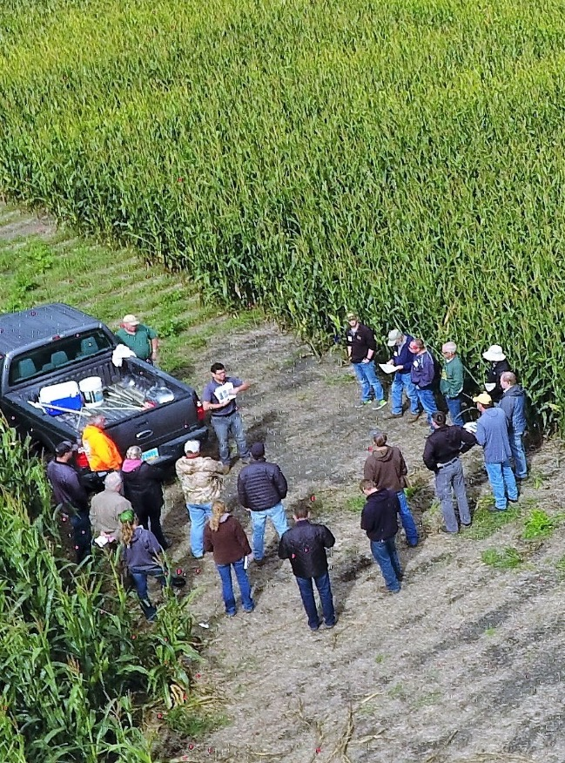

Introduction
NCR-SARE offices:
University of Minnesota
University of Missouri
Lincoln University in Missouri
Photo credit: Marisol Berti
Notes:
This presentation is an introduction to the USDA Sustainable Agriculture Research and Education program in the North Central region, commonly referred to by our acronym, NCR-SARE.

Slide 2

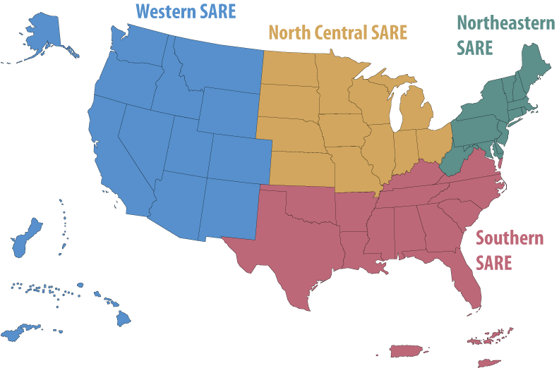

What is SARE?
Grants and outreach to advance sustainable innovations to
the whole of American agriculture.
Visit www.sare.org or
www.northcentral.sare.org
Photo credit: Marie Flanagan
Photo credit: Carol Flaherty
Photo credit: Erin Schneider
Notes:
The Sustainable Agriculture Research and Education (or SARE) program is a competitive grants and education program operating in every state and island protectorate.
The purpose of the SARE program is to provide grants and educational outreach to advance sustainable innovations to the whole of American agriculture.
Depending on the region, applicants can be farmers, ranchers, researchers, graduate students, community development practitioners, and ag educators conducting on-farm research or carrying out education or demonstration projects in sustainable agriculture.

Slide 3
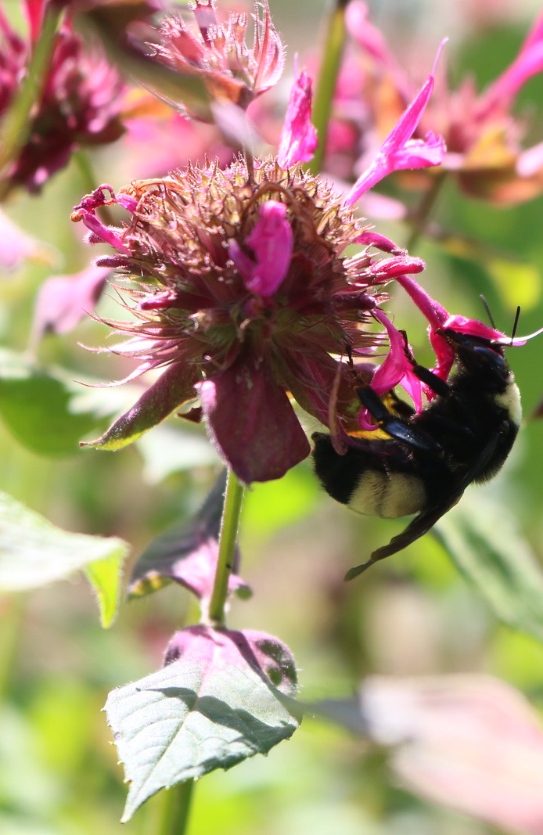

A Different Kind of Grant Program
SARE was started in 1988, conceived as a
decentralized, science-based, grassroots, practical,
problem-solving,
and inclusive
competitive grant-making and outreach program.
Photo credit: Joan Benjamin
Notes:
SARE is a science-based, grassroots grant program, and looks to fund projects with strong farmer/rancher or end-user involvement.
The program is run by four regions—North Central, Northeast, South and West. Each region is guided by a volunteer Administrative Council that makes funding decisions and sets regional priorities. SARE is decentralized, in that each of the four regions make their own funding decisions, including which types of grant programs to offer.
The regional Administrative Councils and the grant review committees, who are also volunteers, include farmers and ranchers, extension educators, researchers, and personnel from state and federal agencies.

Slide 4
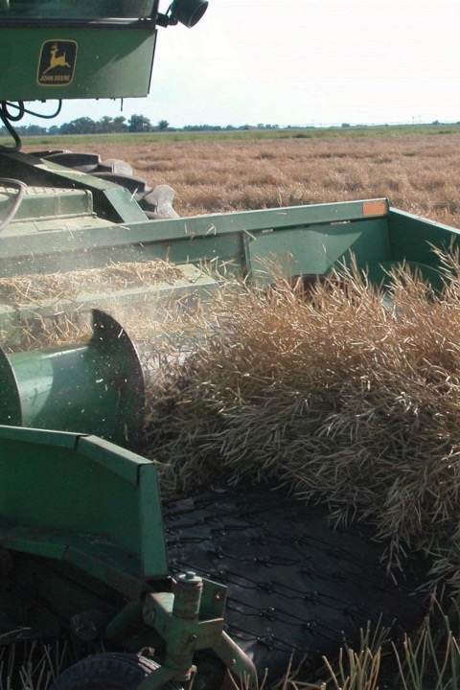
The SARE Model
The SARE Model
USDA-NIFA supports SARE
SARE Outreach produces practical information
Photo credit: David Baltensperger
Notes:
Since 1988, SARE, funded through USDA’s National Institute of Food and Agriculture or NIFA program, has funded more than 8,000 grant projects throughout its four regions. SARE’s national project database features the project reports from the funded research.
SARE Outreach is the national communications arm of SARE and works with SARE's regions to share research results with farmers, ranchers, educators, and the public at large. SARE Outreach products cover the gamut of sustainable agriculture practices, from books on cover crops and building soil health, to bulletins on managing rangeland and water resources, to online courses for ag educators.

Slide 5
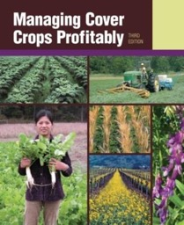
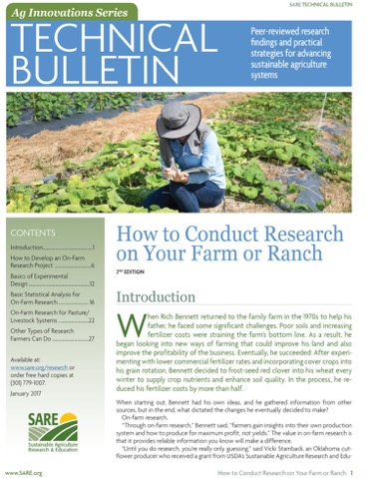
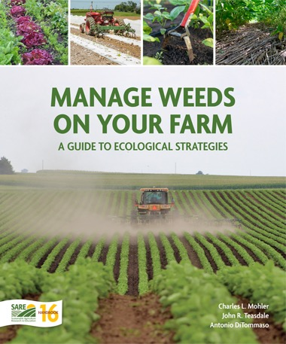
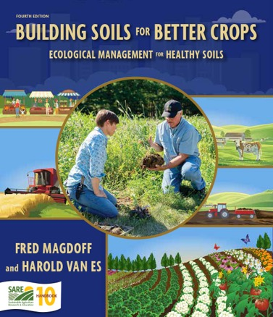
SARE Outreach
_{SARE Outreach}
A library of practical, how-to books and bulletins (in print or free download)
Media outreach
A portfolio of in-depth reports on current topics
Conference sponsorships
Countless online resources, including project reports
Notes:
SARE Outreach’s extensive Learning Center produces practical information like you see here, and you can find a wealth of information online by searching for the type (books, bulletins, fact sheets, topic rooms, newsletters, multi-media, courses and curricula, and SARE project reports) or by topic (including but not limited to: cover crops, crop production, energy conservation and renewable energy, local and regional food systems, pest management, soil health, specialty crops, and value added).
Many of these resources are free for downloading to your computer or tablet.

Slide 6
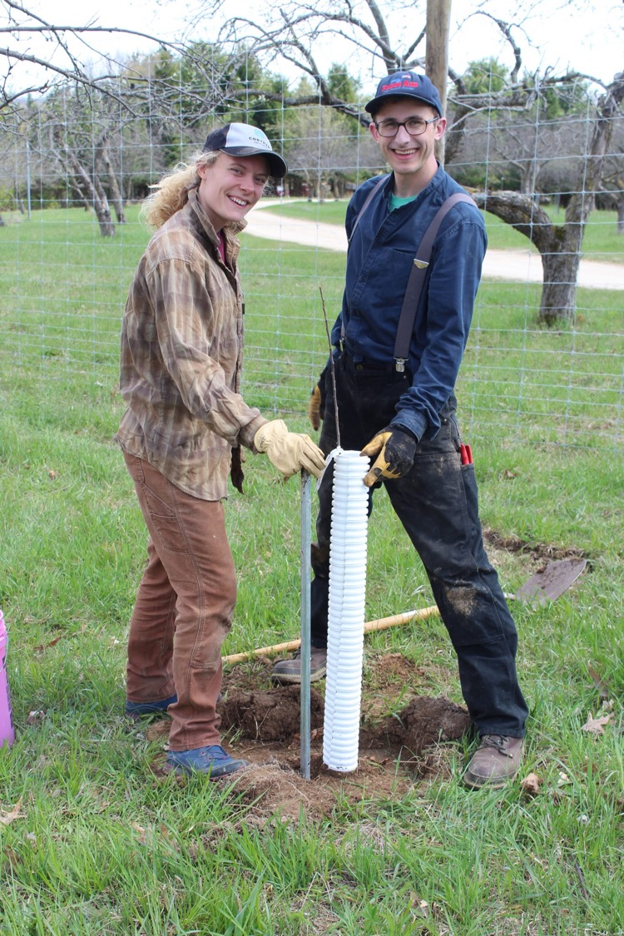
SARE Partners
The
SARE Model
SARE has educational
partnerships with agencies, universities,
Extension, NGOs and other
ag professionals in each of the four regions.
Photo credit: Galen Bergquist
Notes:
The SARE model partners with other USDA agencies, land-grant universities—including 1862, 1890 and 1994 institutions—as well as Extension, other educational institutions, nonprofit organizations, and agricultural professionals in each region.

Slide 7
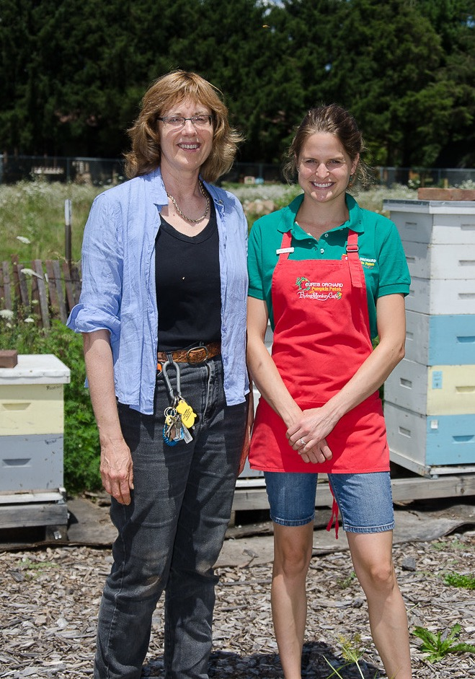
The Principles of Sustainability
The SARE Model
  Successful SARE grantees are engaged in projects that are guided by the 3 principals of
  _{sustainability…}
Stewardship of our nation’s land and water
Economic viability over the long term
Quality of Life for farmers, ranchers, and their communities
photo credit: Darin Eastburn
Notes:
Successful SARE grant projects simultaneously address the three principles of sustainability, even if the project emphasizes one principle more than the others.
These principles are:
Improving the economic viability of farmers and associated agricultural businesses.
Sustaining and improving the environmental quality and natural resource base on which agriculture depends.
Enhancing the quality of life for farmers/ranchers, communities, and society as a whole.

Slide 8
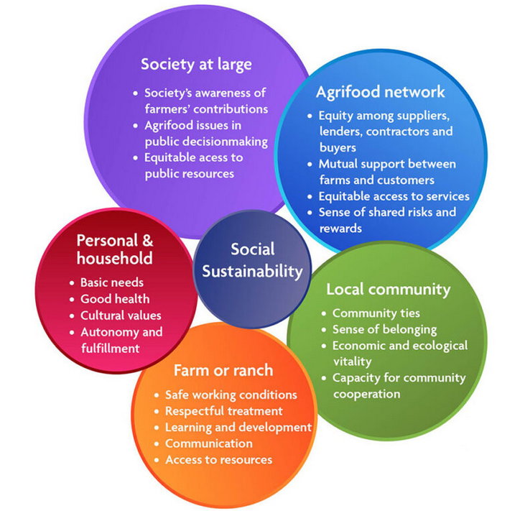
Social Sustainability
www.sare.org/resources/understanding-and-measuring-social-sustainability/
Notes:
Understanding and measuring social sustainability:
https://www.sare.org/resources/understanding-and-measuring-social-sustainability/

Slide 9
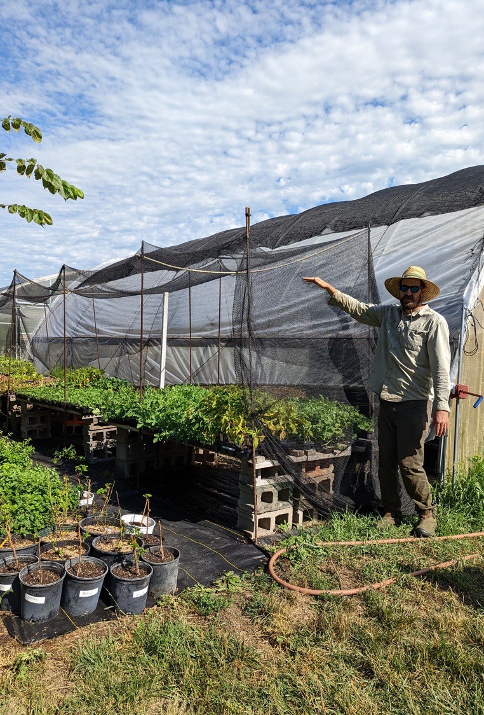
Stakeholder Involvement
Stakeholder Involvement
Problem identified by farmer/rancher and researcher
Farmers/ranchers involved in research
and outreach
Photo credit: Erin Schneider
Notes:
Successful SARE grant projects involve farmers and ranchers, beyond identifying farmers/ranchers as the targeted recipients of the information.
If you are considering submitting a proposal to NCR-SARE, it is important to convey how farmers and ranchers are or will be involved in the project.
Farmers and ranchers themselves are invited to submit proposals to NCR-SARE’s Farmer Rancher grant program designated specifically for the purpose of conducting research on their own operations.

Slide 10
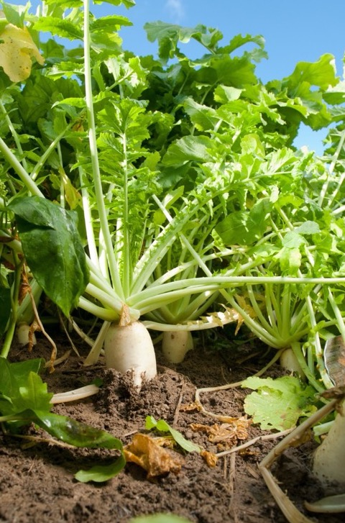
The SARE Portfolio
Sustainable pest and weed management
Marketing and local food systems
Water quality and nutrient management
Systems research
High tunnels and season extension
Crop diversification
Cover crops and soil health
Small ruminants/poultry/cattle
Pastured livestock/grazing systems
Pollinators and biodiversity
Urban agriculture
…and much more
Photo credit: Edwin Remsberg
Notes:
The SARE portfolio includes projects that address some of the following areas in sustainable agriculture:
Sustainable pest and weed management
Marketing and local food systems
Water quality and nutrient management
Systems research
High tunnels and season extension
Crop diversification
Cover crops and soil health
Small ruminants/poultry/cattle
Pastured livestock/grazing systems
Pollinators and biodiversity
Urban agriculture

Slide 11
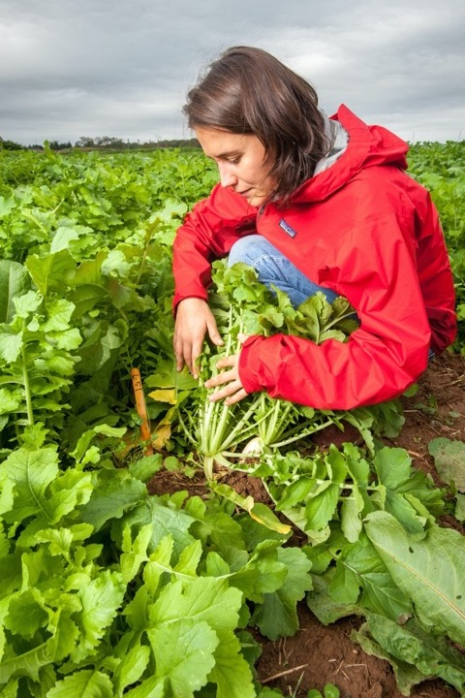
Supporting Tomorrow’s Experts
SARE Projects Database
SARE grantees have found wide-ranging outcomes that can help producers sustain their operations, communities, and the environment.
Visit the projects website:
https://projects.sare.org/
Photo credit: Edwin Remsberg
Notes:
As part of the contract for receiving SARE funds, project coordinators provide progress and final reports on their research efforts.
These reports list the contact information, the participants and their cooperators. They summarize project findings and outline objectives, research methods and results. This growing body of knowledge on sustainable agriculture can be accessed in a variety of ways.
https://projects.sare.org/

Slide 12
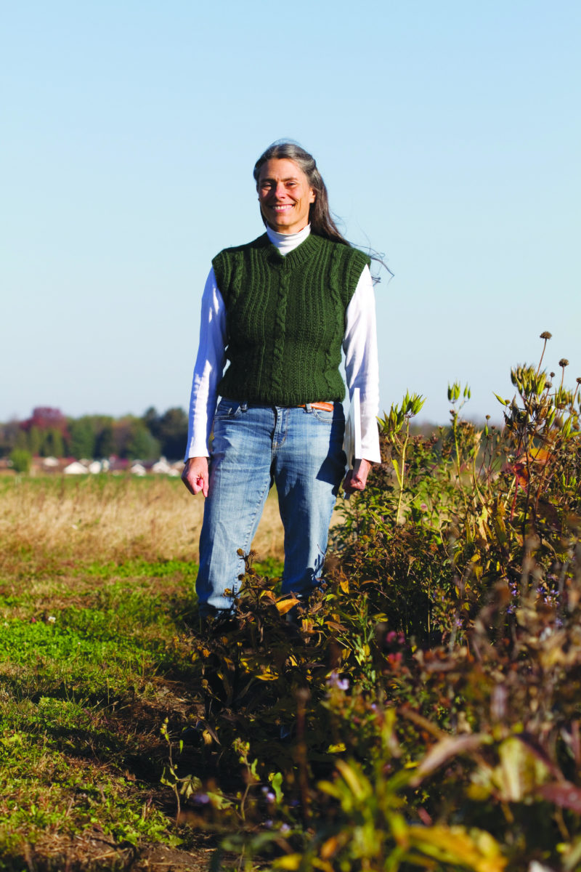
The Principles of Sustainability
SARE in Your State
  SARE state coordinators train agriculture professionals in sustainable practices and advise grant applicants.
  Find your SARE state coordinator online: www.northcentral.sare.org/
  _{state-programs.}
photo credit: Lori Compas
photo credit: Lori Compas
Notes:
SARE has a network of state coordinators working in each state and island protectorate.
Your SARE state coordinator can provide advice and feedback as you work on your grant proposal.
Find your SARE State Coordinator and view documents about funded grants in your state by visiting NCR-SARE online at
https://northcentral.sare.org/state-programs/statecoordinators/.

Slide 13
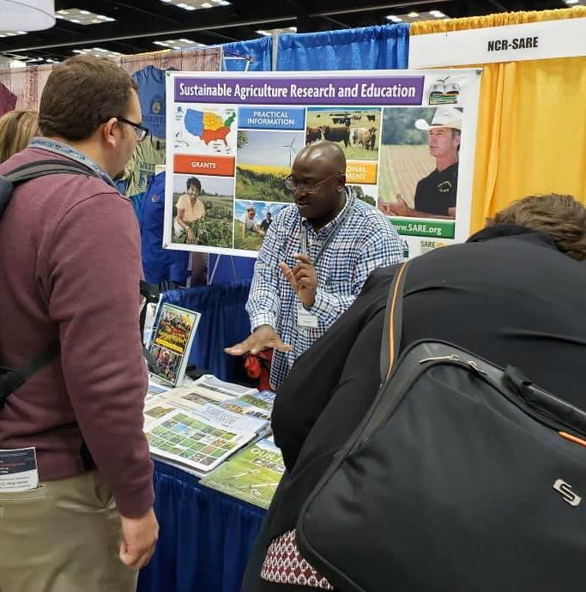
Opportunities to be involved with SARE
Serve as a grant application reviewer. Apply at https://tinyurl.com/
_{NCRSAREreviewer}
_{SARE Outreach Committee}
Regional SARE Administrative Councils
Ask your regional SARE program!
photo credit: Suzanne Mills-Wasniak

Slide 14
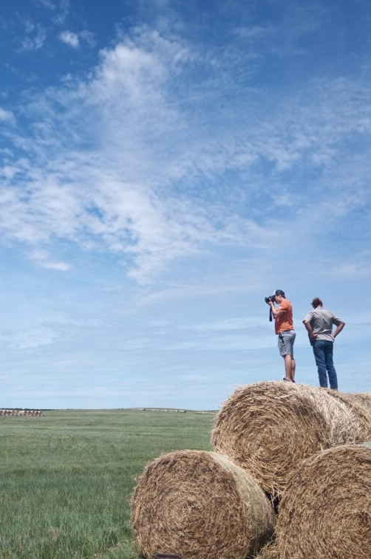
NCR-SARE Grant Types
NCR-SARE
Grant Types
NCR-SARE grant programs are:
Visit www.northcentral.sare.org/grants
Research & Education
Professional Development
Graduate Student
Farmer/Rancher
Youth Educator
Partnership
You can find timelines, tips, and FAQs on our website.
photo credit: Erin Gaugler
Notes:
The North Central region is made up of 12 Midwestern states—a highly productive, critical agricultural region. These states are: Illinois, Indiana, Iowa, Kansas, Michigan, Minnesota, Missouri, Nebraska, North Dakota, Ohio, South Dakota and Wisconsin.
NCR-SARE offers six grant programs:
Information on all of the grant programs, including timelines, can be found on NCR-SARE’s website:
https://northcentral.sare.org/grants/apply-for-a-grant/
The following slides will give you an overview of NCR-SARE’s grant programs.

Slide 15
North Central SARE Grant Types
Notes:
These grant programs are offered in each of the four regions, and you can find information about specific grants on each region’s website, but you’ll also hear more about them in the region-specific breakouts.

Slide 16
NCR-SARE Grants from 1988-2023
Notes:
NCR-SARE has awarded over $107 million and funded more than 3000 projects across the twelve-state region since 1988.

Slide 17
NCR-SARE Grant Funding 2023
Notes:
NCR-SARE has awarded over $107 million and funded more than 3000 projects across the twelve-state region since 1988.
The Partnership Grant Program was recently added to the NCR-SARE portfolio and began funding projects in 2015.

Slide 18
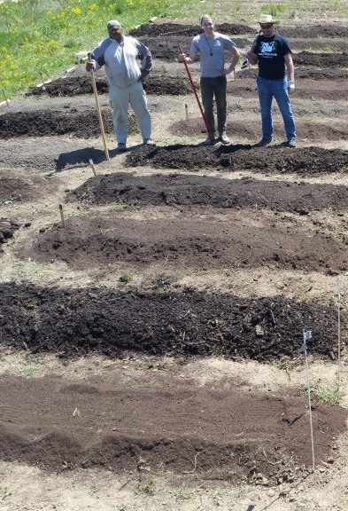
Research & Education Grant Program
Grants for researchers or educators to explore sustainable ag
Up to $250,000 per project
Grants go primarily to organizations
~15 projects funded per year
Coordinated by Beth Nelson
photo credit: Greg Lawless
Notes:
The Research and Education Grant Program is a competitive grant program for researchers and educators involved in projects that explore and promote environmentally sound, profitable, and socially responsible food and/or fiber systems.
These projects include a strong outreach component and significant farmer/rancher involvement from the inception of the idea through the implementation of the project.
R&E preproposals are reviewed by the Administrative Council with regard to their relevance to sustainable agriculture in our region: its potential impact, suitability of approach to address an issue or problem, and farmer involvement.
The Administrative Council determines which preproposals should be invited to submit full proposals. A separate review committee evaluates the invited full proposals based on the technical merit of the proposals. Their recommendations are presented to the Administrative Council, who determine final funding.
One of the unique aspects of NCR-SARE is our personal contact with grantees involved in the program once they are funded. Beth Nelson is the Research and Education Program Coordinator and specific questions about this program can be directed to her.

Slide 19
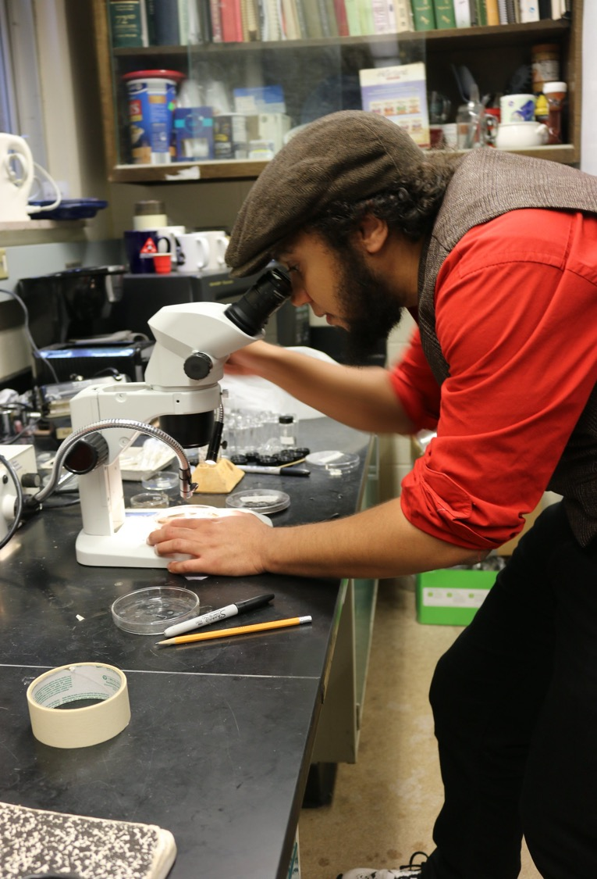

Graduate Student
Grant Program
Grants for graduate students to explore sustainable ag as part of their degree program
Up to $20,000 per project
Grad student must write proposal and lead work on project
~20 projects funded per year
Coordinated by Beth Nelson
photo credit: Marie Flanagan
Notes:
The NCR-SARE Graduate Student Grant Program supports projects by graduate students that address sustainable agriculture issues and are part of the student’s degree program.
NCR-SARE instituted the Graduate Student Grant Program in 2002 for officially registered Masters and Ph.D. graduate students enrolled at accredited colleges or universities. Projects must be of benefit to agriculture in the North Central region.
NCR-SARE’s Graduate Student Grant Program is a competitive grant program and a candidate may only receive one NCR-SARE Graduate Student award during her or his graduate student career. This program strongly encourages students to involve farmers and ranchers in their Graduate Student research projects.
Funding decisions are made by NCR-SARE's Administrative Council after receiving feedback from a review committee made up of farmers, ranchers, university representatives, nonprofit representatives, Extension, NRCS, other government employees, and agribusiness representatives, as well as past Graduate student grant recipients.

Slide 20
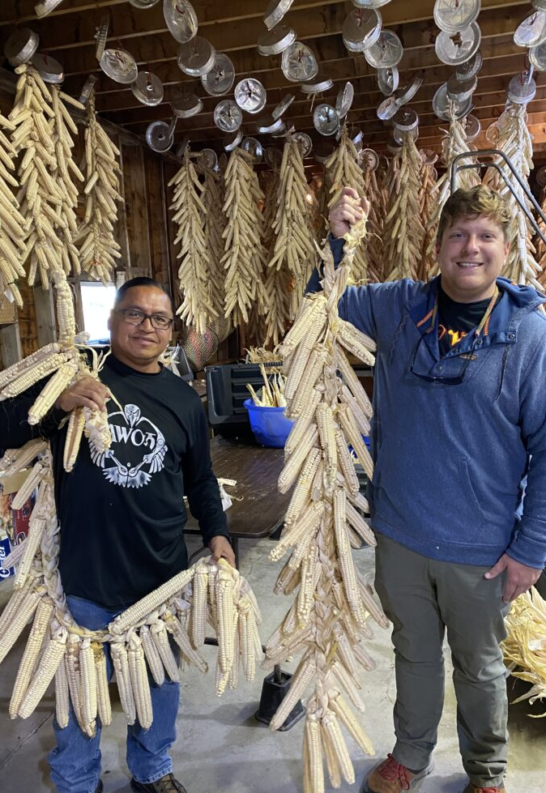
Farmer Rancher
Grant Program
Grants directly fund farmers and ranchers to explore new production methods or marketing approaches for their farm
Up to $15,000 for individual farm, and $30,000 for teams of 2 or more farmers/ranchers
Encouraged to link with university or non-profit partners
~40 projects funded per year
Coordinated by Joan Benjamin
photo credit: Lea Zeise
Notes:
In 1992, NCR-SARE began a competitive Farmer Rancher Grant Program exclusively to fund farmers and ranchers striving for agricultural sustainability.
Farmers and ranchers have a critical insight when it comes to improving their systems. Whether they need to limit off-farm inputs, reduce erosion, create more time for family or community activities, learn marketing skills, or find other ways to enhance their livelihoods, farmers and ranchers can turn to NCR-SARE for grant opportunities and information.
Before writing a grant proposal, applicants should determine a clear project goal and explore previous research. It often helps to contact NCR-SARE, local agriculture groups, the Natural Resources Conservation Service, and/or Extension educators to share ideas and invite their participation.
Funding decisions are made by NCR-SARE's Administrative Council, after receiving feedback from a review committee made up of primarily farmers and ranchers within the north central region.
The Farmer Rancher Grant Program has a full-time liaison, Joan Benjamin. Feel free to contact Joan Benjamin with any questions about this program.

Slide 21
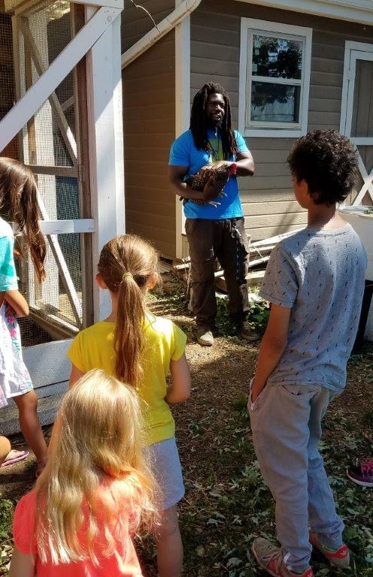
Youth Educator Grants
  Grants for young people and educators to understand sustainable practices and see sustainable agriculture as a viable career option
  Up to $6,000 per project
  Appropriate for vo-ag teachers or other youth educators
  ~12 projects funded per year
  Coordinated by Joan Benjamin
photo credit: Brett Lubbert
Notes:
NCR-SARE recognizes that youth programs are a way to introduce new and exciting farming and ranching options to youth, parents, and community members.
Youth Educator Grants are competitive grants for educators to provide programming on sustainable agriculture for youth, and supports opportunities for youth educators to learn more about sustainable agriculture through research and demonstration projects.
A Youth Educator is someone who teaches youth about sustainable agriculture; this may include professional educators (4-H, FFA, Extension, grade school, high school, community college, college, university), farmers/ranchers, home-school teachers, other youth, or educators from non-profit organizations.
The Youth Educator Grant Program’s liaison is also Joan Benjamin.

Slide 22
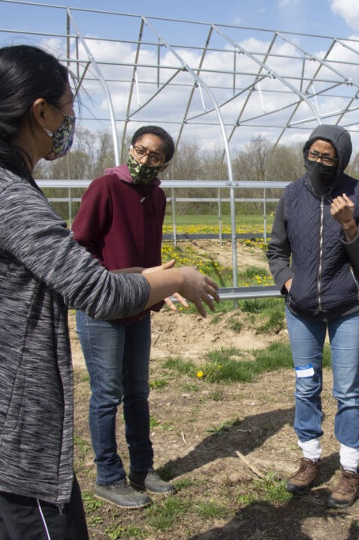

NCR-SARE Partnership Grant Program
Grants for on-farm research, demonstration, and/or educational projects
Up to $50,000 per project
An Agricultural Professional is the grant applicant and principal investigator
Typically three or more farmers or ranchers involved in the project
~18 projects funded per year
Co-coordinated by Beth Nelson and Rob Myers
photo credit: Jessica DAmbrosio
Notes:
The Partnership Grant program is intended to foster cooperation between agriculture professionals and small groups of farmers and ranchers to catalyze on-farm research, demonstration, and education activities related to sustainable agriculture.
Examples of appropriate projects include: developing a curriculum about food storage for farmers and processors, on-farm testing of cropping system strategies or grazing systems, cooperative efforts to develop new marketing approaches, or investigations into new approaches to processing and/or adding value to sustainably produced farm products.
Any agriculture/natural resource professional in the North Central region may apply. These professionals include:
University educators including extension agents and specialists
NRCS field staff, agricultural consultants (individuals who actively consult with farmers and ranchers such as certified crop advisors, soils consultants, ranching consultants, etc.), nonprofit or agency staff assisting farmer and ranchers at the local level who directly working with them.
Beth Nelson and Rob Myers work together to coordinate the Partnership Grant Program. Feel free to contact either Beth or Rob with questions.

Slide 23
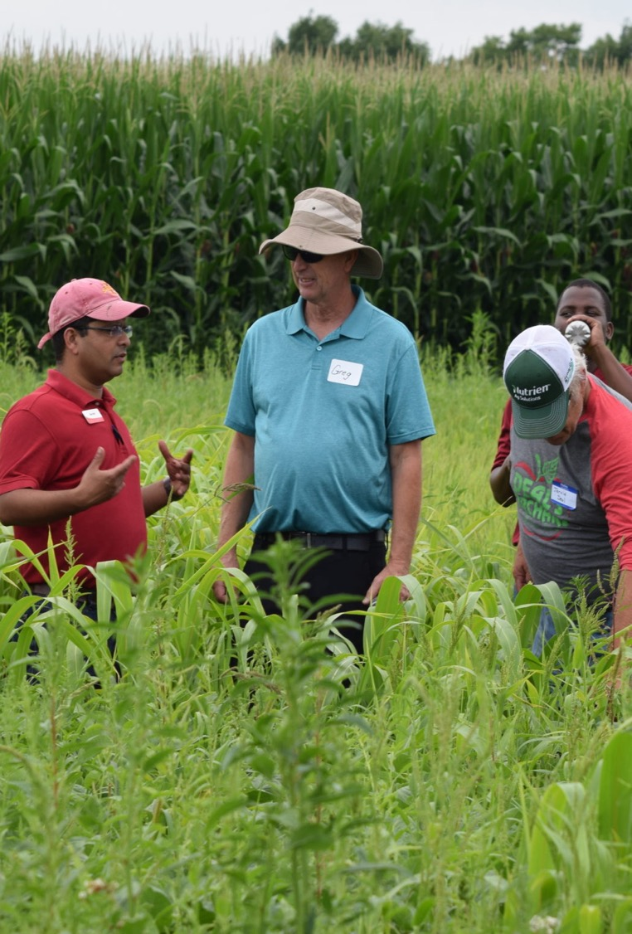
Professional Development Program
State activities organized by State Coordinators
  Face of SARE—communicating about SARE programs
  Workshops, webinars, mini-grants, travel scholarships funded by $65,000 in annual support from the SARE program
Competitive grants
  Grants for ag professionals to train other ag professionals using farmers/ranchers as educators
  Up to $120,000 per project
  ~10 projects funded per year
Coordinated by Rob Myers
photo credit: Ajay Nair
Notes:
Every state has a SARE State Coordinator who promotes, networks, and coordinates annual sustainable agriculture training and educational program opportunities for all appropriate field office personnel and agriculture professionals in their state.
State Coordinators also raise awareness of SARE Outreach educational materials and services, and promote the availability of SARE funding opportunities, program activities and opportunities to farmers, ranchers, and the general public.
The State Coordinators take a bottom-up approach through their SARE state advisory committees in identifying Professional Development Program initiatives each year.
However, in 2009, a consensus developed among the north central region state coordinators to start having a region-wide training focus for professional development, with the tentative goal of a new training topic area every two years.
State coordinators work closely with each other on conference planning, material development, and follow-up as part of these trainings.
The NCR-SARE Professional Development competitive grant program supports professional development programs and competitive grants for state and multi-state projects that emphasize the cross-agency training of agricultural professionals.
Contact Rob Myers, the Professional Development Program Coordinator, if you have questions about the Professional Development Grant Program.

Slide 24
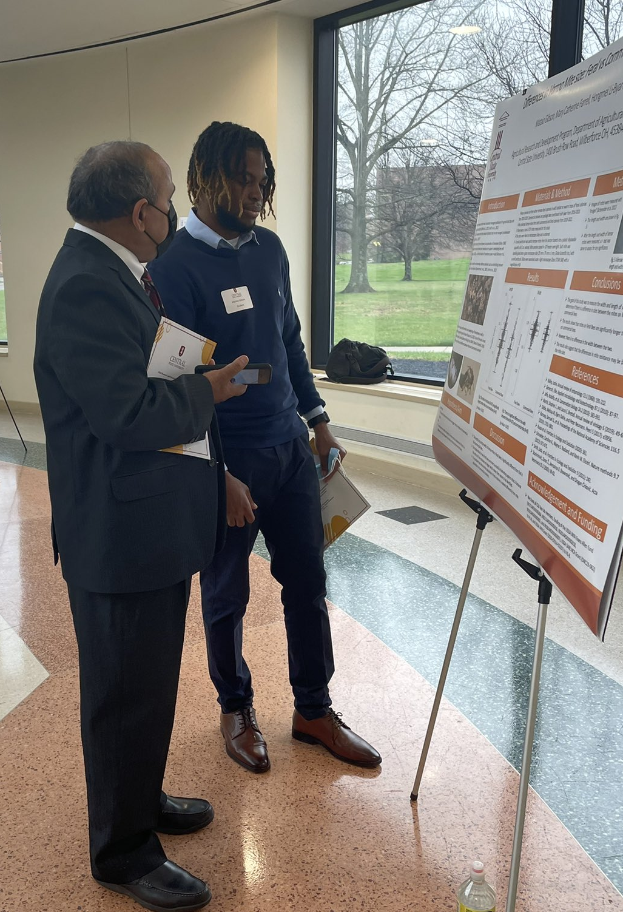
_{New and Future Directions}
  “Ratchet up” NCR-SARE’s programing by collaborating with other organizations
  Broaden outreach to the whole of American agriculture – sponsoring conferences, packaging information
  Strengthen training for ag professionals at the state level, including Extension and NRCS
Photo by Mary Kempfert
photo credit: Hongmei Li-Byarlay
Notes:
NCR-SARE continues to build on existing partnerships, while creating new ones and new opportunities for participation throughout the North Central region.
NCR-SARE supports conferences and educational events relevant to sustainable agriculture through our Conference Support Funding and our Farmers Forums.
In June 2020, NCR-SARE worked with Maggie Norton, farmer outreach coordinator for Practical Farmers of Iowa, to offer two webinars for SARE grantees about hosting virtual field days. The first webinar was hosted with agricultural professionals and educators in mind, while the second webinar was geared toward farmers and ranchers.

Slide 25
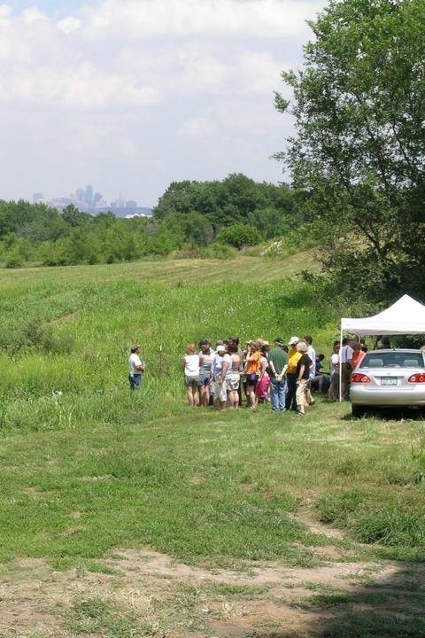

For more information about NCR-SARE:
by phone: 612-626-3113
by email: ncrsare@umn.edu
www.northcentralsare.org
Follow us on:
@NCRSARE
photo credit: Joan Benjamin
Notes:
For more information about NCR-SARE contact our Saint Paul office:
By phone: 612.626.3113
By email: ncrsare@umn.edu
Or visit our website: www.northcentralsare.org
You can also follow us on Facebook, twitter, and YouTube

